Slide 1
Combustion Synthesis of Nanoscale Magnesium Borides with Improved Hydrogen Uptake and Release
Principal Investigator: Evgeny Shafirovich
Students: Andre Molina (PhD Research Associate)
Miguel Camarena (Graduate Research Assistant)
Organization: The University of Texas at El Paso
DOE project award #: DE-EE0010429
DOE Hydrogen Program
2024 Annual Merit Review and Peer Evaluation Meeting
May 6 – 9, 2024
AMR Project ID # ST250
This presentation does not contain any proprietary, confidential, or otherwise restricted information

Slide 2
Acknowledgment
This material is based upon work supported by the U.S. Department of Energy’s Office of Energy Efficiency and Renewable Energy (EERE) under the award number DE-EE0010429.
Disclaimer
This report was prepared as an account of work sponsored by an agency of the United States Government. Neither the United States Government nor any agency thereof, nor any of their employees, makes any warranty, express or implied, or assumes any legal liability or responsibility for the accuracy, completeness, or usefulness of any information, apparatus, product, or process disclosed, or represents that its use would not infringe privately owned rights. Reference herein to any specific commercial product, process, or service by trade name, trademark, manufacturer, or otherwise does not necessarily constitute or imply its endorsement, recommendation, or favoring by the United States Government or any agency thereof. The views and opinions of authors expressed herein do not necessarily state or reflect those of the United States Government or any agency thereof.

Slide 3
Project Goal
Overarching Goal:
Develop high-capacity reversible metal hydrides that can be dehydrogenated and recharged at relatively low temperatures and pressures.
Specific Objectives:
Fabricate nanoscale magnesium boride powders with various B/Mg atomic ratios using self-propagating high-temperature synthesis (combustion synthesis).
Investigate the effects of B/Mg atomic ratio and particle size on the hydrogenation and dehydrogenation properties of the obtained magnesium borides.

Slide 4
Overview
Timeline
Barriers
Project Start Date: 03/01/2023
Project End Date: 02/28/2025
Particle size and B/Mg ratio affect the hydrogenation of magnesium borides.
Hydrogenation of nanoscale MgB_{0.75} (instead of MgB₂) still needs 700 bar and 280°C.
(Y.-S. Liu et al., J. Phys Chem C 124 (2020) 21761)
The project aims to further decrease the required P and T via synthesis of nanoscale MgB_{x} (x < 2 and x > 2) phases.
Budget
Total Project Budget: $300,000
DOE Share: $300,000
Cost Share: 0
DOE Funds Spent*: $137,771
* As of 03/01/2024
Partners
Collaborator: Dr. Vitalie Stavila, Sandia National Laboratories – Livermore

Slide 5
Potential Impact
The project complements the research on reversible metal hydrides for hydrogen storage, conducted at the Hydrogen Materials – Advanced Research Consortium (HyMARC).
The HyMARC has been investigating magnesium borohydride, Mg(BH₄)₂, as the material is reversible and has a theoretical hydrogen content of 14.9 wt%.
Complete dehydrogenation of Mg(BH₄)₂ generates MgB₂, which requires very high pressures and temperatures to regenerate the borohydride.
Particle size and B/Mg ratio affect the hydrogenation of magnesium borides.
Hydrogenation of nanoscale MgB_{0.75} still needs 700 bar and 280°C.
The project aims to decrease the required P and T via synthesis of nanoscale MgB_{x} (x < 2 and x > 2) phases.

Slide 6
Approach
Synthesis of magnesium borides with various B/Mg atomic ratios by two methods:
Combustion synthesis
A tube furnace
Characterization of the obtained materials:
X-ray diffraction analysis
Scanning electron microscopy
Laser diffraction particle size analysis
Specific surface area analysis
Hydrogenation and dehydrogenation:
Hydrogenation is first studied in a high-pressure differential scanning calorimeter (up to 150 bar).
Next, hydrogenation and dehydrogenation are studied using pressure-composition-temperature measurements and high-pressure hydrogenation at SNL (up to 1000 bar and 450 °C).

Slide 7
Approach: Safety Planning and Culture
This project was NOT required to submit a safety plan to the Hydrogen Safety Panel (HSP).
Prioritizing safety and analyzing hazards:
The Operating Procedures document (65 pages plus Safety Data Sheets) has been prepared and submitted to the Environmental Heath and Safety (EH&S) of UTEP.
This document is updated each time when a new procedure is added.

Slide 8
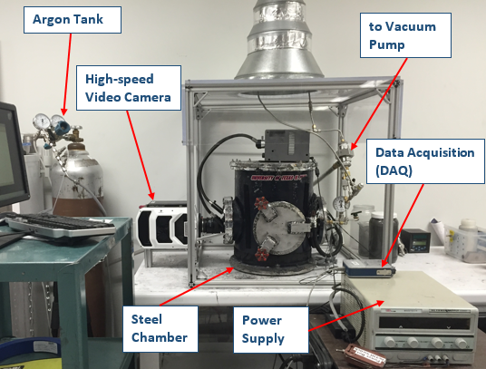
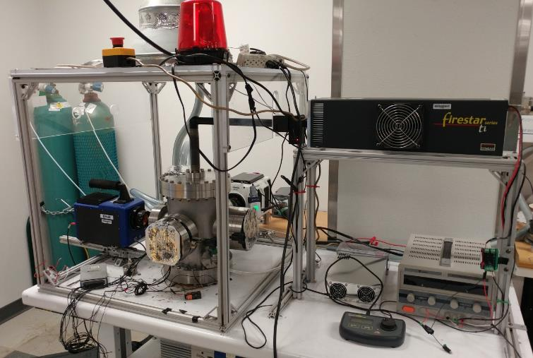
Accomplishments and Progress
Magnesium borides were synthesized by two methods.
Combustion synthesis (chemical oven)
A ceramic (BN) crucible with an Mg/B pellet surrounded by an annular layer of a Ti/B (1:2 mole ratio) mixture
The crucible is placed into a chamber filled with Ar.
The Ti/B mixture is ignited by a hot wire or by a laser.
The released heat ignites the Mg/B mixture.
Heating rate: 300-500°C/s
Ti/B mixture
Mg/B pellet
Crucible
Chemical oven schematic
Hot-wire ignition setup
Laser ignition setup

Slide 9
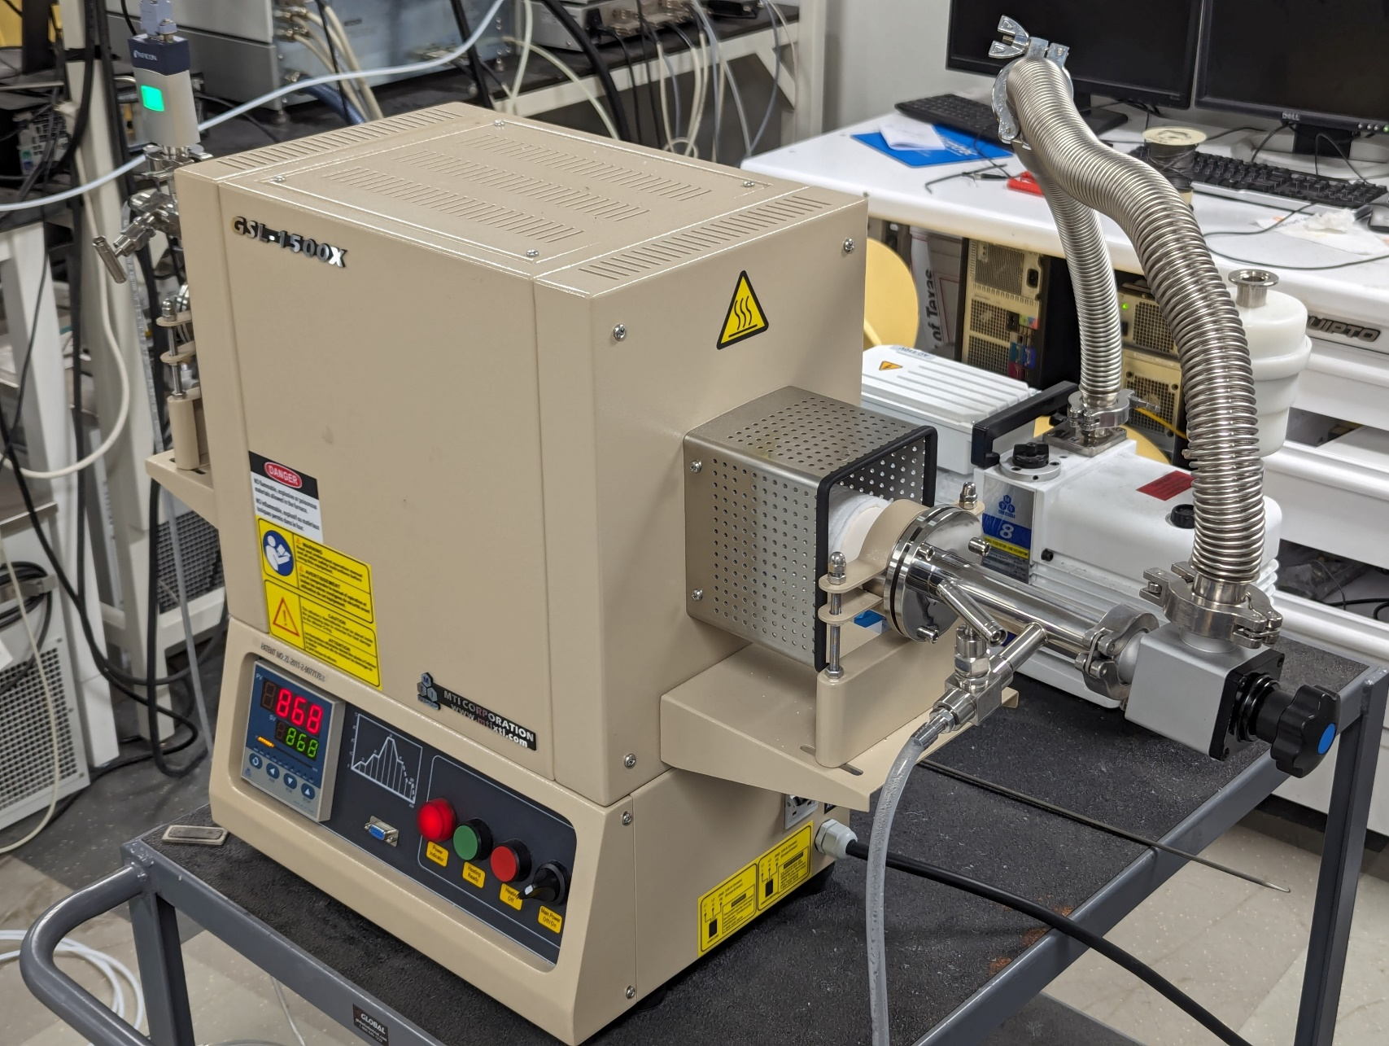
Accomplishments and Progress
Tube furnace
Mg/B pellet in Ar flow
Heated at 5°C/min up to 650–1050°C.
Held for 1 – 6 h.
Cooled at a rate of 5°C/min.
Tube furnace

Slide 10
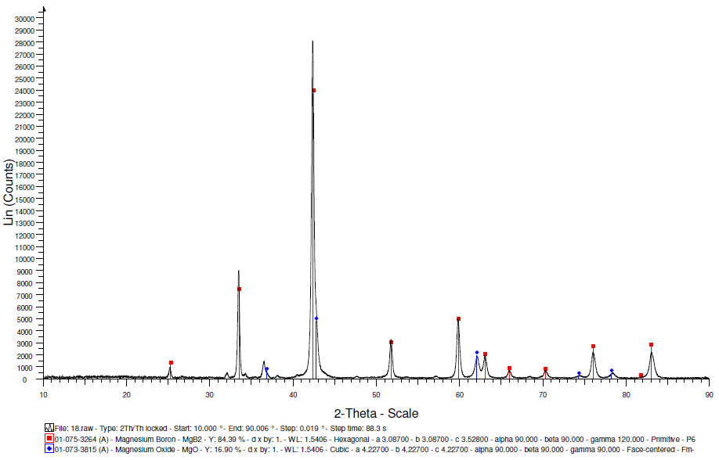
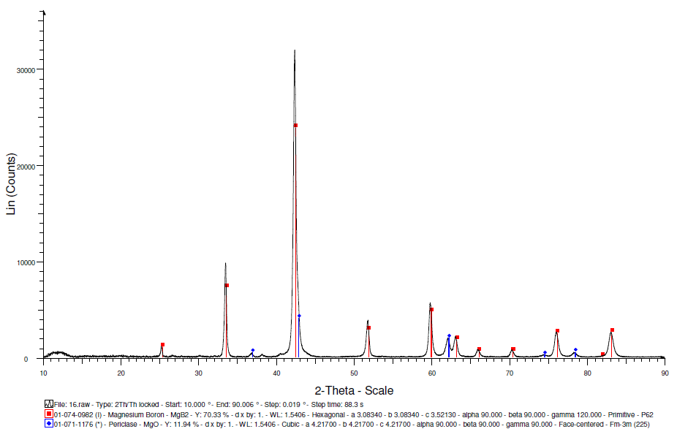
Accomplishments and Progress
Synthesis of MgB₂
Chemical oven
Synthesis of MgB₂
Heating at 750 °C for 2 h
MgB₂
MgB₂
MgB₂
MgB₂
MgO
MgO
MgO
MgO
XRD patterns of MgB₂ products synthesized by the chemical oven technique (left) and in a tube furnace (right)

Slide 11
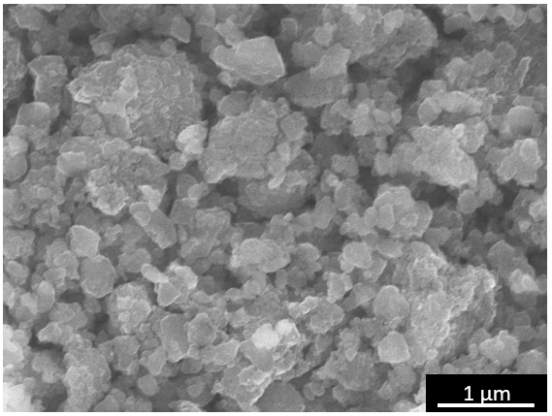
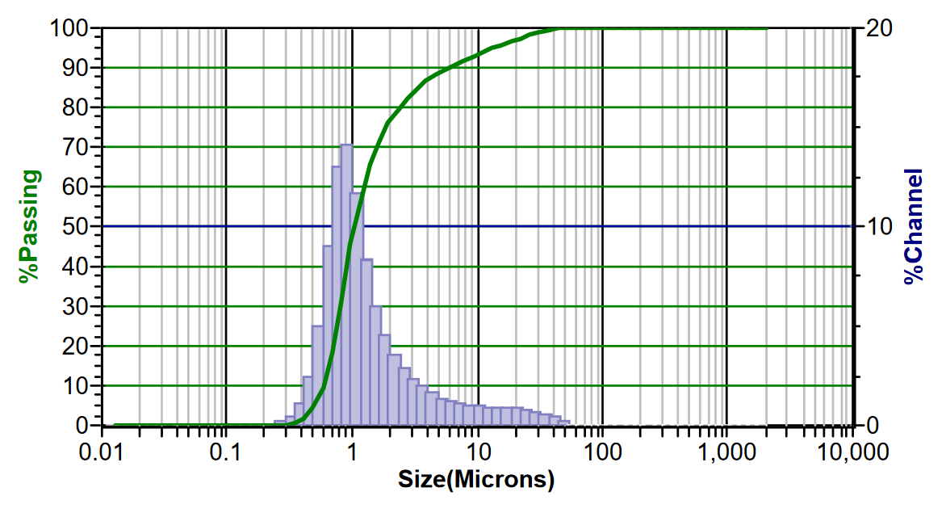
Accomplishments and Progress
The products were ground via surfactant-assisted ball milling in a SPEX shaker.
Scanning electron microscopy shows nanoscale particles.
Particle size analysis indicates agglomeration.
SEM image of milled MgB₂
Particle size distribution of milled MgB₂

Slide 12
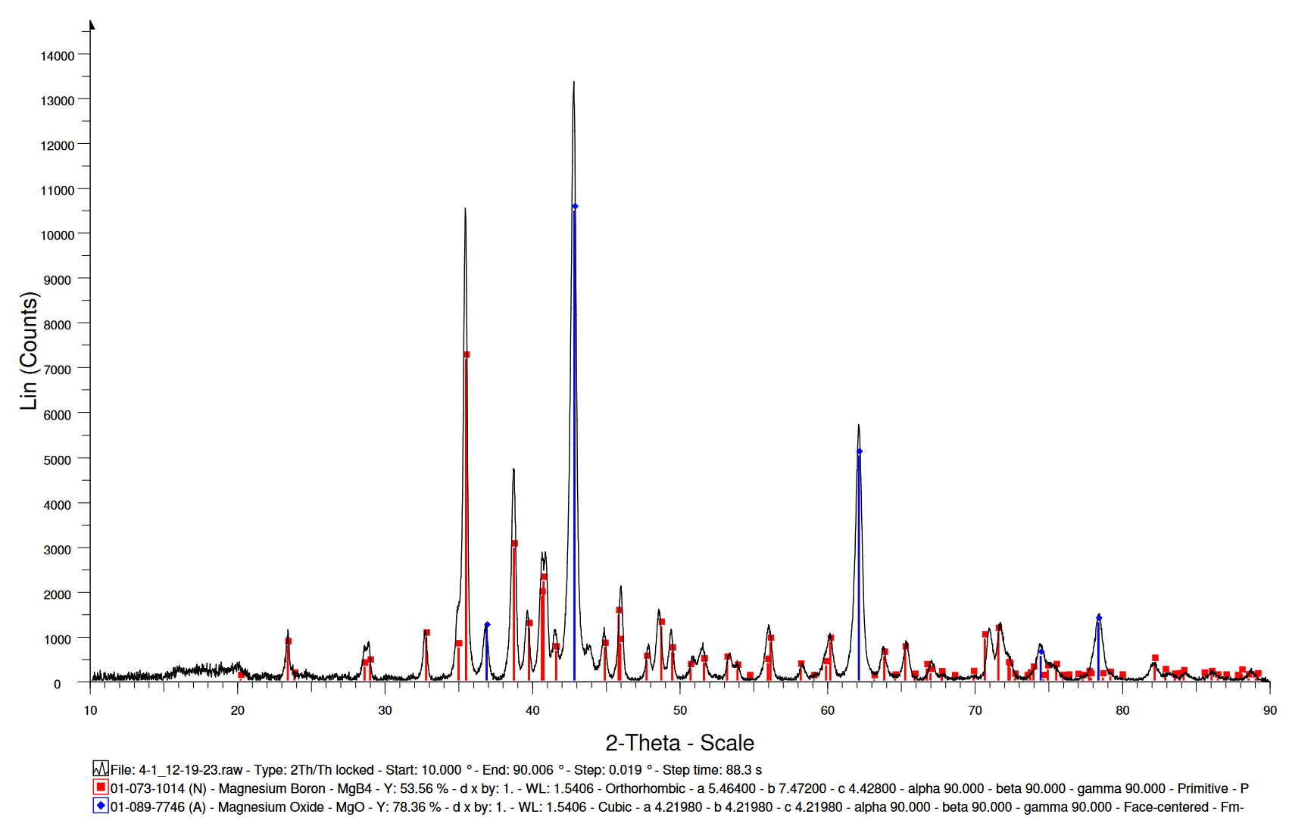
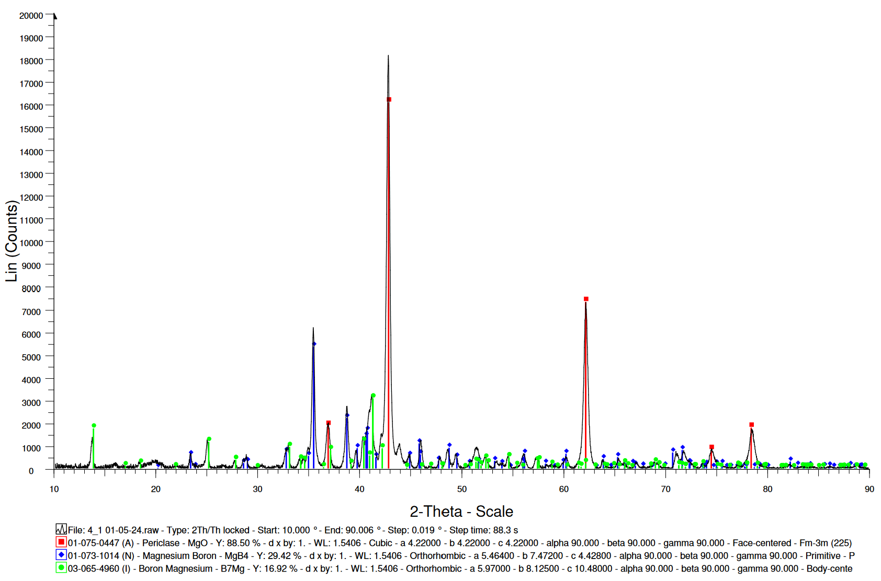
Accomplishments and Progress
Synthesis of MgB₄
Heating at 1050°C for 1 h
Synthesis of MgB₄-MgB₇
Heating at 1050°C for 3 h
MgO
MgO
MgB₄
MgB₇
MgO
MgB₄
MgO
MgB₇
XRD patterns of MgB₄ (left) and MgB₄-MgB₇ (right) products synthesized in a tube furnace
80 at% B in the initial Mg/B mixture

Slide 13
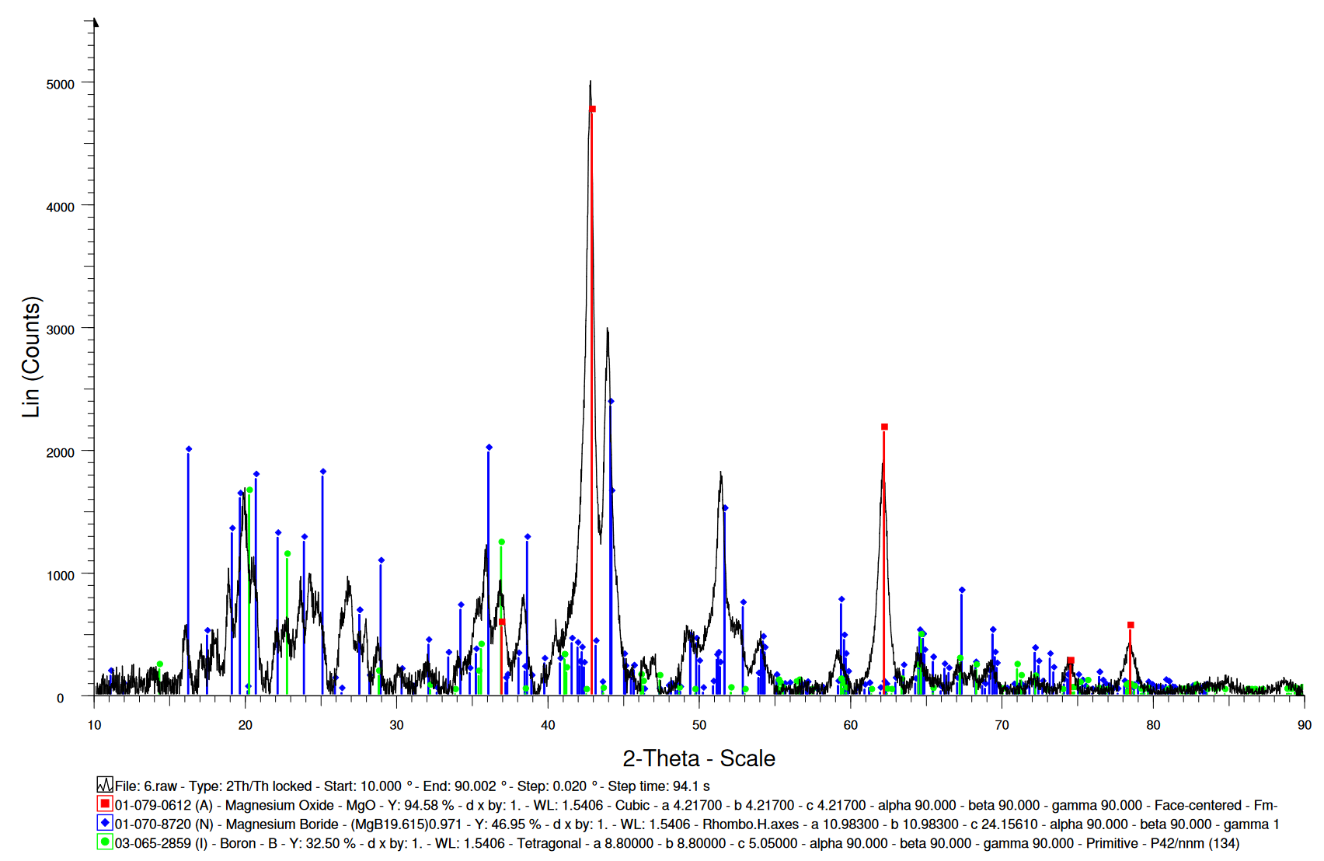
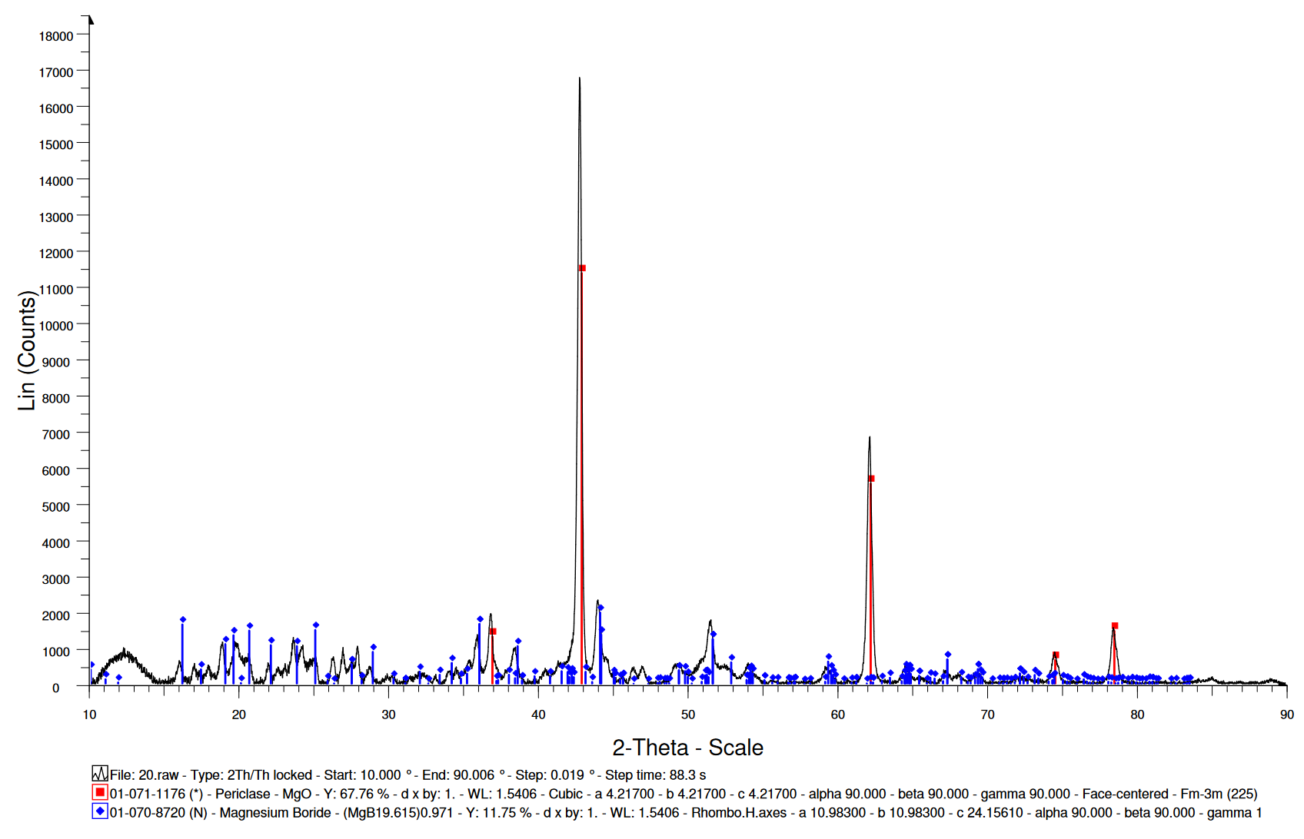
Accomplishments and Progress
Synthesis of MgB₂₀
Chemical oven
Synthesis of MgB₂₀
Heating at 1050°C for 2 h
MgO
MgO
MgB₂₀
MgO
MgO
MgB₂₀
XRD patterns of MgB₂₀ products synthesized by the chemical oven technique (left) and in a tube furnace (right) 91 at% B in the initial Mg/B mixture

Slide 14
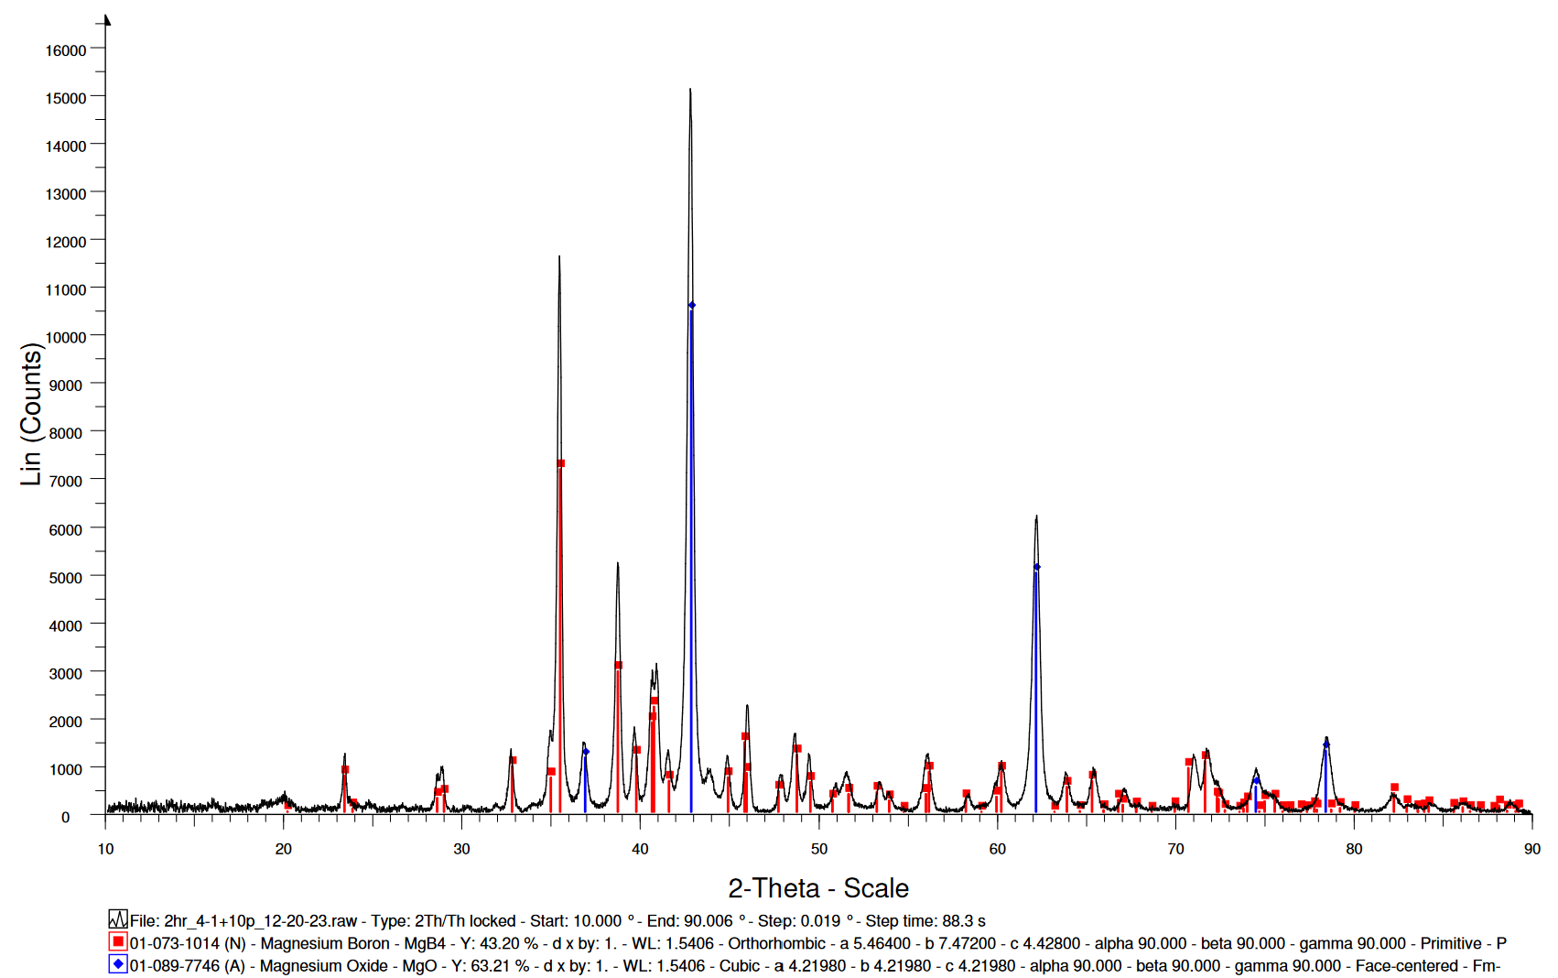
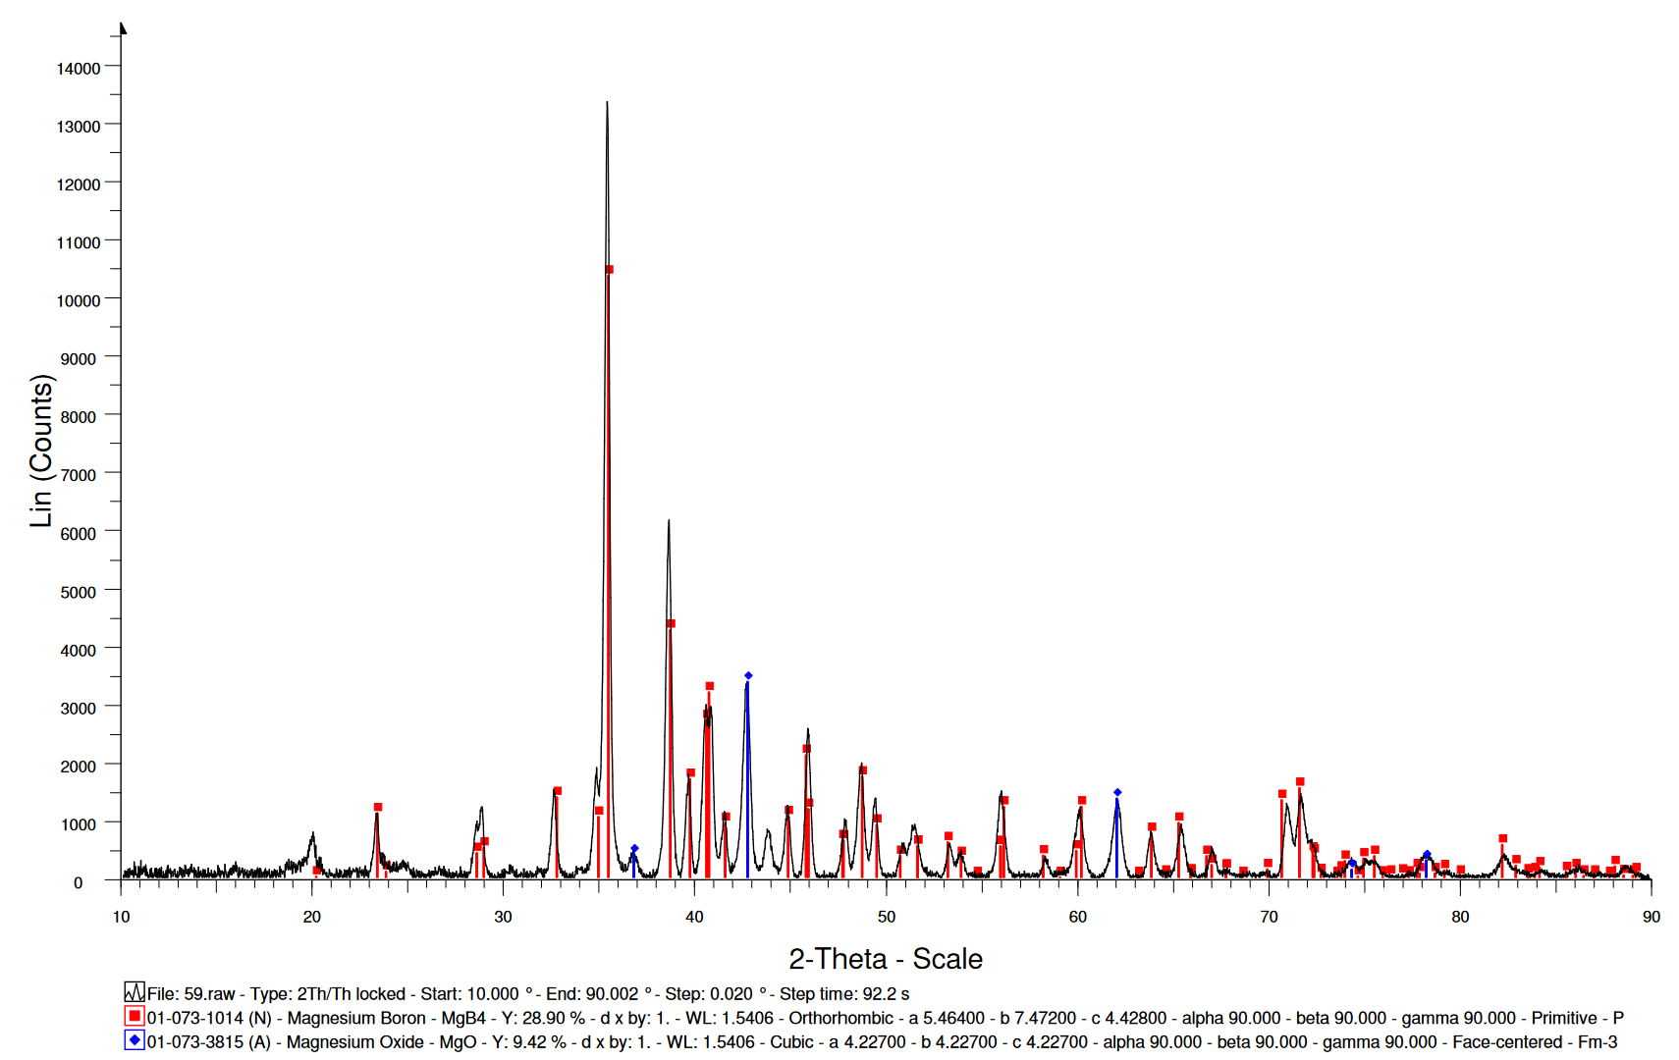
Accomplishments and Progress
Removal of MgO from the products by acid leaching
The powder is submersed in nitric acid (1M) for 5 min.
Nitric acid is removed by vacuum filtration followed by washing in ethanol, deionized water, and acetone.
MgO
MgB₄
MgB₄
MgO
XRD patterns of MgB₄–containing products before (left) and after (right) acid leaching

Slide 15
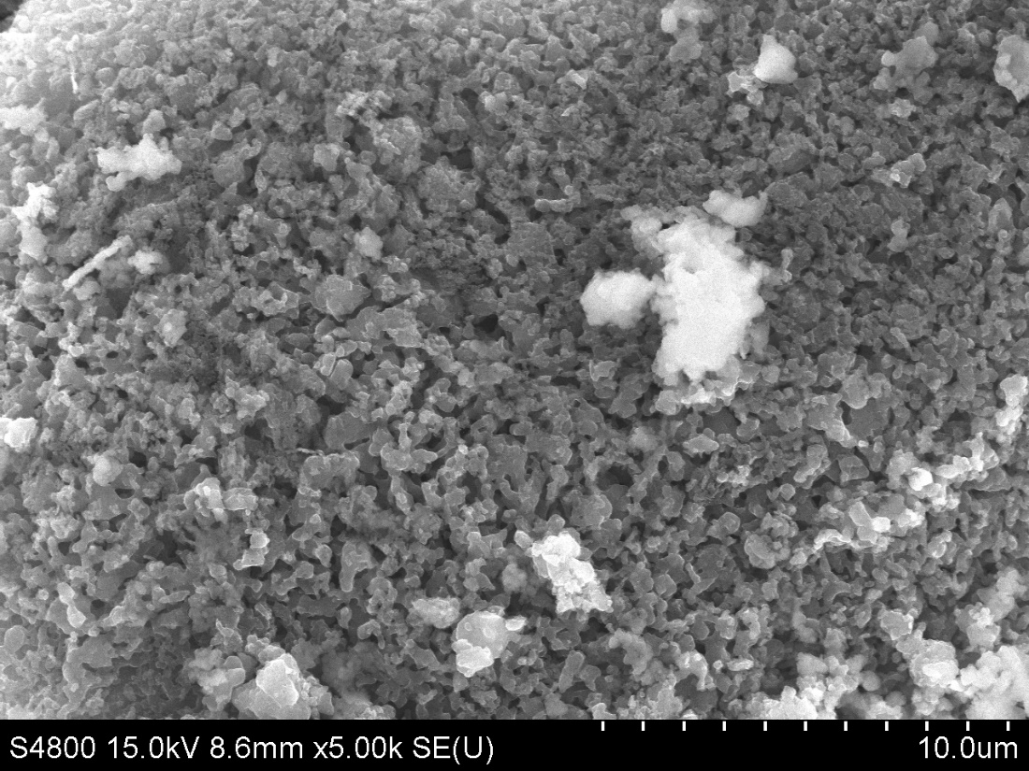
Accomplishments and Progress
Scanning electron microscopy shows that the leached MgB₄ powder consists of irregularly shaped particles, approximately 1 µm in size.
SEM image of the leached MgB₄ sample

Slide 16
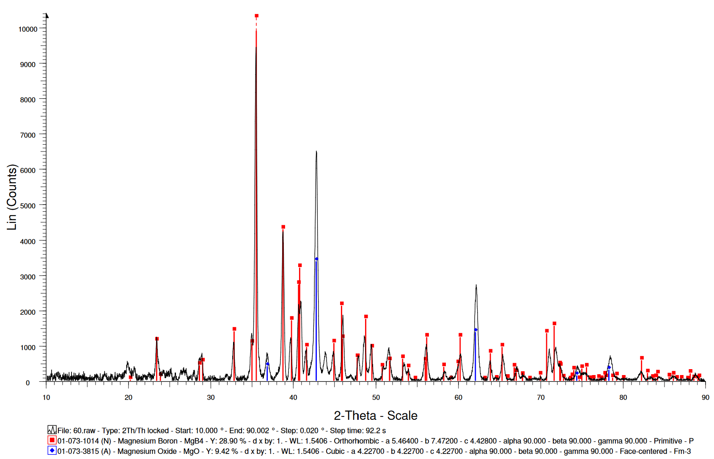
Accomplishments and Progress
Preventing MgO formation
MgB_{x} products synthesized with high-purity boron (min. 98% B) have less MgO than those synthesized with low-purity boron (93-96% B).
MgO
MgB₄
MgB₄
MgO
XRD patterns of MgB₄ synthesized using low-purity (left) and high-purity (right) boron

Slide 17
Accomplishments and Progress: Responses to Previous Year Reviewers’ Comments
This project has not been previously reviewed at an AMR.

Slide 18
Collaboration and Coordination
Collaborator:
Dr. Vitalie Stavila, Sandia National Laboratories – Livermore
The collaborator studies hydrogenation and dehydrogenation of the materials synthesized at UTEP using SNL facilities for pressure-composition-temperature (PCT) measurements and high-pressure hydrogenation.
Miguel Camarena visited SNL in the summer of 2023 and performed:
Characterization of Mg-B materials (XRD and FTIR spectroscopy)
Chemical purification of Mg-B materials
Andre Molina will be trained at SNL in summer 2024.

Slide 19
DEIA/Community Benefits Plans and Activities
The project helps maintain and upgrade educational, training, and research capabilities of UTEP, a prominent minority-serving university.
Over 24,000 students
Most students are drawn from the Southwest border region with a population of over 80% Hispanics.
A student body is 84% Hispanic.
Approximately 50% of UTEP students are first in their families to attend college.
Two Mexican American students are directly involved in the project.
Research at UTEP
Training at Sandia National Laboratories – Livermore

Slide 20
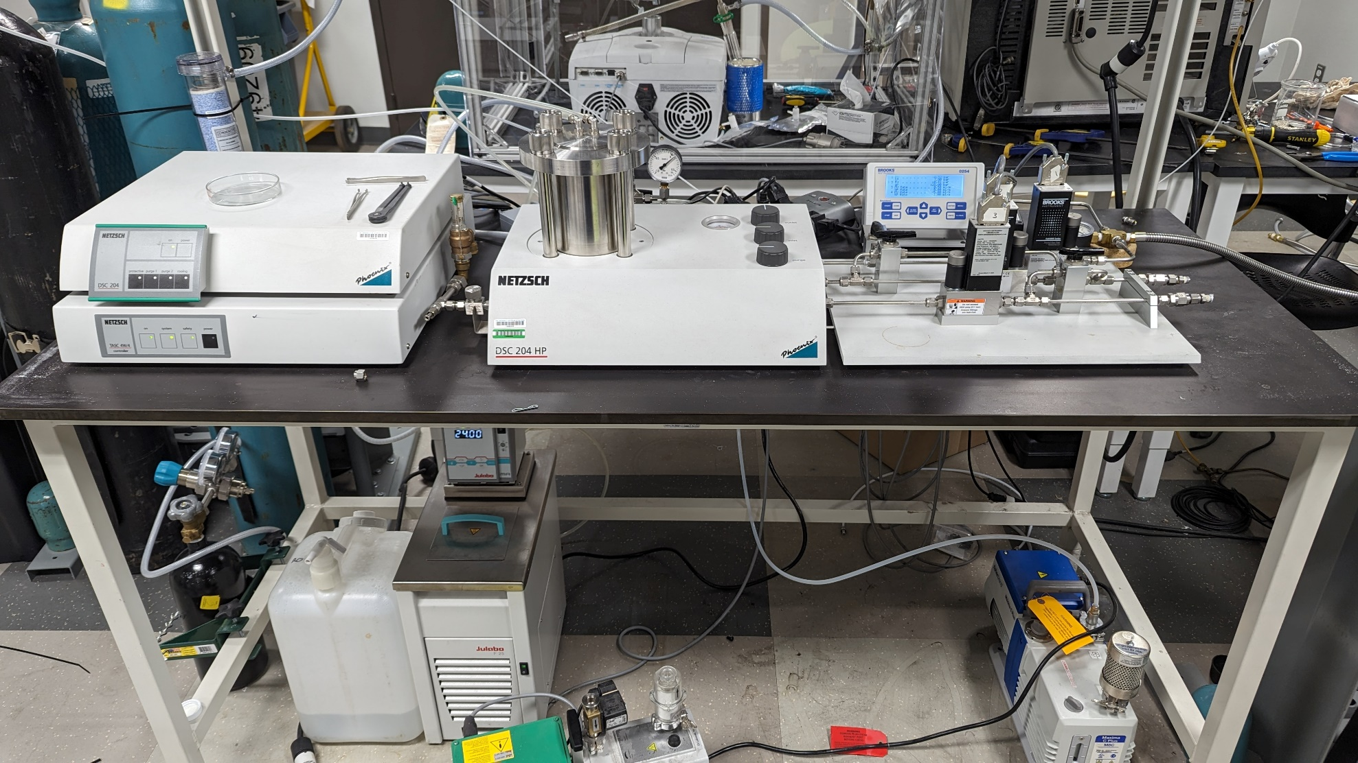
Remaining Challenges and Barriers
Fabrication and characterization of nanoscale/nanostructured MgB_{x} (x≠2) materials remain a challenge.
Acid leaching does not remove MgO impurity completely.
Hydrogenation in a high-pressure differential scanning calorimeter has not shown any mass gain.
MgB₂ at 500 psi (34 bar) and 450°C for 5 h
MgB₄ at 1200 psi (83 bar) and 300°C for 5 h
High-pressure differential scanning calorimeter

Slide 21
Proposed Future Work
Determine effective post-processing methods to create nanoscale or nanostructured MgB_{x} materials.
Synthesize MgB_{x} materials with x < 2.
Improve the MgO removal methods.
Continue to pass the obtained borides to the Collaborator for investigating their hydrogenation and dehydrogenation at Sandia National Laboratories.

Slide 22
Summary
Four MgB_{x} phases have been synthesized: MgB₂, MgB₄, MgB₇, and MgB₂₀.
The phase composition depends on the heating time.
Combustion synthesis cannot improve the product quality despite the very high heating rate; it also leads to loss of Mg.
An effective acid leaching procedure has been identified for removal of MgO.
Use of high-purity boron decreases the MgO impurity.
First samples have been shipped to the Collaborator for investigating their hydrogenation at Sandia National Laboratories.

