Slide 1
15th International Workshop on Combustion and Propulsion
July 6 – 9, 2025, Pescara, Italy
Fabrication, Oxidation, and Combustion of Nanoscale Magnesium Diboride and Tetraboride
Andre Molina, Miguel Camarena, Juan Noveron, and Evgeny Shafirovich
The University of Texas at El Paso

Slide 2
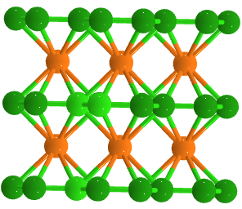
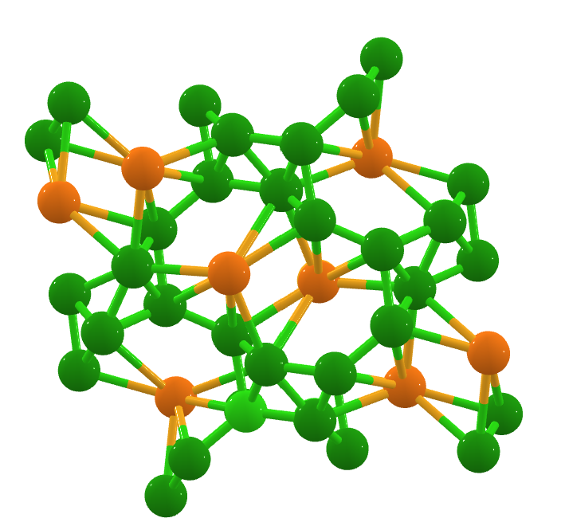
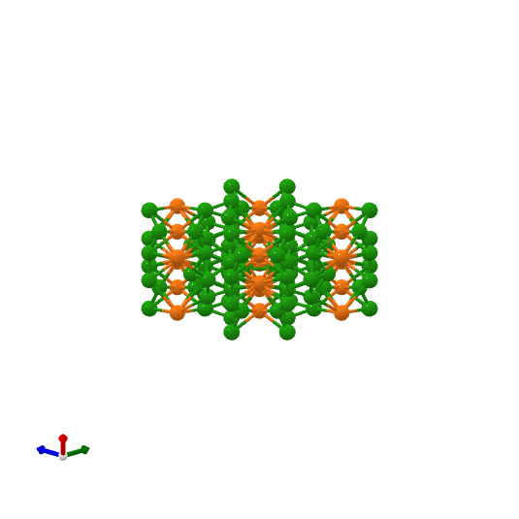
Motivation
One of the main approaches to improving ignition and combustion of boron particles is the addition of magnesium.
Boron/magnesium mixtures and composites
Magnesium borides
There exist borides with different B/Mg ratios (e.g., 2:1, 4:1, 7:1).
MgB₂ has been studied extensively as a superconductor and as a fuel for propulsion systems.
Since the addition of Mg decreases the energy density, the feasibility to use magnesium borides with higher B/Mg ratios should be examined.
MgB₂
MgB₄
MgB₇

Slide 3
Objectives
To fabricate nanoscale MgB₂ and MgB₄ by combustion synthesis and by sintering in a tube furnace followed by high-energy ball milling and by acid leaching for oxide removal.
To study their oxidation by thermogravimetric analysis (TGA).
To study their combustion using laser ignition, high-speed video recording, and emission spectroscopy.

Slide 4
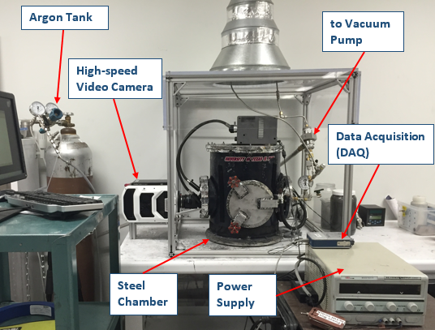
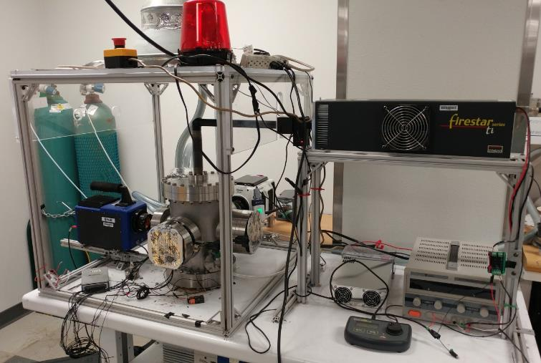
Combustion Synthesis
Chemical oven
A ceramic (BN) crucible with an B/Mg pellet surrounded by an annular layer of a Ti/B (1:2 mole ratio) mixture
The crucible is placed into a chamber filled with Ar.
The Ti/B mixture is ignited by a hot wire or by a laser.
The released heat ignites the B/Mg mixture.
Heating rate: 300-500 K/s
Ti/B mixture
B/Mg pellet
Crucible
Chemical oven schematic
Hot-wire ignition setup
Laser ignition setup

Slide 5
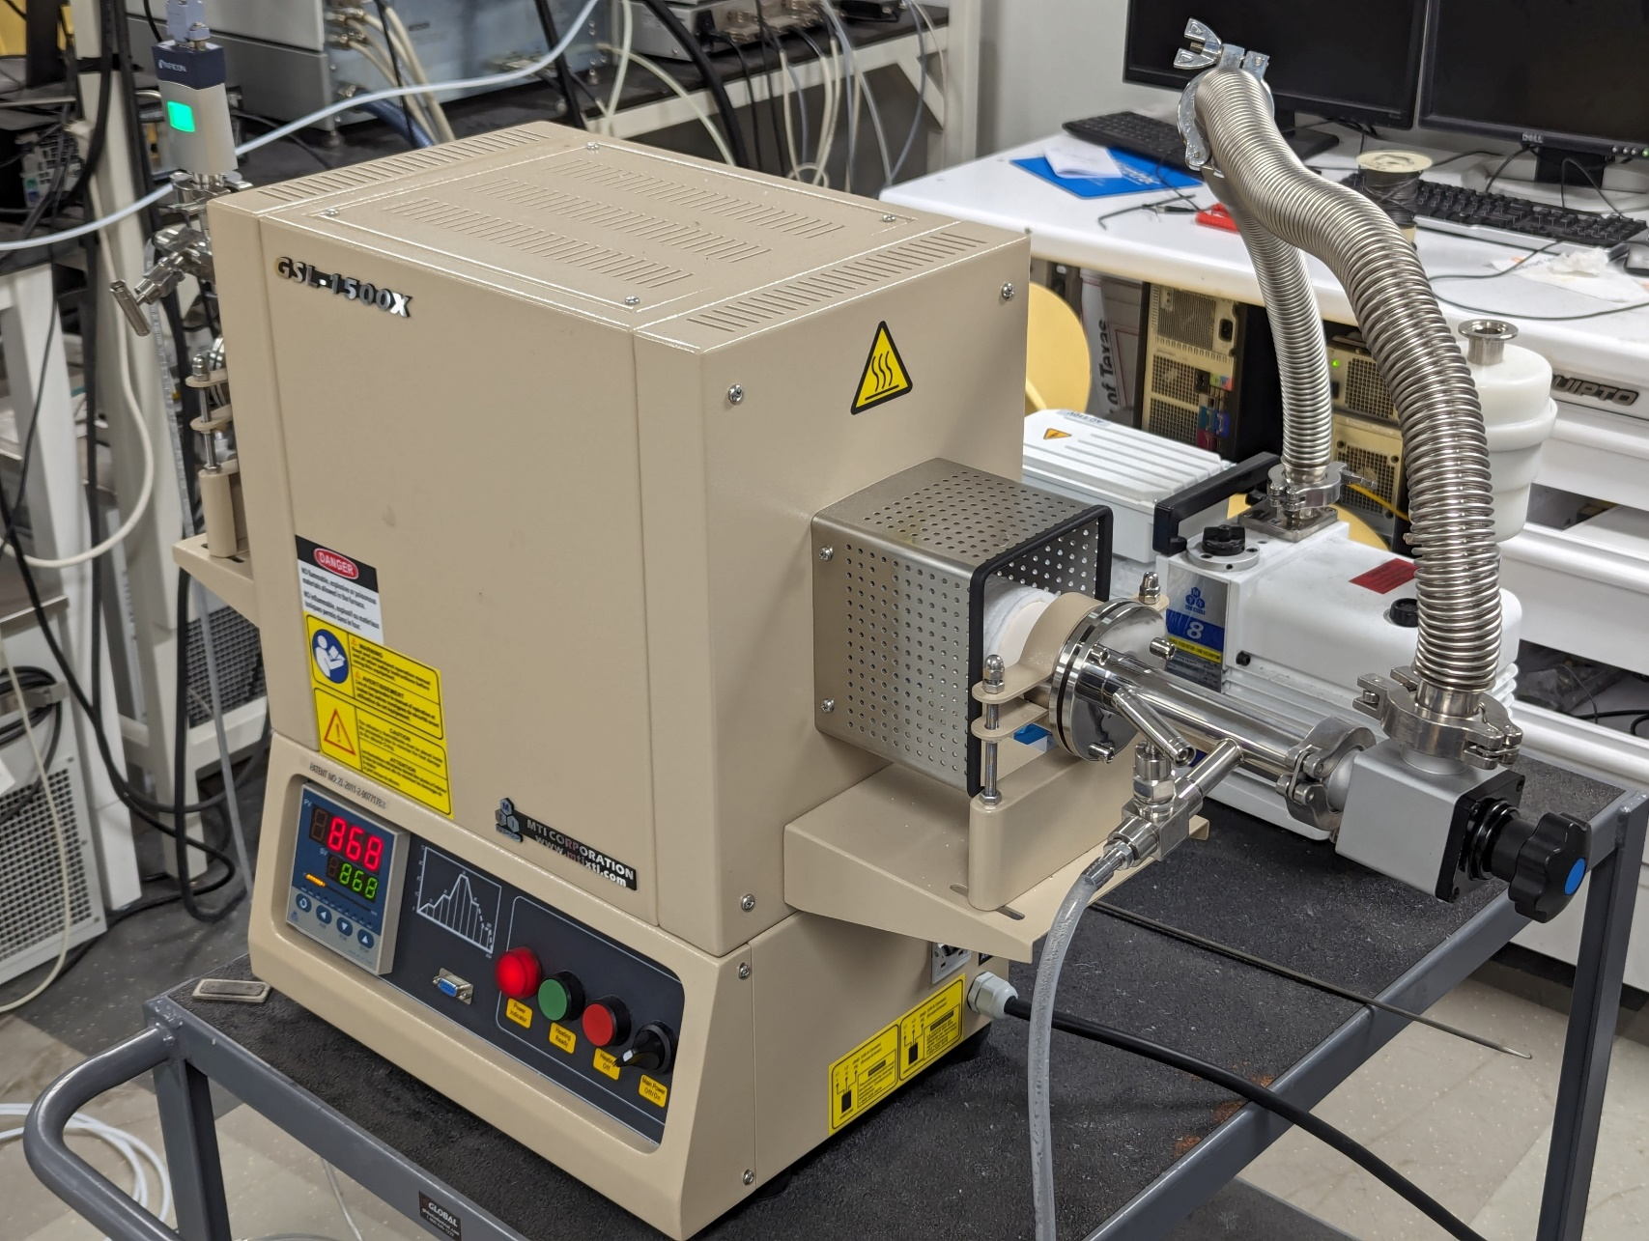
Sintering in a Tube Furnace
B/Mg pellet in Ar flow
Heated at 5 °C/min up to 650–1050°C.
Held for 1 – 6 h.
Cooled at a rate of 5 °C/min.
MTI GSL-1500x

Slide 6
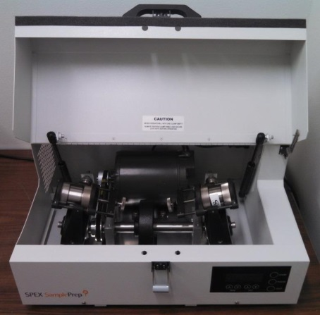
High-energy Ball Milling
Ball-powder mass ratio: 15 – 30
ZrO₂ vials
ZrO₂ balls (diameter: 0.5 – 12.7 mm)
Environment: Ar
Milling time: 1 – 4 h
SPEX 8000D Shaker Mill

Slide 7
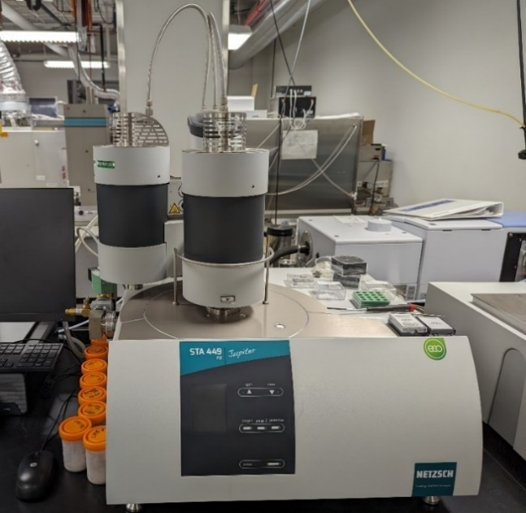
Thermogravimetric Analysis (TGA)
2 – 5 mg powder
Alumina crucibles (85 μL)
Temperature range: 25 – 1550 °C
Heating rate: 2 – 10 °C /min
Argon or oxygen flow (50 mL/min)
Netzsch STA 449 F3 Jupiter

Slide 8
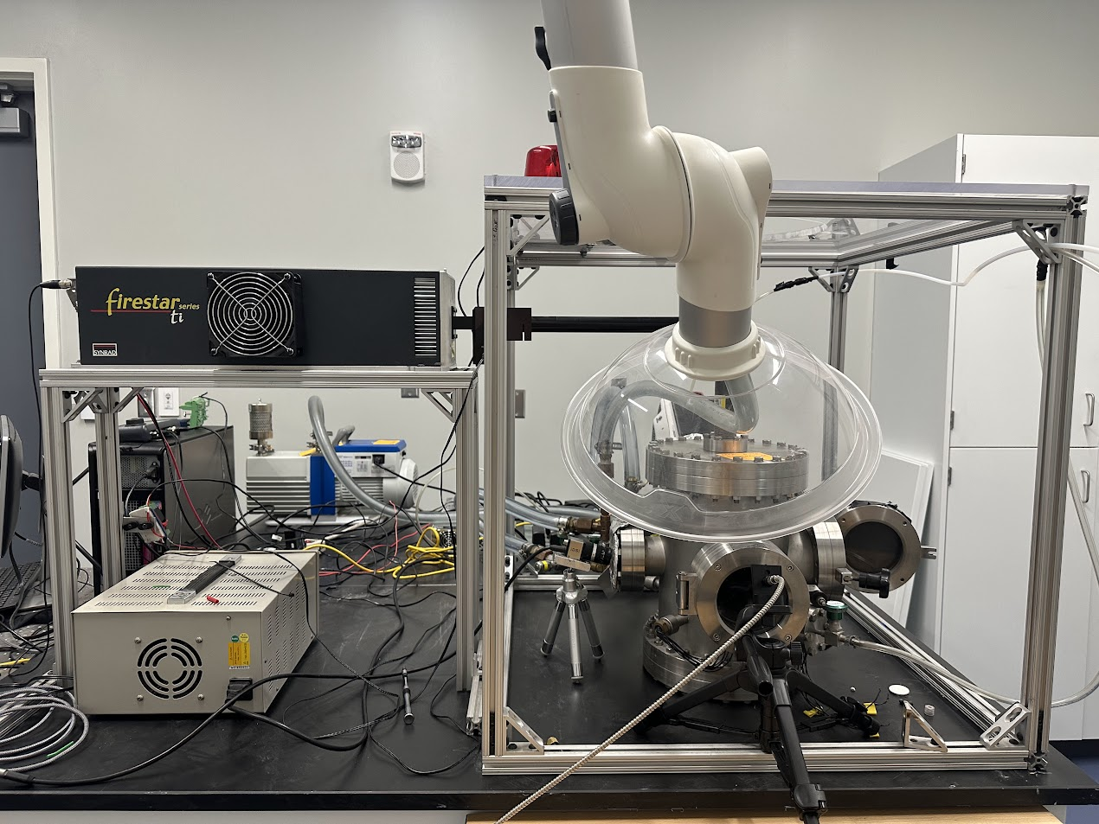
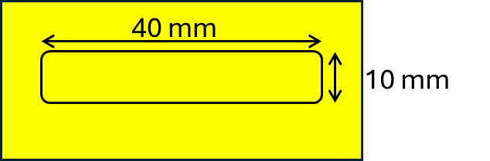
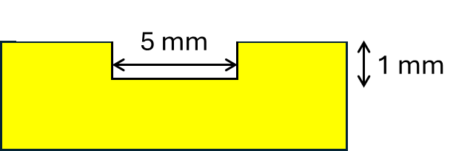
Combustion Experiments
Laser ignition
Synrad Firestar ti-60
Beam diameter: 2.0 ± 0.3 mm
32 W, 100 ms
Environment: O₂
High-speed video camera
Phantom v1210
Nikon AF NIKKOR 60 mm f/2.8D
3000 fps
Spectrometer
AvaSpec-ULS2048CL-EVO-RS-UA
Wavelength range: 200 – 1100 nm
Sampling time: 1.35 ms
Sample holders

Slide 9
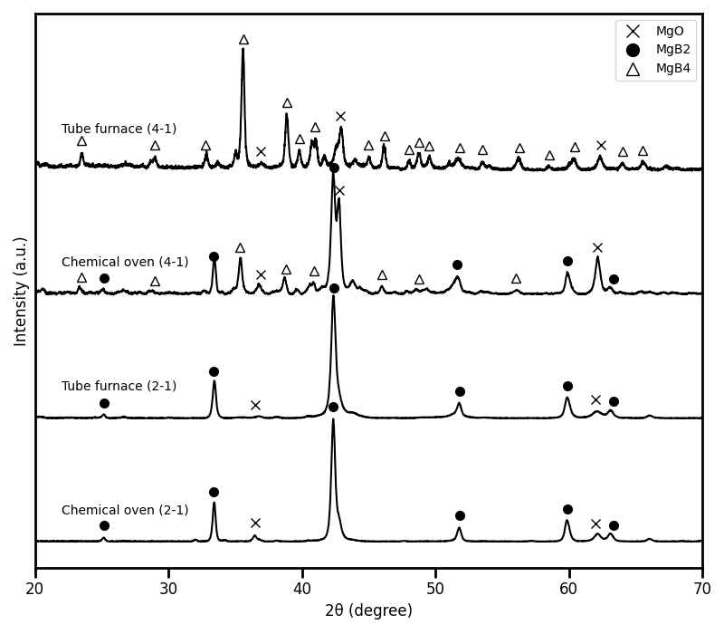
XRD of Synthesized MgB₂ and MgB₄
MgO
At 2:1, both methods yield similar products.
At 4:1, the tube furnace forms MgB₄ + MgO, while the chemical oven also produces MgB₂.
MgO

Slide 10
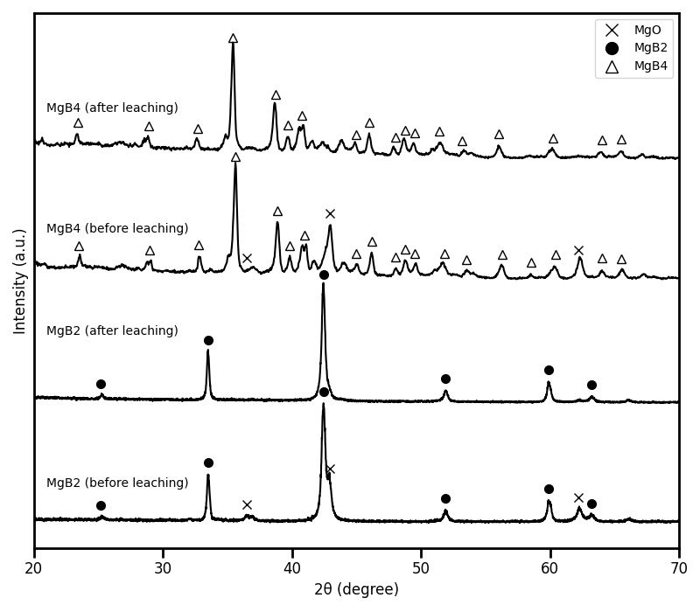
Purification of Synthesized Materials
MgO
Leaching with acetic acid and nitric acid removes oxides effectively.
MgO
MgO
MgO
Notes:
We submerge the borides in dilute acid for 5 minutes, remove the acid with vacuum filtration, wash away residual acid away with ethanol and water
We cannot use identical solutions of acid for each phase, the borides become increasingly more acid insoluble with increasing boron content. For MgB2 we needed to use an anhydrous solution of 10% acetic acid in toluene, and for MgB4 we have a lot more options, and we can use HCl and HNO3.

Slide 11
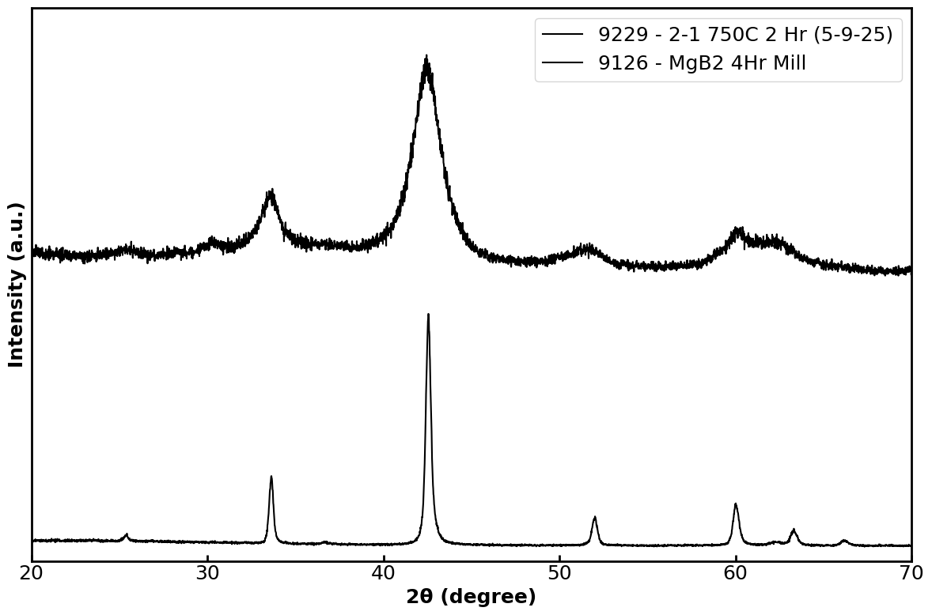
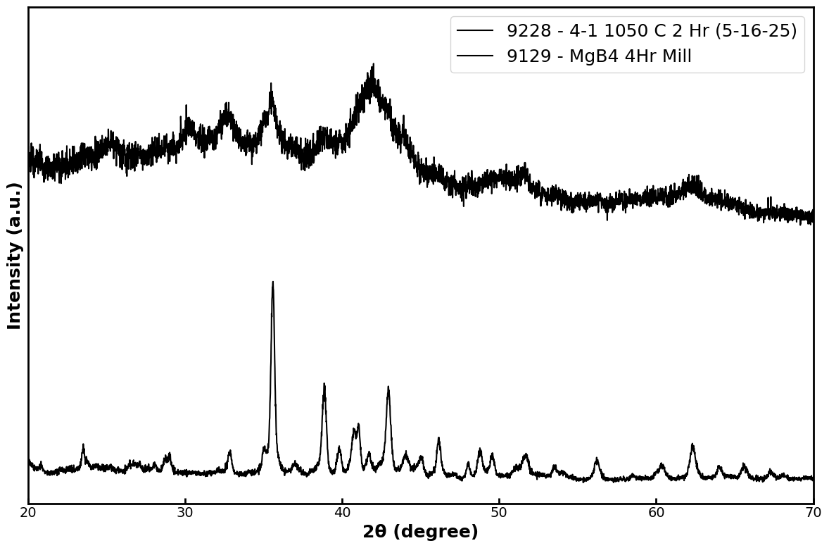
Decreasing Particle Size
MgB4 (milled)
MgB2 (milled)
MgB4
MgB2
Evolution of MgB₂ and MgB₄ XRD patterns during milling
After 4 hours of milling, peak broadening indicates a reduced crystallite size.

Slide 12
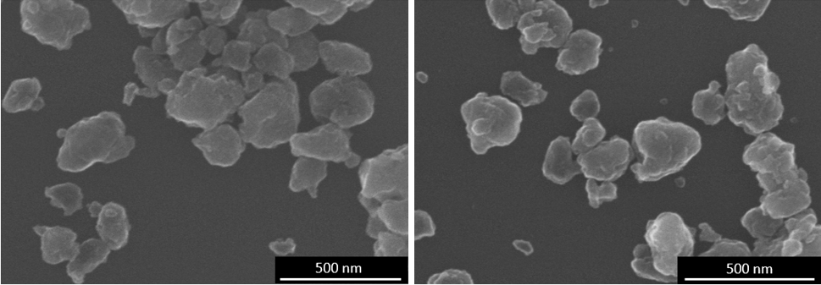
Decreasing Particle Size
MgB₂
MgB₄
High-energy ball milling has produced nanoscale MgB₂ and MgB₄.

Slide 13
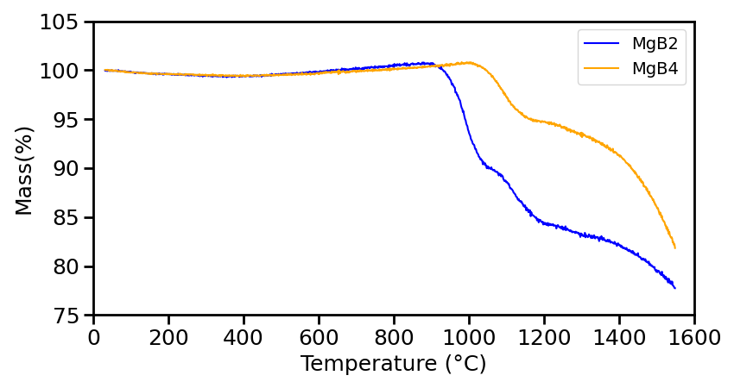
Decomposition of MgB₂ and MgB₄
MgB₂ decomposes into MgB₄ + Mg
MgB₄ decomposes into MgB₇ + Mg
MgB₇ decomposes into MgB₂₀ + Mg
Decomposition of MgB₂ is a multi-step process known from prior studies.
MgB₄ is also a multi-step process.

Slide 14
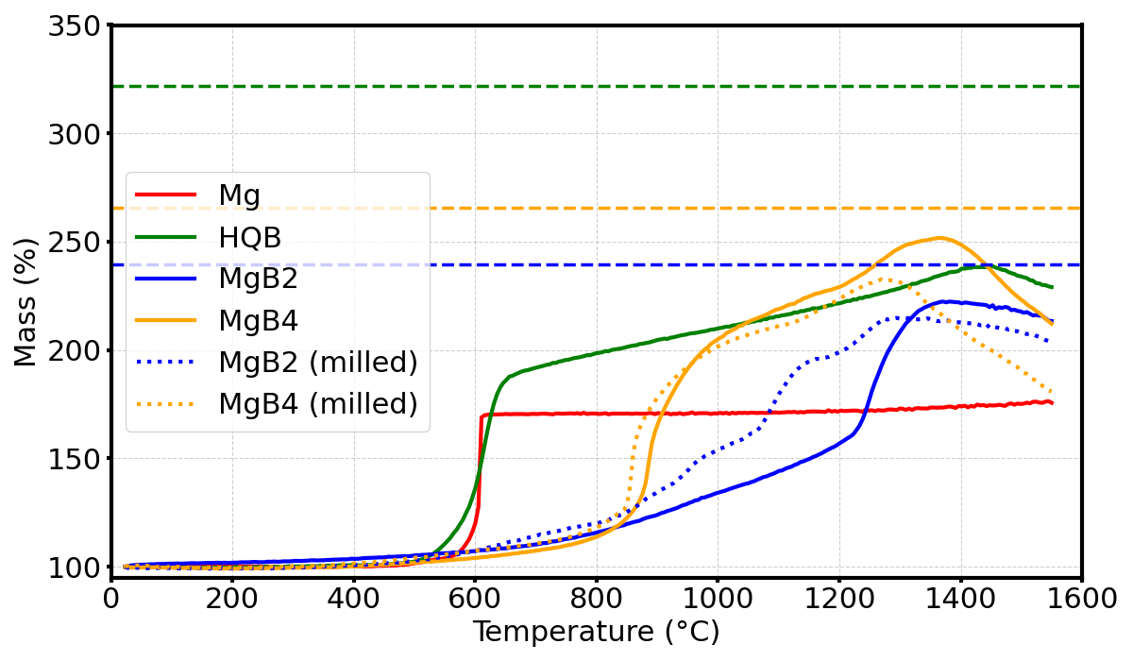
Oxidation of MgB₂ and MgB₄
B Max mass = 322%
MgB₄ Max mass = 266%
MgB₂ Max mass = 239%
Extent of conversion
Mg: 100%
B: 74%
MgB2: 93%
MgB4: 95%
MgB2 (milled): 90%
MgB4 (milled): 87%
Both borides exhibit high extents of conversion compared to boron.
MgB₄ is oxidized at a much lower temperature than MgB₂.

Slide 15
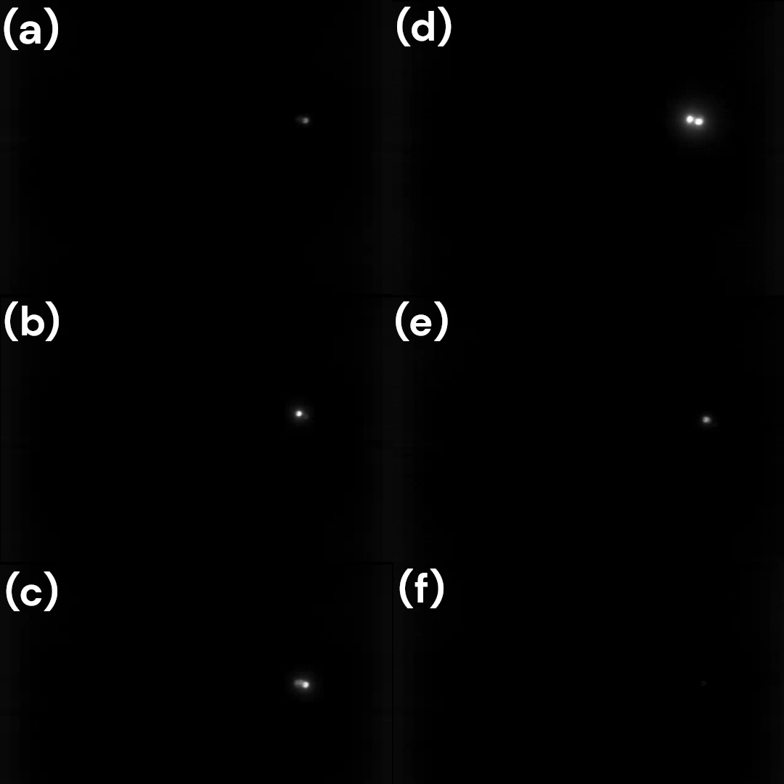
Combustion of MgB₂ and MgB₄
Mg
MgB₄
B
MgB₂
_{(milled)}
MgB₂
MgB₄
_{(milled)}
Video of combustion propagation (slowed 12x)

Slide 16
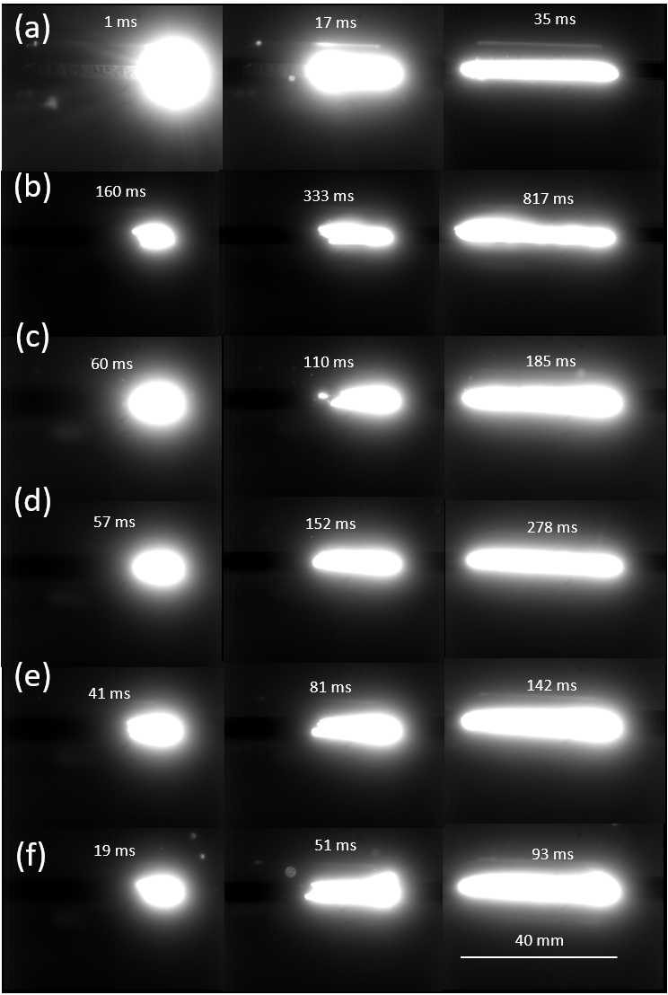
Combustion of MgB₂ and MgB₄
Mg
MgB₄
MgB₂
_{(milled)}
B
MgB₄
_{(milled)}
MgB₂
Images of combustion propagation.
Time zero is the onset of light emission.

Slide 17
Linear Burn Rates of MgB₂ and MgB₄
1010
762
489
91
Both MgB₂ and MgB₄ burn much faster than B.
MgB₄ burns slower than MgB₂.

Slide 18
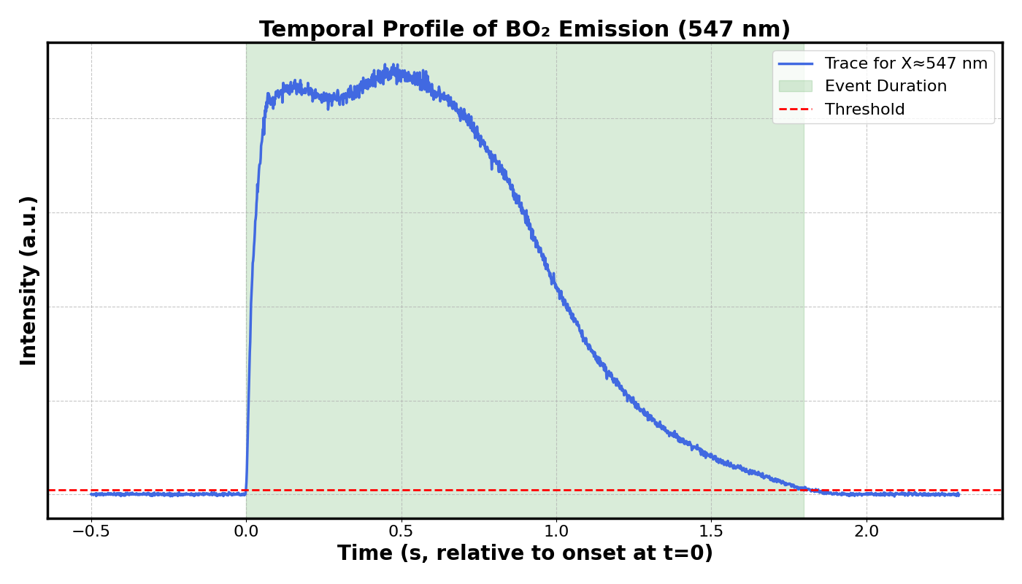
BO₂ Emission Profile
Sample | Duration (s)*
B | 1.71
MgB2 | 0.77
MgB4 | 1.81
MgB2 (milled) | 1.26
MgB4 (milled) | 1.60
Onset
End
*Average values
MgB₂ shows a shorter BO₂ emission time.

Slide 19
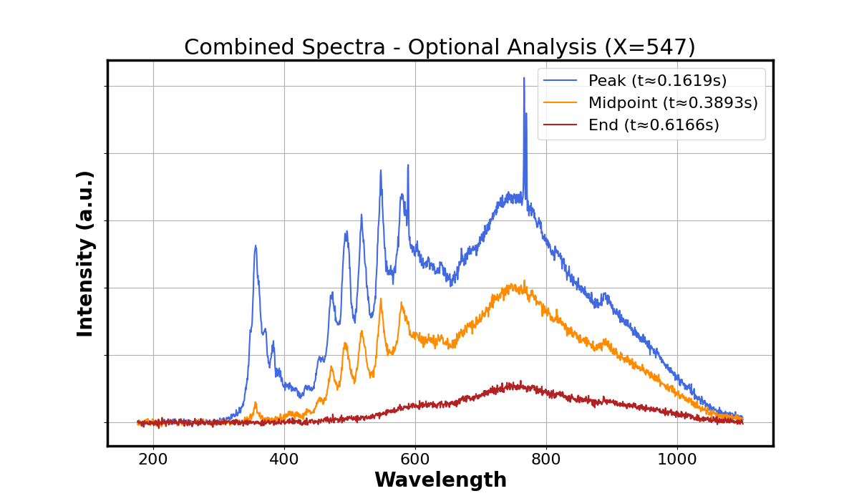
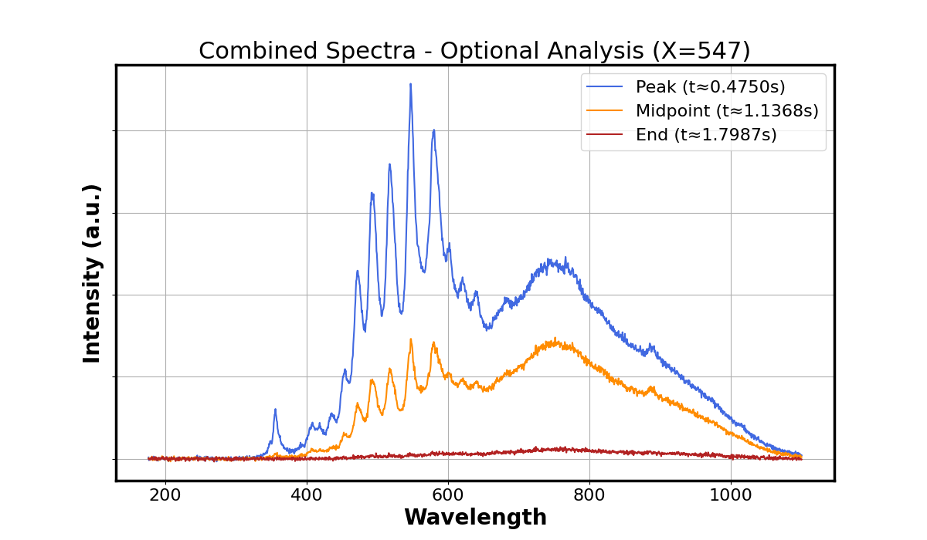
Emission Spectra of MgB₂ and MgB₄
MgB2 emission spectra over time
MgB4 emission spectra over time
MgO
BO₂
Na, K, Li
MgB₄ spectrum has much lower MgO peaks.

Slide 20
Conclusions
Fabrication
Synthesis in a tube furnace produced MgB₄ without MgB₂ additive.
Nanoscale MgB₂ and MgB₄ have been obtained by using high-energy ball milling.
Leaching with acetic acid and nitric acid is an effective means to remove oxides.
Oxidation
Both borides exhibit high extents of conversion compared to boron.
MgB₄ is oxidized at a lower temperature than MgB₂.
Combustion
MgB₂ and MgB₄ burn much faster than B.
MgB₄ burns slower than MgB₂.

Slide 21
Acknowledgment
This material is based upon work supported by the U.S. Department of Energy’s Office of Energy Efficiency and Renewable Energy (EERE) under the award number DE-EE0010429.
Disclaimer
This report was prepared as an account of work sponsored by an agency of the United States Government. Neither the United States Government nor any agency thereof, nor any of their employees, makes any warranty, express or implied, or assumes any legal liability or responsibility for the accuracy, completeness, or usefulness of any information, apparatus, product, or process disclosed, or represents that its use would not infringe privately owned rights. Reference herein to any specific commercial product, process, or service by trade name, trademark, manufacturer, or otherwise does not necessarily constitute or imply its endorsement, recommendation, or favoring by the United States Government or any agency thereof. The views and opinions of authors expressed herein do not necessarily state or reflect those of the United States Government or any agency thereof.

