Slide 1
Status and planned updates of the SINBAD evaluation of HPRR shielding experiments SINBAD Task Force meeting Meetings of the ICSBEP and IRPhE Technical Review Groups and the SINBAD Task Force
April 14–18, 2025, Reaktorski Center Podgorica, Ljubljana, Slovenia
Mathieu Dupont
Collaborators: Cihangir Celik (ORNL), David Heinrichs (LLNL), Rob Weldon (LANL)
Notes:
PRO 3537: DOE PHOTO - Historic 1947 aerial of the Graphite Reactor, building 3001, when it was painted white.

Slide 2
US DOE Nuclear Criticality Safety Program (NCSP) Task IP&D-5: Goal
The goal is to use available data from Health Physics Research Reactor (HPRR) operation to create a benchmark report for inclusion in the International Criticality Safety Benchmark Evaluation Project (ICSBEP) Handbook, or SINBAD, as a criticality accident alarm system (CAAS) shielding benchmark

Slide 3
Outline
The Health Physics Research Reactor (HPRR)
Version 1 - Evaluation Status and Contents
Version 2 - Evaluation of Experimental Data: Planned Additions
Conclusions

Slide 4
Outline
The Health Physics Research Reactor (HPRR)
Version 1 - Evaluation Status and Contents
Version 2 - Evaluation of Experimental Data: Planned Additions
Conclusions

Slide 5
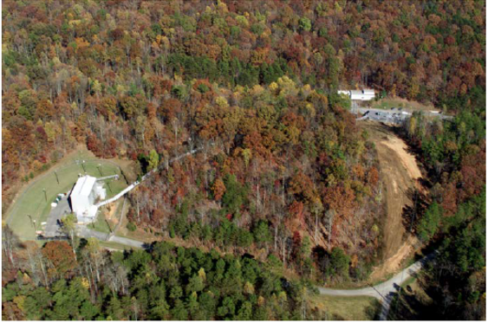
The Health Physics Research Reactor
Facts about the HPRR
DOSAR Facility, A History of Research Reactors Division (1987)
Also known as the Fast Burst Reactor (FBR)
Designed and built at ORNL in 1961
Part of the Dosimetry Application Research (DOSAR) facility at ORNL from 1963 to 1987
Operated for thousands of hours; achieved criticality 10,000 times
Inspired numerous relevant studies and publications on dosimetry, plant radiobiology, radiation alarms, teaching, and training
Decommissioned in 1987

Slide 6
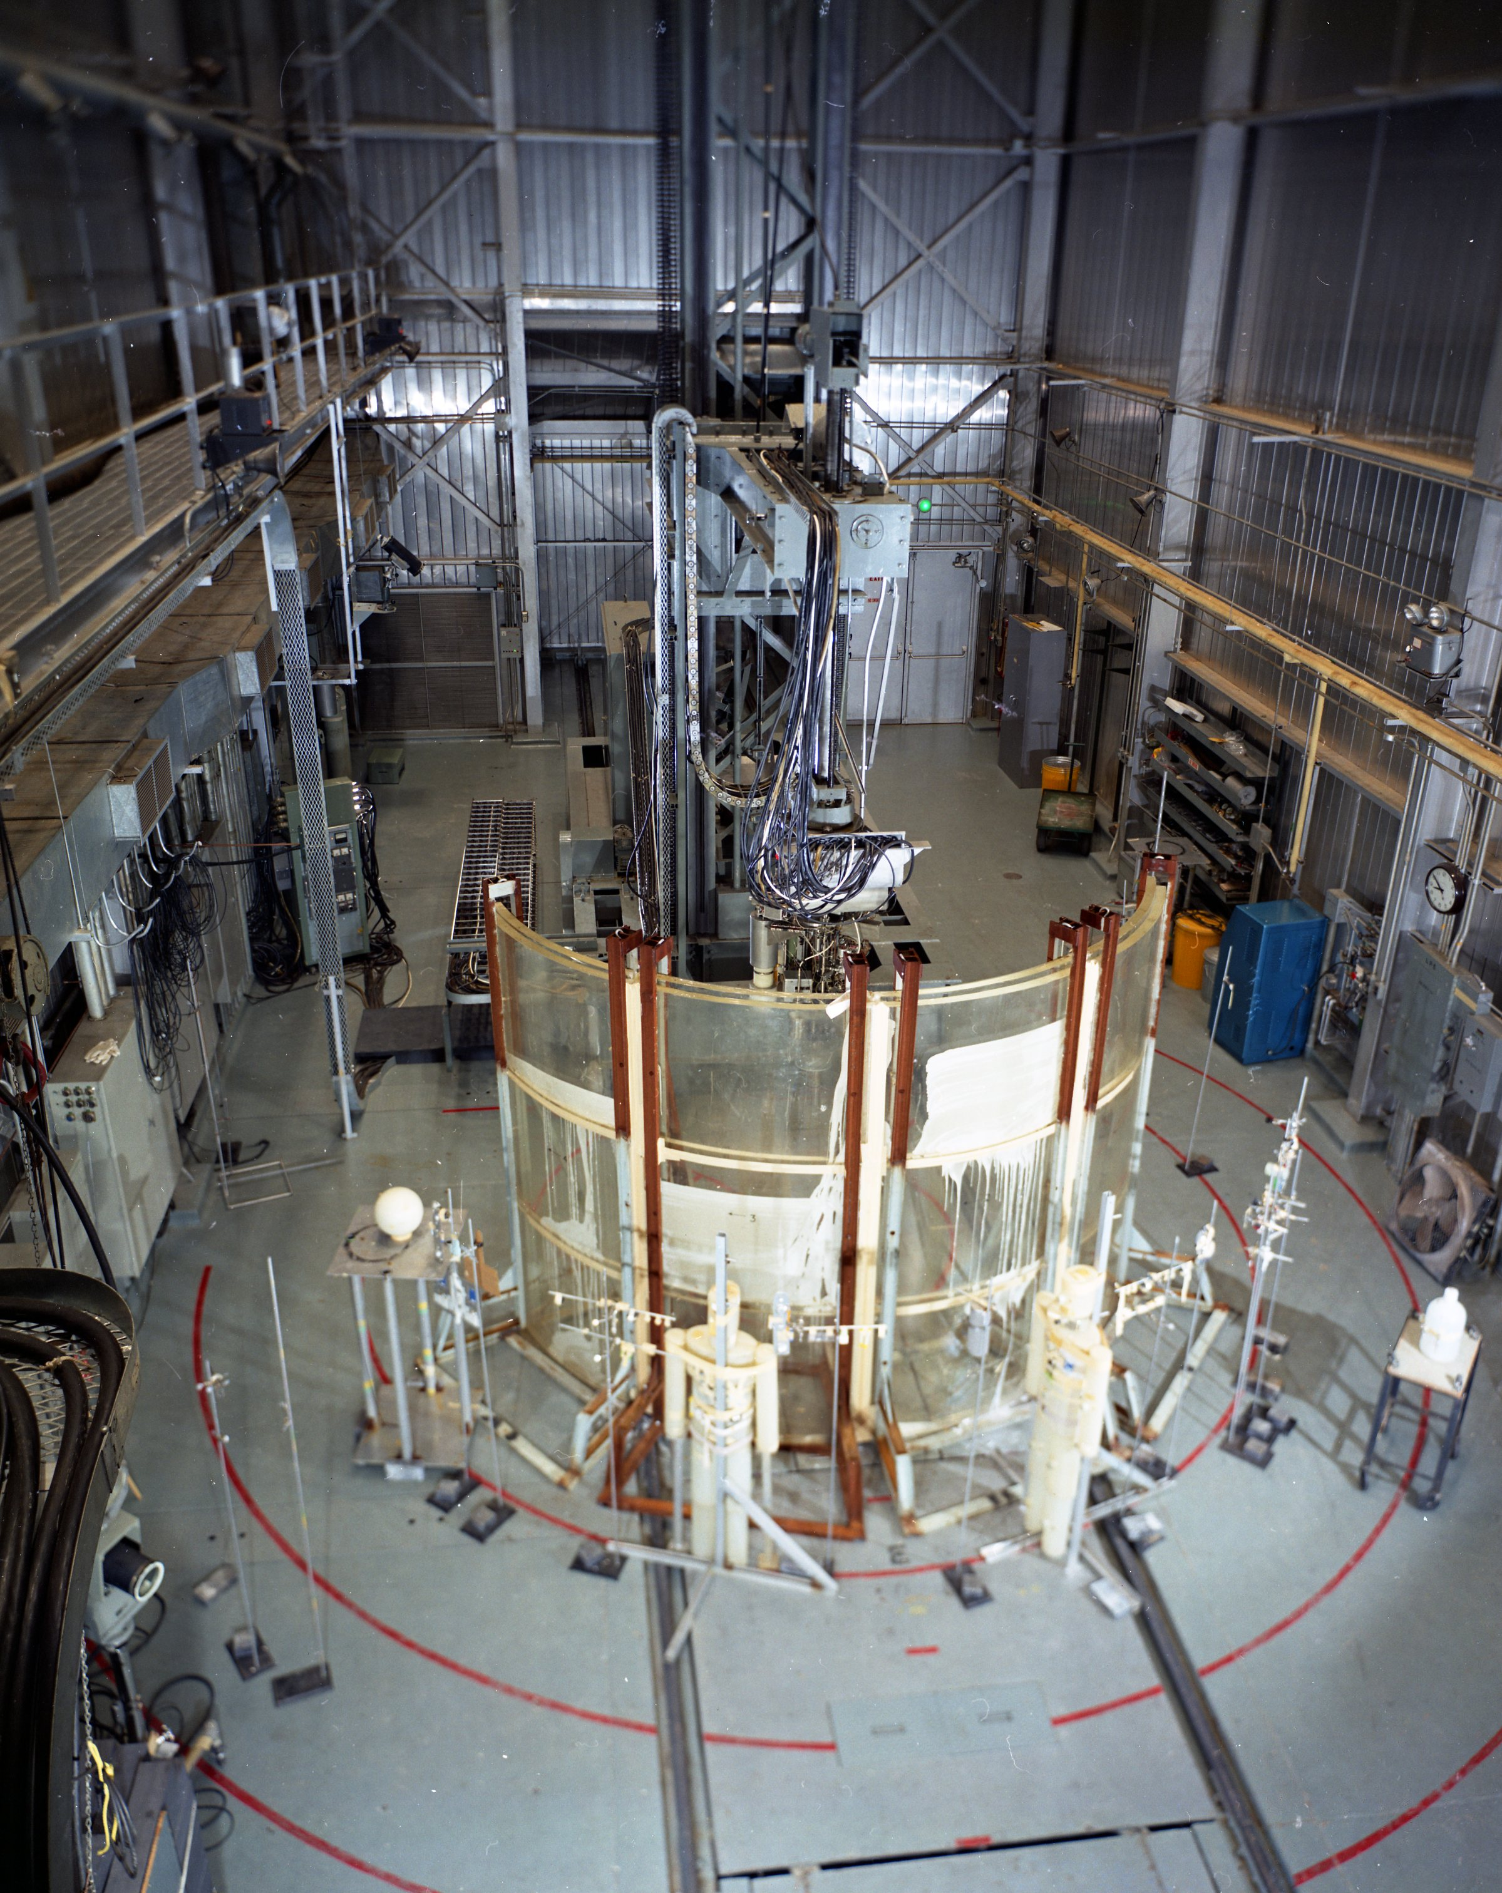
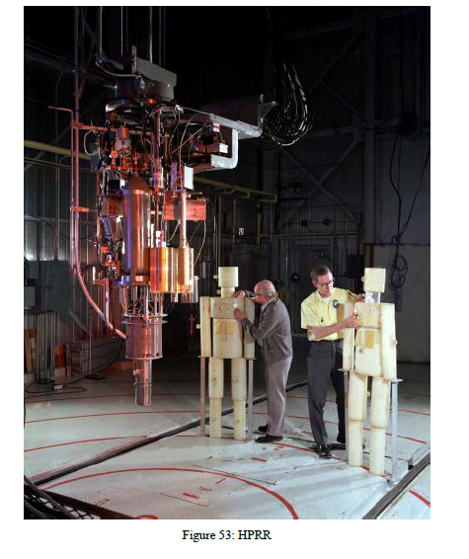
The Health Physics Research Reactor
Phantom setup inside the HPRR building, August 7, 1970 (A History of Research Reactors Division, 1987).

Slide 7
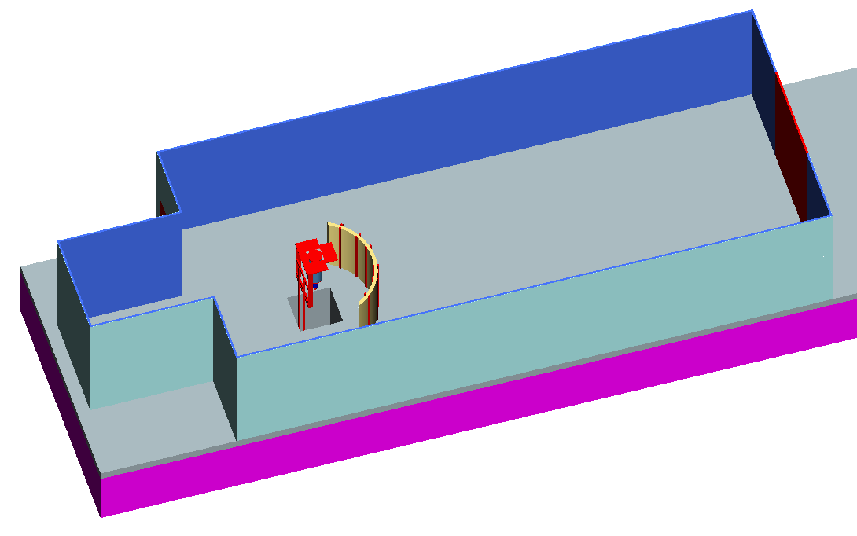
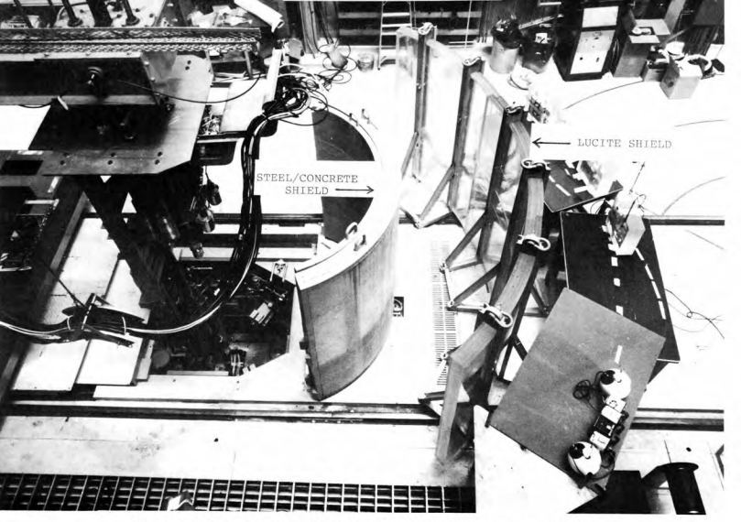
The Health Physics Research Reactor
HPRR reference dosimetry (ORNL-6240, 1987).
SCALE model of HPRR.

Slide 8
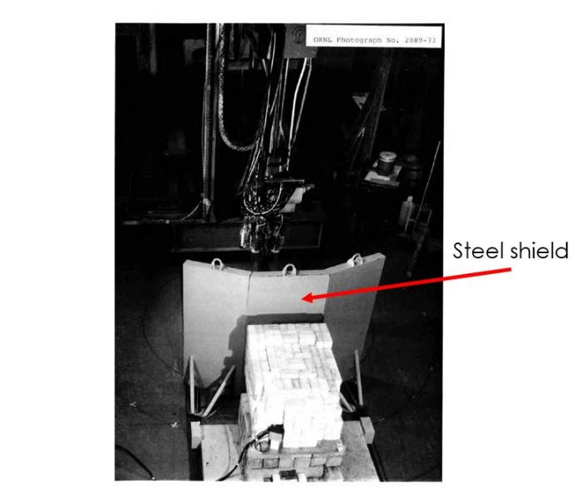
The Health Physics Research Reactor
Health Physics Research Reactor reference dosimetry (ORNL-6240, 1987).

Slide 9
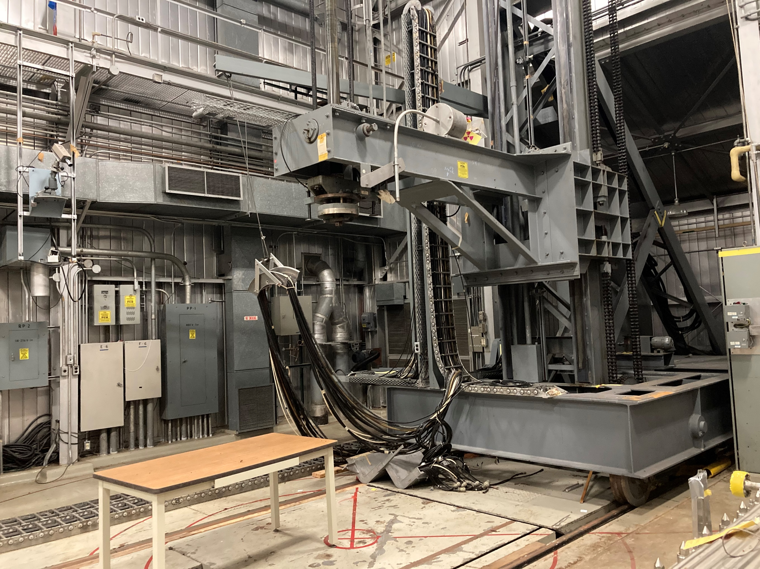
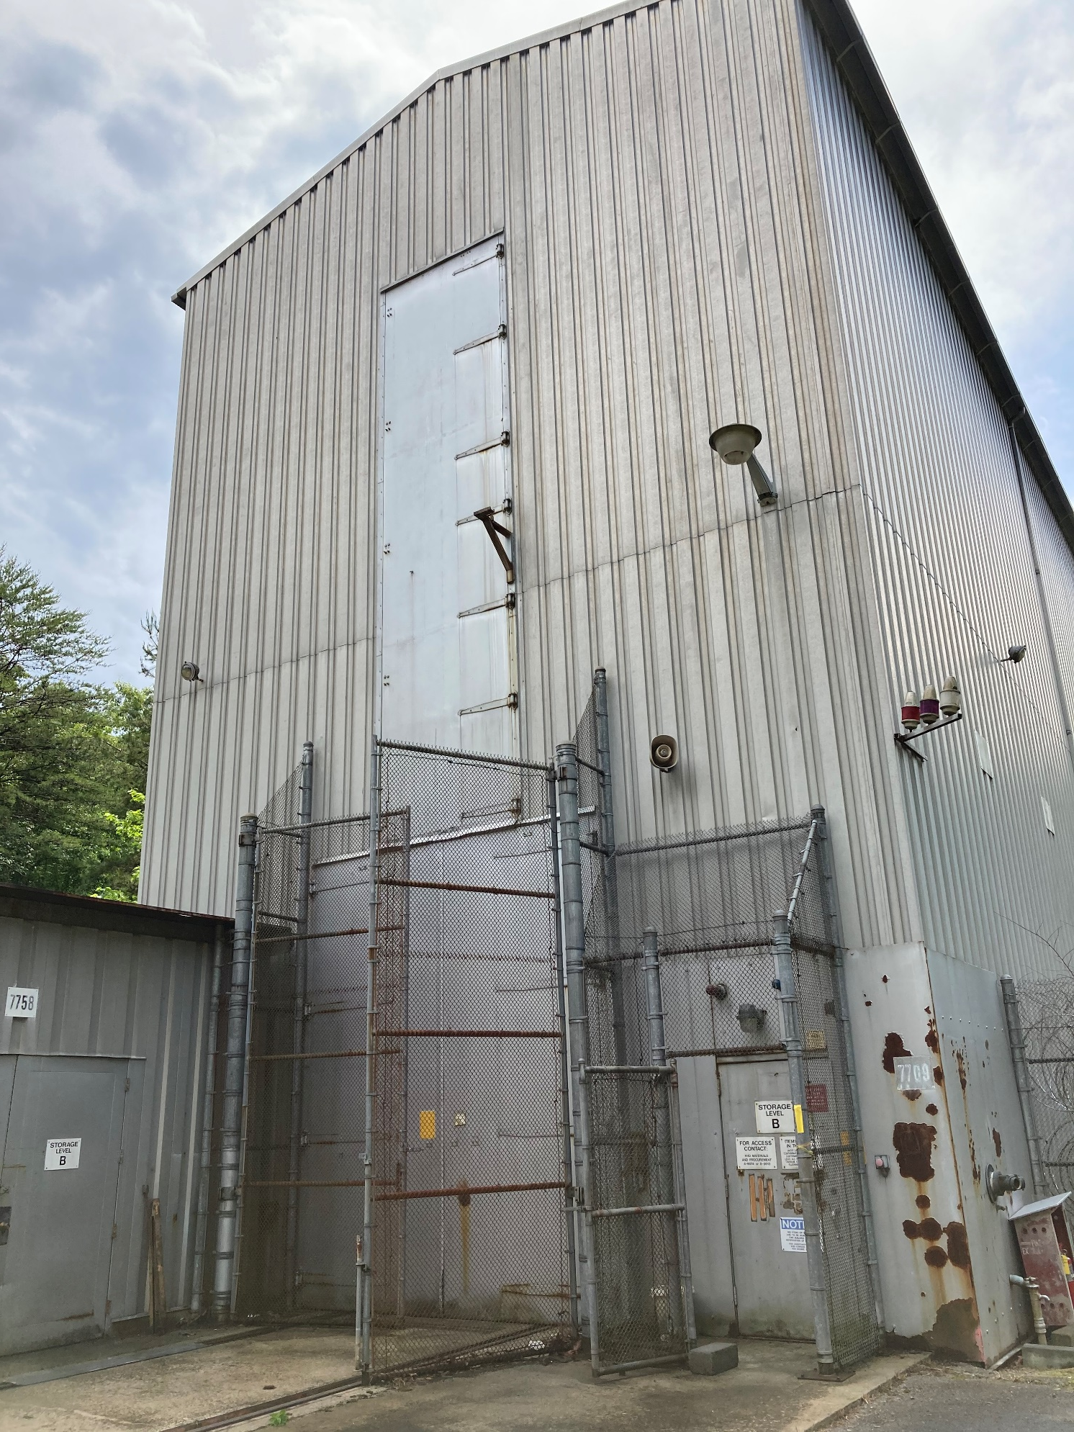
The Health Physics Research Reactor
HPRR building (left), inside HPRR building (right), pictures taken on 06/03/2021.

Slide 10
Outline
The Health Physics Research Reactor (HPRR)
Version 1 - Evaluation Status and Contents
Version 2 - Evaluation of Experimental Data: Planned Additions
Conclusions

Slide 11
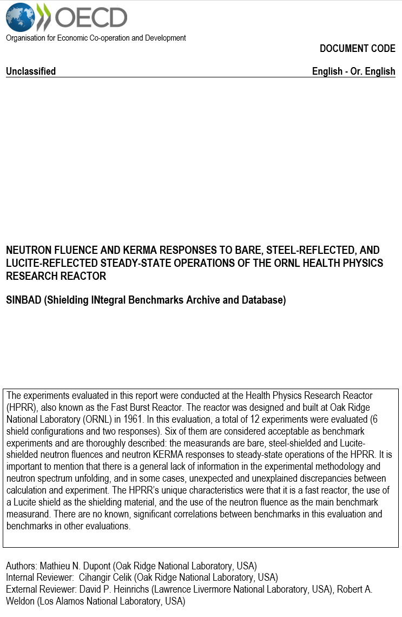
Version 1 - evaluation status and contents
Officially accepted by the SINBAD Task Force on March 10, 2025:
Currently in final ORNL review for SINBAD release
Gitlab repo includes everything related to the evaluation (input/output files, references, data in Microsoft Excel format)
To be released to the Nuclear Energy Agency (NEA) through the Radiation Safety Information Computational Center (RSICC)
Contents:
Total neutron fluence from steady-state operation of the HPRR measured by Bonner sphere spectrometry, shielded and unshielded
Derived neutron KERMA (kinetic energy released in matter) results from Step 1
Cover page of evaluation to be released in SINBAD.

Slide 12
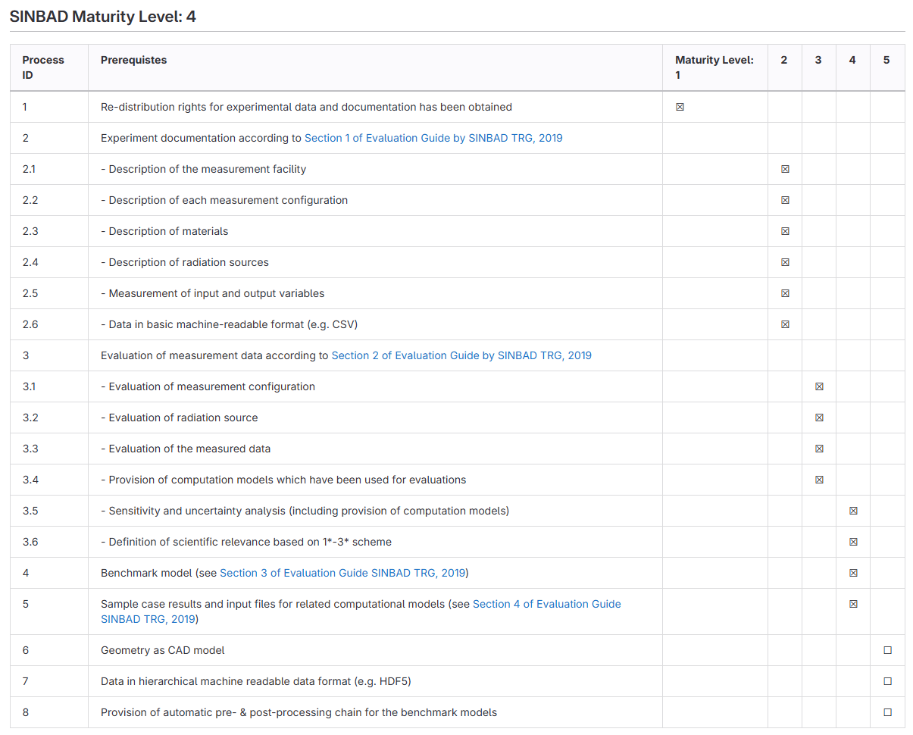
Version 1 - evaluation status and contents
SINBAD taskforce, new process
SINBAD maturity level: 4

Slide 13
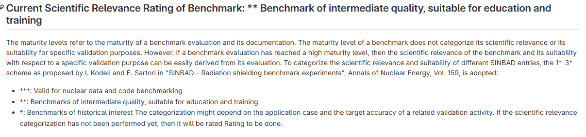
Version 1 - evaluation status and contents
SINBAD taskforce new process
SINBAD scientific relevance: **

Slide 14
Version 1 - evaluation status and contents
Acceptable benchmarks: three shielding configurations and two measurands: six benchmark cases.
Experiments results are from ORNL-6240 “Health Physics Research Reactor Reference Dosimetry (1987)”.
Acceptable benchmarks in the evaluation
Shield | Neutron fluence | Neutron kerma
Bare | ✓ | ✓
Steel | ✓ | ✓
Lucite | ✓ | ✓

Slide 15
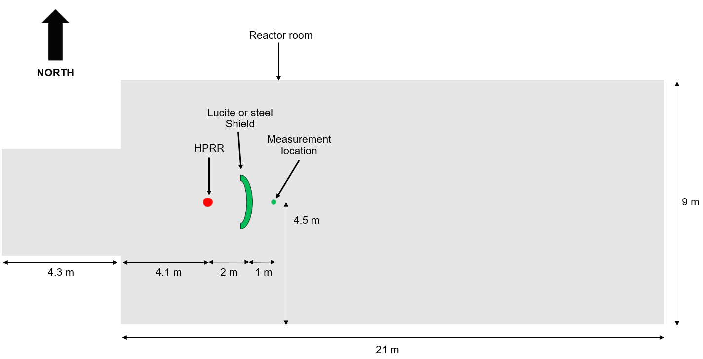
Version 1 - evaluation status and contents
Experimental setup overview for the Bonner spheres measurements.

Slide 16
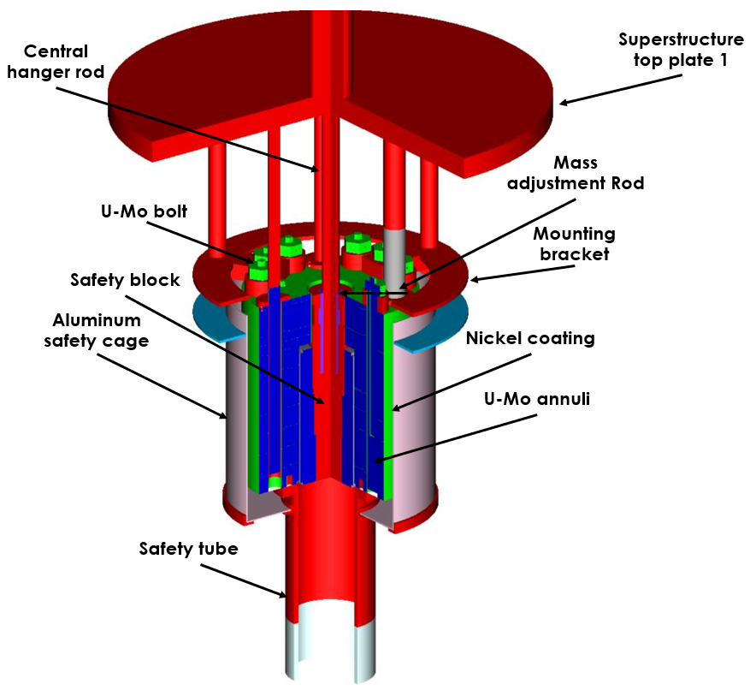
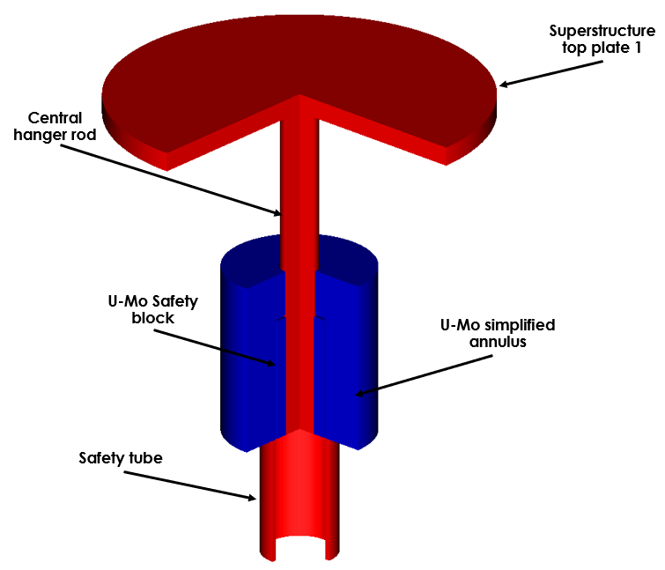
Version 1 - evaluation status and contents
Overview of the detailed (left) and benchmark (right) models, front right quarter.

Slide 17
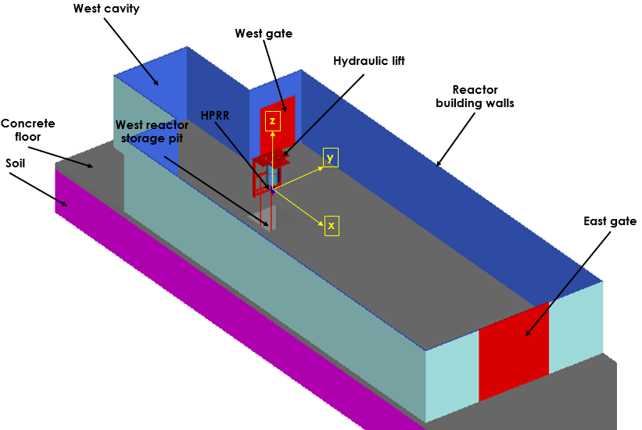
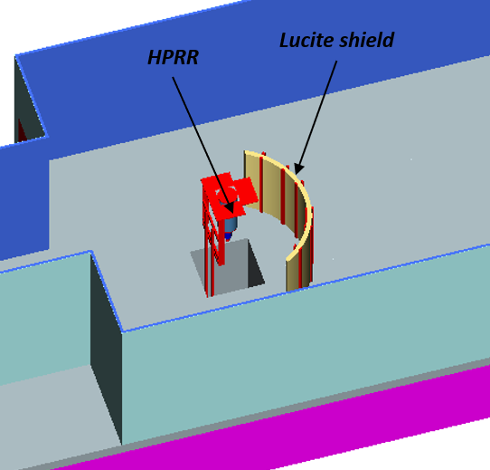
Version 1 - evaluation status and contents
Overview of the bare (left) and Lucite-shielded (right) configuration benchmark models.

Slide 18
Version 1 - evaluation status and contents
 | Neutron fluence at 3 m resulting from 10¹⁷ fissions of the HPRR
 | Expected |  | Calculated (SCALE 6.3.1 MAVRIC with ENDF/B-VIII.0) |  |  | Calculated (COG 11.3 with ENDF/B-VIII.0)
Configuration | Neutron fluence (cm⁻²) | Relative standard uncertainty (%) | Neutron fluence (cm⁻²) | Relative standard uncertainty (%) | C/E ± 1 sigma relative uncertainty (%) | Neutron fluence (cm⁻²) | Relative standard uncertainty (%) | C/E ± 1 sigma relative uncertainty (%)
Bare | 1.64E+11 | 20.40 | 2.33E + 11 | 0.07 | 1.42 ± 20.4 % | 2.16E + 11 | 0.12 | 1.32 ± 20.4 %
Steel shield | 9.08E+10 | 21.28 | 1.14E + 11 | 0.16 | 1.26 ± 21.3 % | 1.08E + 10 | 0.34 | 1.19 ± 21.3 %
Lucite shield | 3.55E+10 | 28.92 | 3.89E + 10 | 0.27 | 1.10 ± 28.9 % | 3.52E + 10 | 0.55 | 0.99 ± 28.9 %

Slide 19
Version 1 - evaluation status and contents
 | Neutron kerma at 3 m resulting from 10¹⁷ fissions of the HPRR
 | Expected |  | Calculated (SCALE 6.3.1 MAVRIC with ENDF/B-VIII.0) |  |  | Calculated (COG 11.3 with ENDF/B-VIII.0)
Configuration | Neutron kerma (Gy) | Relative standard uncertainty (%) | Neutron kerma (Gy) | Relative standard uncertainty (%) | C/E ± 1 sigma relative uncertainty (%) | Neutron kerma (Gy) | Relative standard uncertainty (%) | C/E ± 1 sigma relative uncertainty (%)
Bare | 3.364 | 19.78 | 4.518 | 0.07 | 1.34 ± 19.8 % | 4.100 | 0.12 | 1.22 ± 20.4 %
Steel shield | 1.478 | 21.34 | 1.729 | 0.15 | 1.17 ± 21.3 % | 1.564 | 0.38 | 1.06 ± 21.3 %
Lucite shield | 0.561 | 29.62 | 0.680 | 0.26 | 1.21 ± 29.6 % | 0.581 | 0.55 | 1.04 ± 29.6 %

Slide 20
Outline
The Health Physics Research Reactor (HPRR)
Version 1 - Evaluation Status and Contents
Version 2 - Evaluation of Experimental Data: Planned Additions
Conclusions

Slide 21
Version 2 - evaluation of experimental data: planned additions
Planned additions:
Sulfur pellet activation at different distances from an HPRR pulse, shielded and unshielded
Gamma dose from an HPRR pulse measured by Geiger-Müller (G-M) counter and thermoluminescent dosimeter (TLD)
Cover page of evaluation, to be released in SINBAD.

Slide 22
Version 2 - evaluation of experimental data: planned additions
Sulfur pellet activation at different distances from an HPRR pulse, shielded and unshielded (see ORNL-1731)
The reactor was used in burst operation to irradiate sulfur pellets placed at different distances and shielded by different materials (steel, Lucite, concrete)
Sulfur is activated and measured later, and a fluence at the sulfur location can be obtained
The experimental results are from ORNL-6240
In 2021’s evaluation, focus was only on bare and steel shield configurations, so Lucite must be added
The evaluation revealed missing information regarding the sulfur fluence definition and sulfur pellet counting calibration

Slide 23
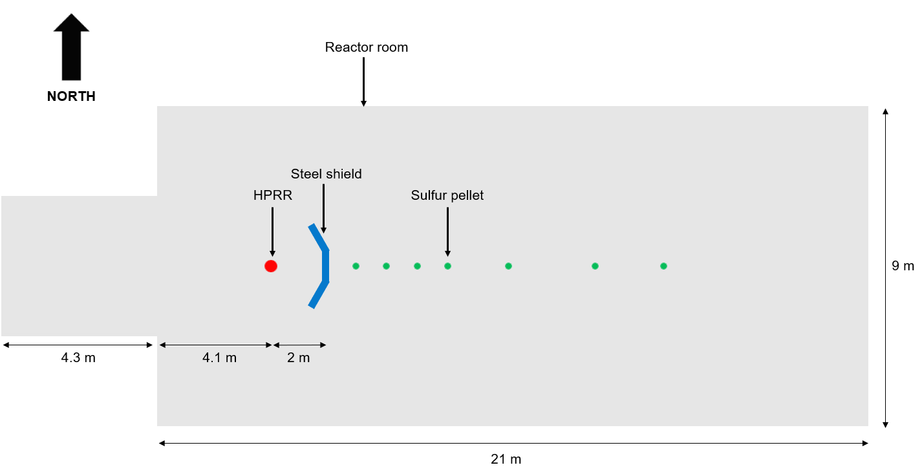
Version 2 - evaluation of experimental data: planned additions
Experimental setup overview for the Bonner spheres measurements.

Slide 24
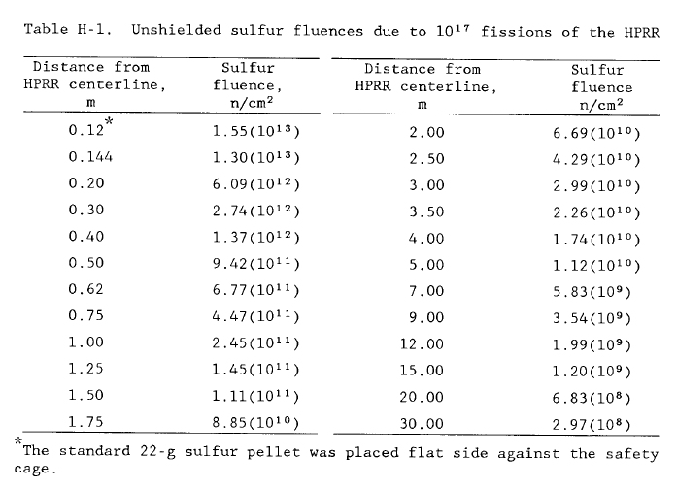
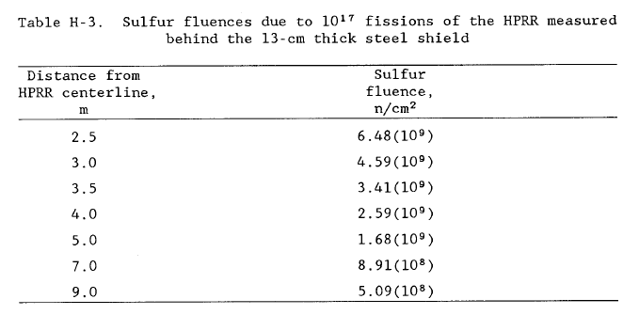
Version 2 - evaluation of experimental data: planned additions
From Health Physics Research Reactor Reference Dosimetry (ORNL-6240, 1987).

Slide 25
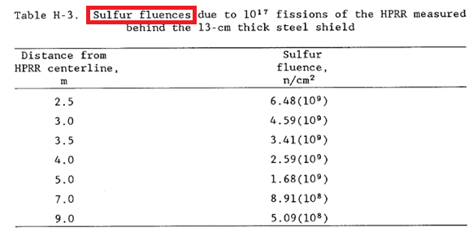
Version 2 - evaluation of experimental data: planned additions
What to calculate? Neutron flux or something else?
No information on the sulfur pellets’ counting after activation could be located
Experiment result explanation:
“Sulfur fluence”
is equivalent to
“neutron fluence from sulfur pellet activation,” which is not the same as
“neutron fluence at sulfur pellet location”
From ORNL-6240 (1987).

Slide 26
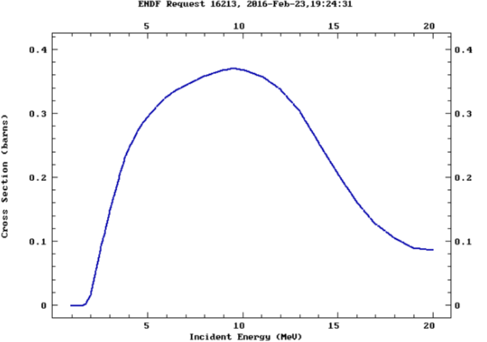

Version 2 - evaluation of experimental data: planned additions
Activation probability of sulfur with neutrons of energy less than 2 MeV is low
Correct modeling methodology:
Estimate the reaction rate S-32(n,p) with MAVRIC and divide each energy response by the corresponding reaction cross section
The result obtained is sulfur reaction–weighted flux
Weighted flux $=\sum_{E}{\frac{MAVRIC reaction rate}{Reaction cross section}}$
Neutron cross section for S-32(n,p) reaction from ENDF/B-VIII.0, Evaluation of the Fluence Conversion Factor for P-32 in Sulfur (2019).

Slide 27
Version 2 - evaluation of experimental data: planned additions
Another issue:
Even with a low probability, MAVRIC calculations showed that neutrons of energy below 2 MeV still contribute significantly to the sulfur activation rate results
Sulfur fluence experimental results indicate that sulfur fluence is under 2.5 MeV; a correction may have been applied by experimentalists. Multiple calculations were performed with different energy cut-offs, thus removing the lower energy groups from the activation cross-section library
Energy (eV) | Cross section (barns) | Cutoff definition
2.00E+07 | 8.6800E-02 | No cutoff
3.75E+06 | 2.2700E-01
----- | -----
2.75E+06 | 1.1500E-01
2.50E+06 | 8.9500E-02
2.40E+06 | 7.5000E-02 | Cutoff 2
2.00E+06 | 1.7152E-02
1.75E+06 | 2.3456E-03 | Cutoff 1
1.55E+06 | 8.3705E-05
ENDF/B-VIII.0 S-32(n,p)P-32 reaction cross section excerpt and cutoff definition (ORNL-1731, 2020).

Slide 28
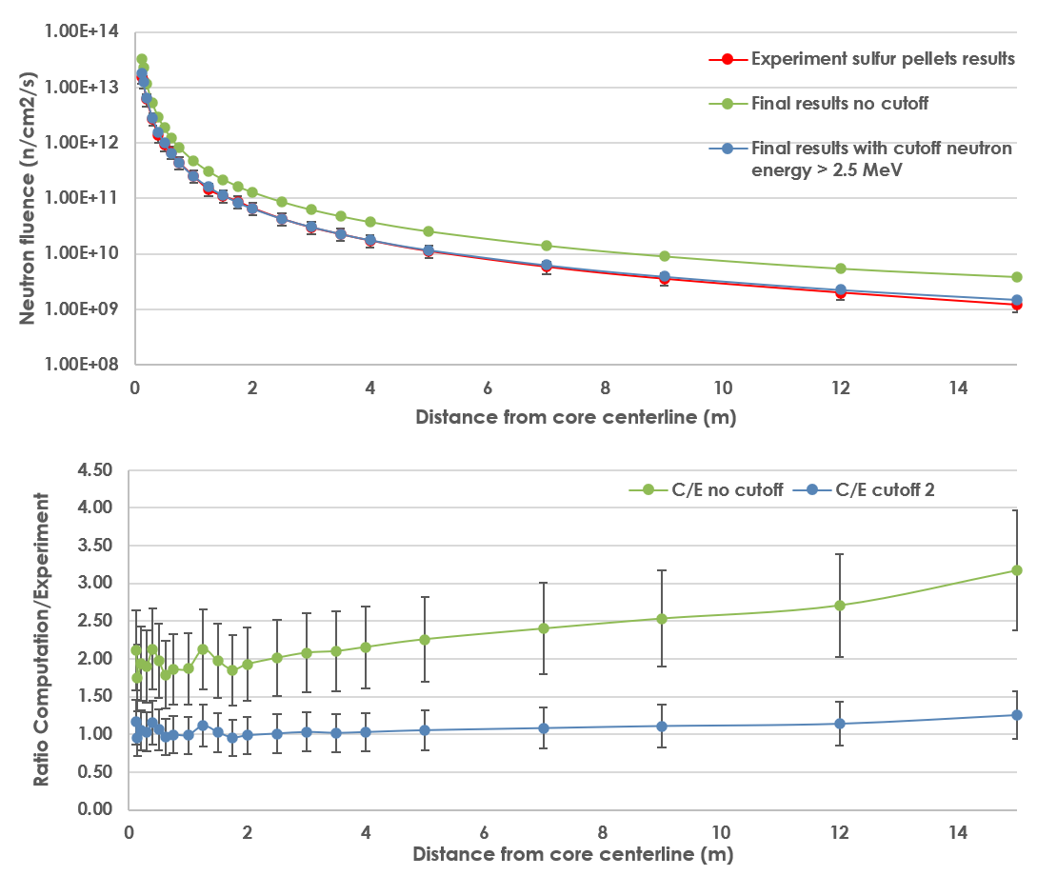
Version 2 - evaluation of experimental data: planned additions
Bare reactor:
Regular cross section (no cutoff):
Large discrepancy computation/experiment
Ratio between 1.7 and 3.2
Modified cross section (neutrons below 2.5 MeV are ignored):
Small discrepancy computation/ experiment for the cutoff
Ratio between 1 and 1.3

Slide 29
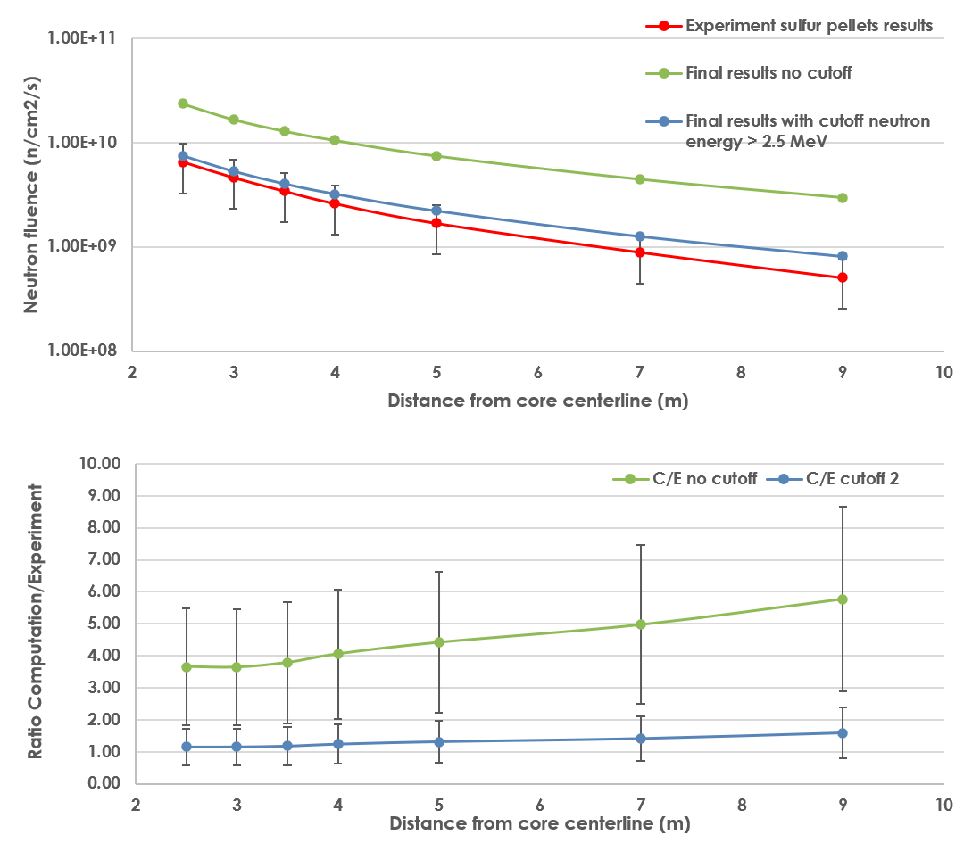
Version 2 - evaluation of experimental data: planned additions
Steel-shielded reactor:
Regular cross section (no cutoff):
Large discrepancy computation/experiment
Ratio between 3.6 and 5.8
Modified cross section (neutrons below 2.5 MeV are ignored):
Small discrepancy computation/experiment for the cutoff
Ratio between 1.1 and 1.6

Slide 30
Version 2 - evaluation of experimental data: planned additions
Gamma dose from an HPRR pulse measured by G-M counter and TLD
The reactor was used in burst operation to irradiate G-M counters and TLDs placed at different distances and shielded by different materials (steel, Lucite, concrete)
Results are published in R. Oyan and C. S. Sims, “Radiation Dose from HPRR Gamma Rays Radiation Protection Dosimetry,” Radiation Protection Dosimetry 16, 3, 213–217, 1986.
Preliminary calculation results are underpredicting expected results for G-M counters; TLD results have not been tested
An uncertainty study is to be performed

Slide 31
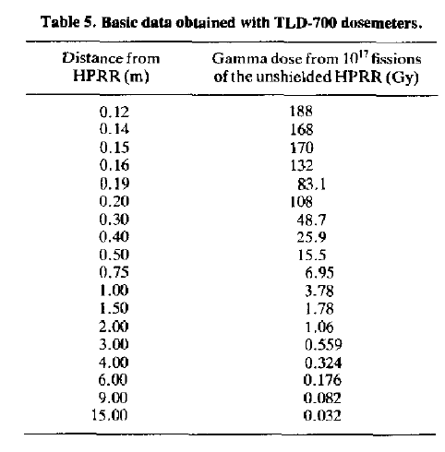
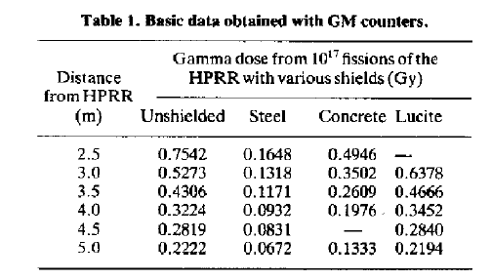
Version 2 - evaluation of experimental data: planned additions
From R. Oyan and C. S. Sims, “Radiation Dose from HPRR Gamma Rays Radiation Protection Dosimetry,” Radiation Protection Dosimetry 16, 3, 213–217, 1986).

Slide 32
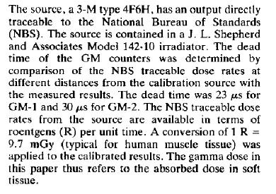
Version 2 - evaluation of experimental data: planned additions
From R. Oyan and C. S. Sims, “Radiation Dose from HPRR Gamma Rays Radiation Protection Dosimetry,” Radiation Protection Dosimetry 16, 3, 213–217, 1986).
 | Gamma dose at 3 m resulting from 10¹⁷ fissions of the HPRR
 | Expected | Calculated (SCALE 6.3.1 MAVRIC with ENDF/B-VIII.0)
Configuration | G-M Gamma dose (Gy) | ICRU-57 Table A.21 (air) Kerma (Gy) | C/E
Bare | 0.5273 | 0.2610 | 0.49
Steel shield | 0.1318 | 0.0572 | 0.43
Lucite shield | 0.6378 | 0.3850 | 0.60
Underprediction:
More investigation is needed, different dose conversion factors to be used?

Slide 33
Version 2 - evaluation of experimental data: planned additions
Planned acceptable benchmarks in the evaluation version 2
Shield | Neutron fluence | Neutron kerma | Sulfur foil activation | Gamma dose
Bare | ✓ | ✓ | ! | X
Steel | ✓ | ✓ | ! | X
Lucite | ✓ | ✓ | X | X
✓: Included in initial release
! : Done before; will be updated in Version 2
X : Needs full evaluation; will be added in Version 2

Slide 34
Outline
The Health Physics Research Reactor (HPRR)
Version 1 - Evaluation Status and Contents
Version 2 - Evaluation of Experimental Data: Planned Additions
Conclusions

Slide 35
Conclusions
Version 1
The SINBAD Evaluation of Legacy HPRR Experiments, Version 1, is accepted for publication in SINBAD after taskforce review
The evaluation includes neutron fluence and kerma (1) with no shield, (2) with a steel shield, and (3) with a Lucite shield (6 cases)
Sample calculation results are mostly good, with notable artifacts resulting from Bonner sphere unfolding imprecisions that seem difficult to solve

Slide 36
Conclusions
Version 2: future work
Version 2 will include sulfur pellet neutron activation and gamma dose results with the same shield configurations
The sulfur pellet experiment evaluation is almost complete; the Lucite shield needs to be added, and the uncertainty analysis must be updated
The gamma dose experiment evaluation is ongoing; preliminary results show ~0.5 C/E discrepancies
Funding has not yet been obtained to pursue Version 2

Slide 37
This presentation was supported by the Nuclear Criticality Safety Program, funded and managed by the National Nuclear Security Administration for the US Department of Energy

Slide 38
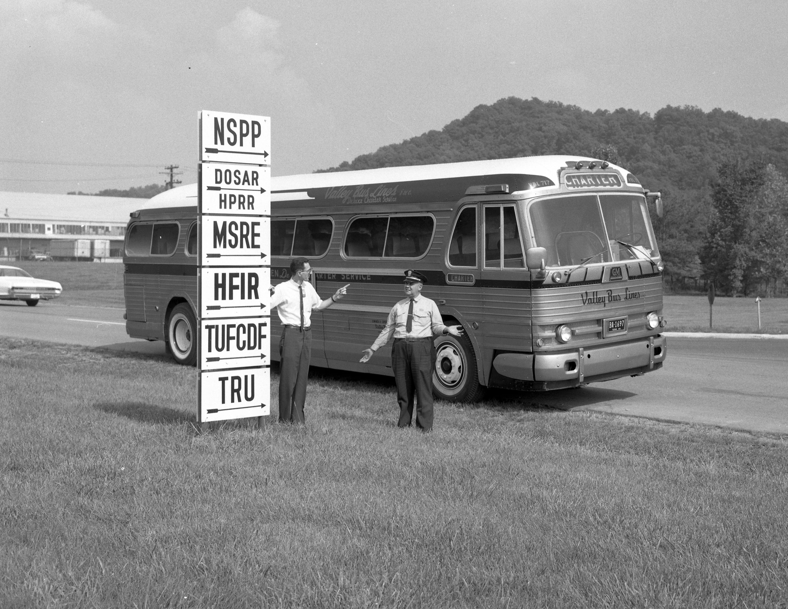
Questions?
ORNL News Photo - bus lost in front of the Melton Valley Complex, August 1966.

Slide 39
Back-up slides

Slide 40
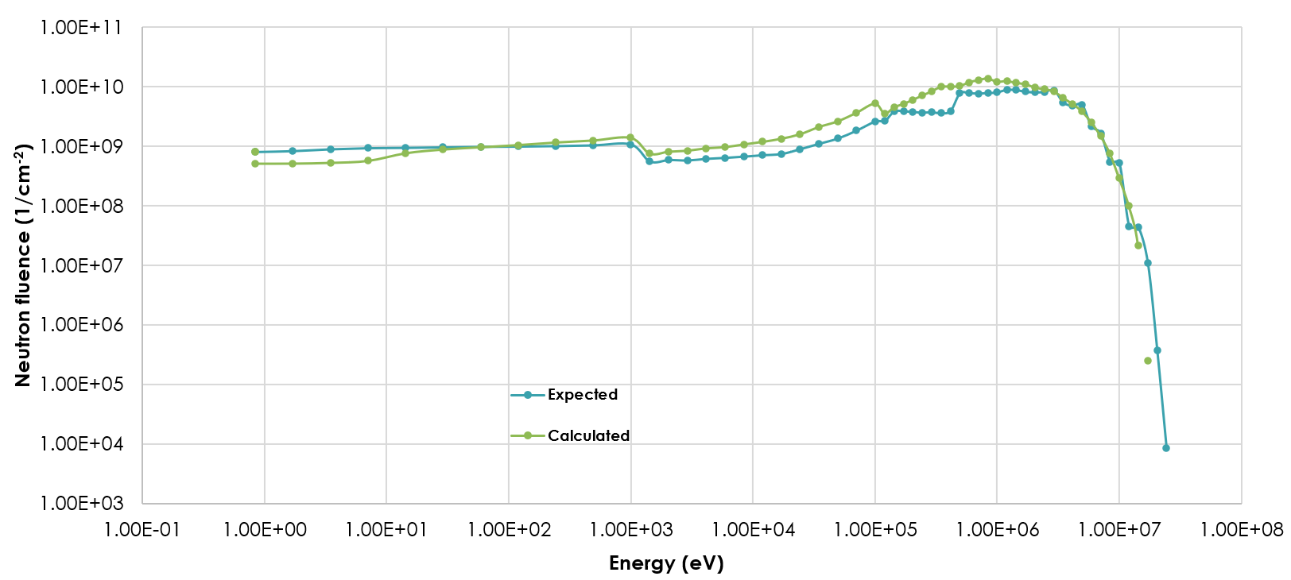
Benchmark and SCALE MAVRIC sample calculation results
Bare configuration comparison.

Slide 41
Benchmark and SCALE MAVRIC sample calculation results
Bad agreement at low energy
Excellent agreement above 1 MeV
Potential Bonner sphere counting artifact
Bare configuration comparison.

Slide 42
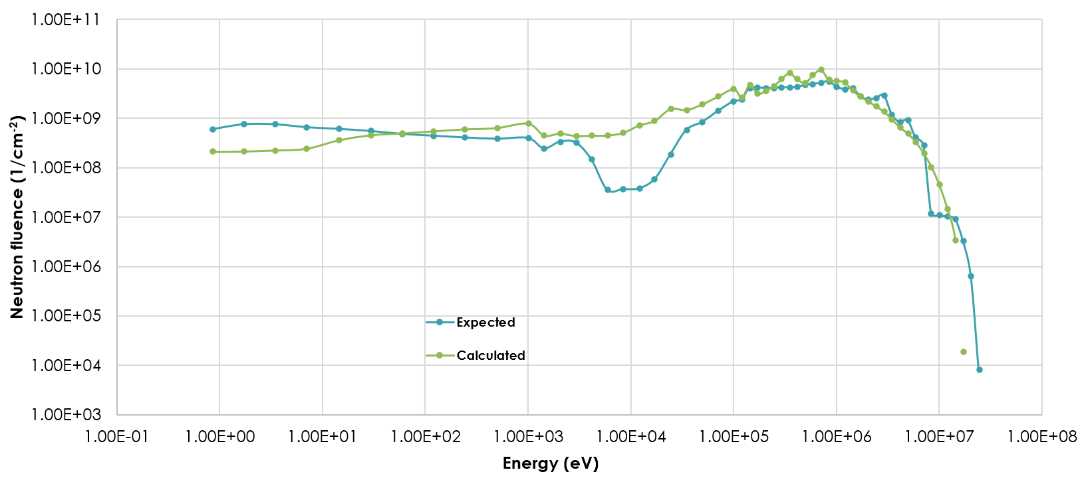
Benchmark and SCALE MAVRIC sample calculation results
Steel-shielded configuration comparison.

Slide 43
Benchmark and SCALE MAVRIC sample calculation results
Bad agreement at low energy
Very good agreement above 1 MeV
Potential Bonner sphere counting artifact
Steel-shielded configuration comparison.

Slide 44
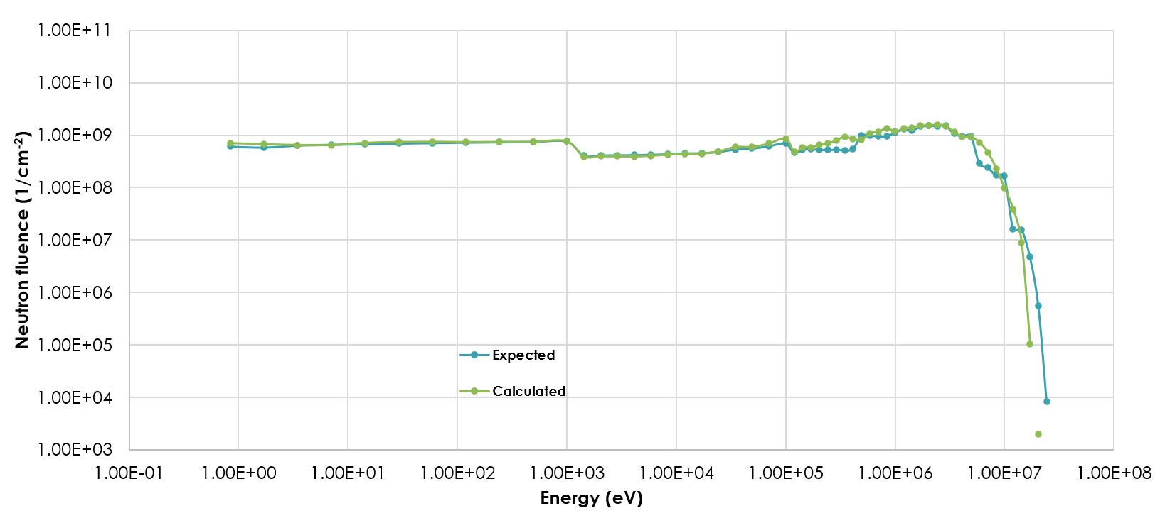
Benchmark and SCALE MAVRIC sample calculation results
Lucite-shielded configuration comparison.

Slide 45
Benchmark and SCALE MAVRIC sample calculation results
Excellent agreement at low and “high” energy
Potential Bonner sphere counting artifact
Lucite-shielded configuration comparison.

