Slide 1
Calculations of Subcritical Limits in ANSI/ANS-8.1
Travis Greene
PATRAM
July 27 – August 1, 2025

Slide 2
Outline
Introduction
Methodology
Results
Conclusions

Slide 3

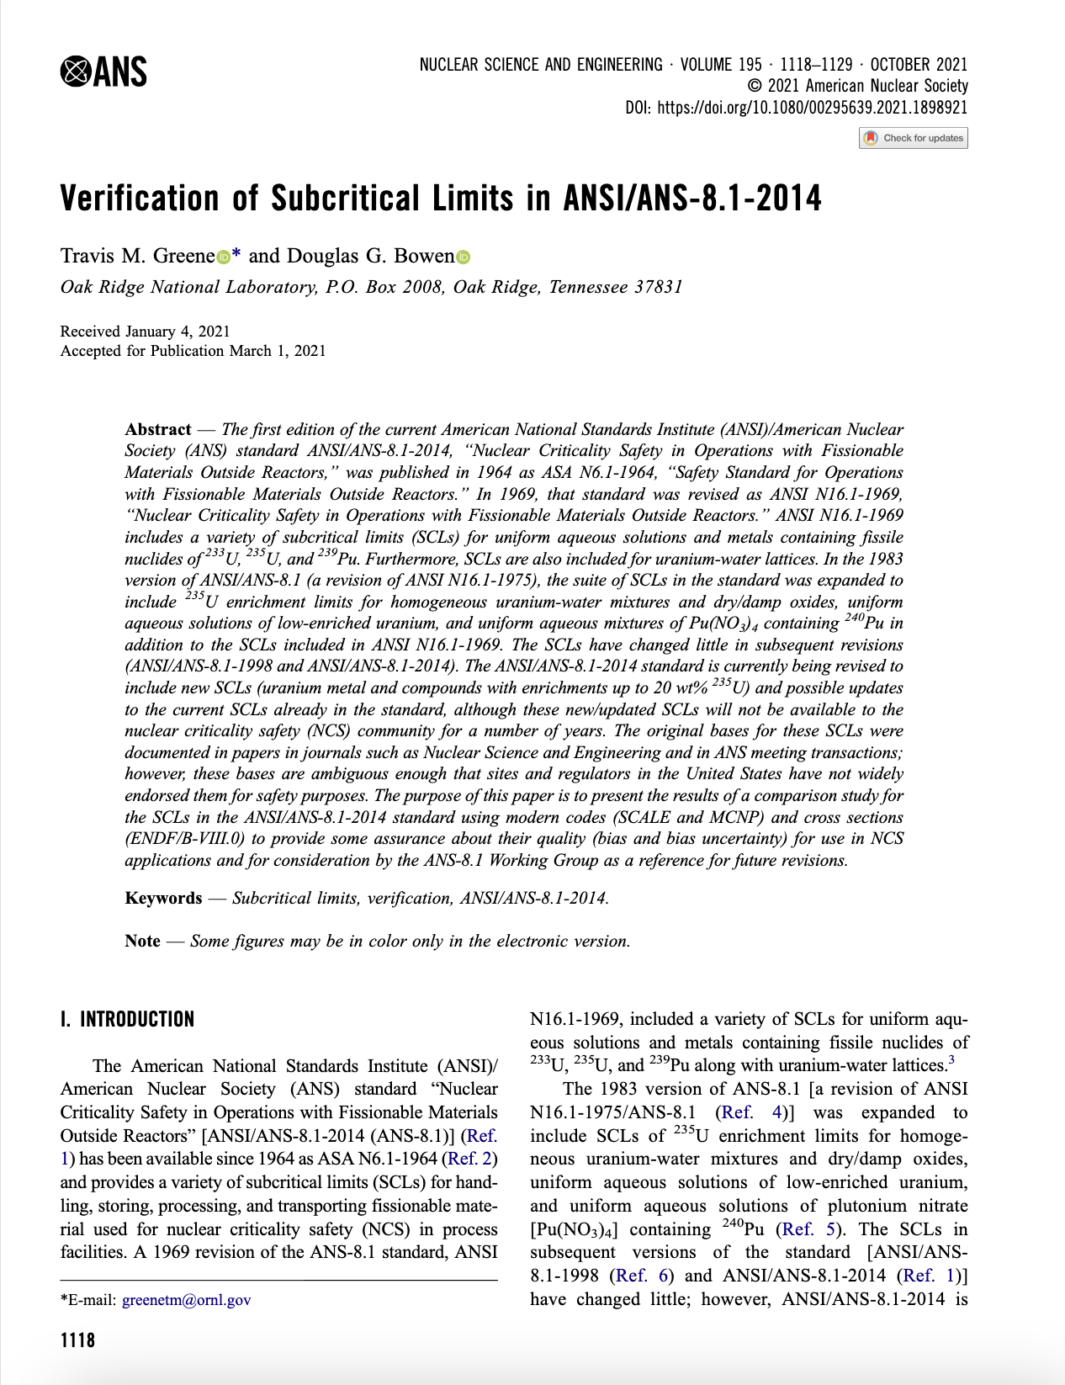
Introduction
ANSI/ANS-8.1 standard “Nuclear Criticality Safety in Operations with Fissionable Materials Outside of Reactors” provides subcritical limit (SCL) values for several single- and multiple-parameter limits for fissile nuclides, including, uniform aqueous solutions and metals containing nuclides of ²³³U, ²³⁵U, and ²³⁹Pu, uranium-water lattices, homogeneous uranium-water mixtures of dry/damp oxides, uniform aqueous solutions of low-enriched uranium, and uniform aqueous mixtures of Pu(NO₃)₄ containing ²⁴⁰Pu

Slide 4
Introduction
Recent efforts by the ANSI/ANS-8.1 working group (WG) have involved recalculating/updating current subcritical limits (SCLs) in the standard with current cross section data (ENDF/B-VII.1 and –VIII.0) and transport codes (SCALE 6.2 and MCNP 6.1)
WG is currently focusing on revising the standard to include SCLs for uranium compounds in the LEU+ (between 5 and 10 wt% ²³⁵U) and HALEU (between 10 and 20 wt% ²³⁵U) ranges for advanced reactor concepts
While nuclear data and calculational methods and transport codes have evolved over the years, values in the standard have had little to no change during the same time

Slide 5
Introduction
Given the evolutionary changes to nuclear data and computational methods, it is important to examine how k_{eff} values for the SCLs found in ANS-8.1 are affected
The purpose of this paper is to present results of a comparison study for the SCLs in ANS-8.1 using the SCALE transport code with several cross-section libraries (ENDF/B-VII.0, -VII.1, -VIII.0, and –VIII.1) to track the progression of k_{eff} values
The values presented here are only references for the WG to compare to the current values and should not be used explicitly in any safety analysis report

Slide 6
Methodology
SCALE 6.3.2 transport code used for all calculations
Four continuous energy libraries
  ENDF/B-VII.0
  ENDF/B-VII.1
  ENDF/B-VIII.0
  ENDF/B-VIII.1

Slide 7
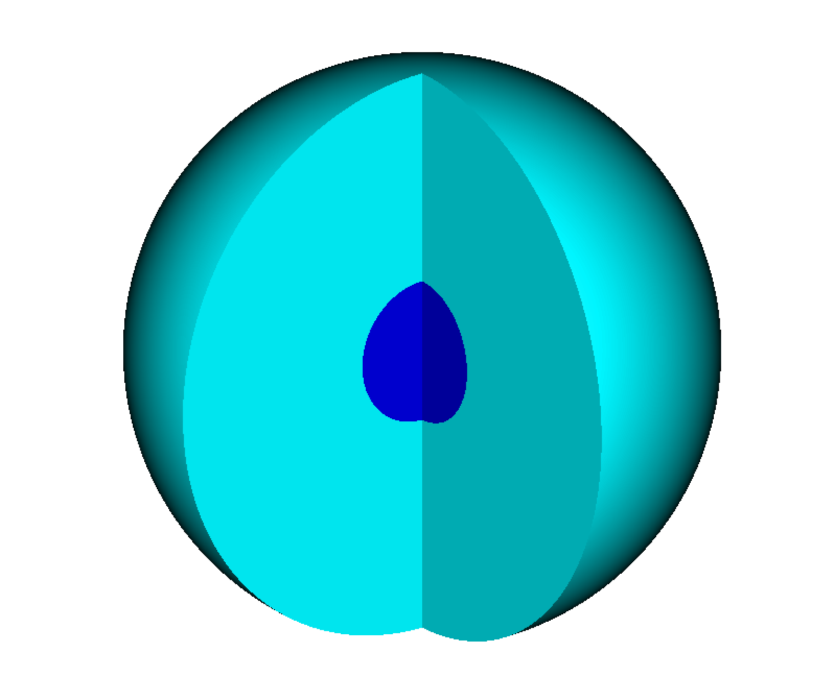
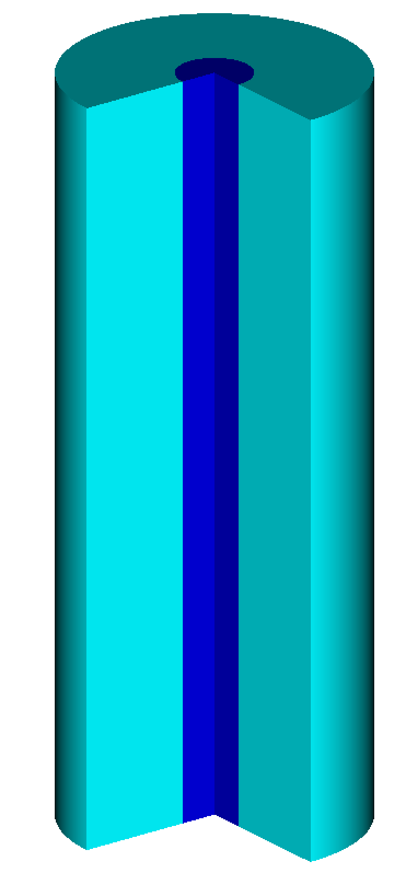
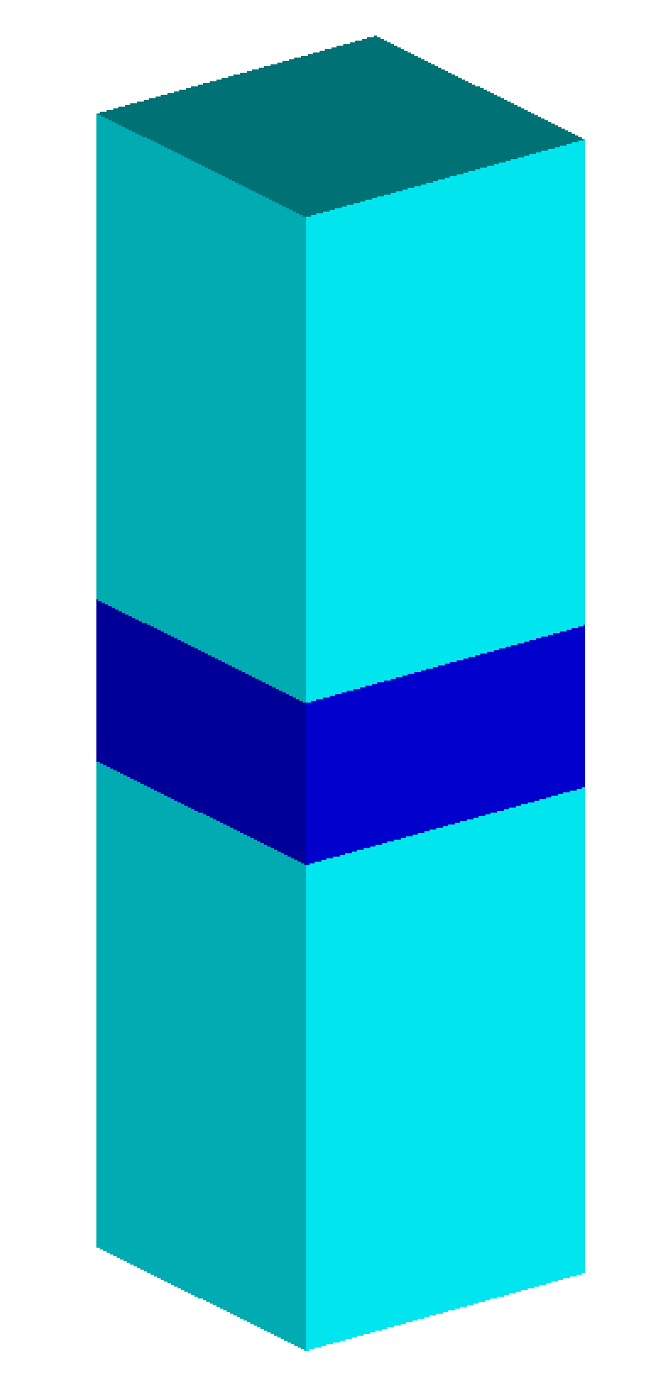
Methodology
Four specific geometries used
  Spheres for mass and volume calculations
  Infinite cylinders for diameters
  Infinite slabs for thicknesses and areal densities
  Infinite medium for concentrations and H/X ratios
Spheres, cylinders, and slabs assume 30 cm water reflector
Monte Carlo parameters: 10,000 neutrons per generation, skipping 100 generations, and run until 10 pcm uncertainty
Values highlighted in red are above k_{eff} of 0.98 for emphasis only

Slide 8
Results: ANS-8.1 Table 1 – Single-parameter subcritical limits for uniform aqueous solutions of fissile nuclides
Parameter | Subcritical limit for fissile solute*
 | ²³³UO₂F₂ | ²³³UO₂(NO₃)₂ | ²³⁵UO₂F₂ | ²³⁵UO₂(NO₃)₂ | ²³⁹Pu(NO₃)₄
Mass of fissile nuclide (kg) | 0.54 | 0.55 | 0.76 | 0.78 | 0.48
ENDF/B-VII.0 | 0.98845 | 0.98548 | 0.98696 | 0.98543 | 0.98090
ENDF/B-VII.1 | 0.98851 | 0.98538 | 0.98693 | 0.98550 | 0.98081
ENDF/B-VIII.0 | 0.98680 | 0.98378 | 0.98822 | 0.98659 | 0.97505
ENDF/B-VIII.1 | 0.99052 | 0.98779 | 0.98843 | 0.98704 | 0.97898
Diameter of cylinder of solution (cm) | 10.5 | 11.7 | 13.7 | 14.4 | 15.4
ENDF/B-VII.0 | 0.97716 | 0.97754 | 0.98093 | 0.97104 | 0.98743
ENDF/B-VII.1 | 0.97700 | 0.97758 | 0.98094 | 0.97120 | 0.98772
ENDF/B-VIII.0 | 0.97646 | 0.97652 | 0.98084 | 0.97121 | 0.98428
ENDF/B-VIII.1 | 0.98200 | 0.98252 | 0.98194 | 0.97283 | 0.98879
Thickness of slab of solution (cm) | 2.5 | 3.1 | 4.4 | 4.9 | 5.5
ENDF/B-VII.0 | 0.97747 | 0.97444 | 0.96992 | 0.96787 | 0.98711
ENDF/B-VII.1 | 0.97732 | 0.97463 | 0.97014 | 0.96780 | 0.98692
ENDF/B-VIII.0 | 0.97811 | 0.97509 | 0.96997 | 0.96775 | 0.98546
ENDF/B-VIII.1 | 0.98206 | 0.97914 | 0.97108 | 0.96930 | 0.98785

Slide 9
Results: ANS-8.1 Table 1 – Single-parameter subcritical limits for uniform aqueous solutions of fissile nuclides
Parameter | Subcritical limit for fissile solute*
 | ²³³UO₂F₂ | ²³³UO₂(NO₃)₂ | ²³⁵UO₂F₂ | ²³⁵UO₂(NO₃)₂ | ²³⁹Pu(NO₃)₄
Volume of solution (L) | 2.8 | 3.6 | 5.5 | 6.2 | 7.3
ENDF/B-VII.0 | 0.97469 | 0.97147 | 0.98098 | 0.96259 | 0.97984
ENDF/B-VII.1 | 0.97497 | 0.97139 | 0.98100 | 0.96253 | 0.97960
ENDF/B-VIII.0 | 0.97386 | 0.97000 | 0.98025 | 0.96207 | 0.97808
ENDF/B-VIII.1 | 0.97952 | 0.97686 | 0.98138 | 0.96439 | 0.98155
Concentration of fissile nuclide (g/L) | 10.8 | 10.8 | 11.6 | 11.6 | 7.3
ENDF/B-VII.0 | 0.97861 | 0.97673 | 0.97823 | 0.97651 | 1.00617
ENDF/B-VII.1 | 0.97859 | 0.97672 | 0.97817 | 0.97639 | 1.00610
ENDF/B-VIII.0 | 0.97680 | 0.97485 | 0.97704 | 0.97519 | 0.99955
ENDF/B-VIII.1 | 0.97477 | 0.97300 | 0.97695 | 0.97508 | 0.99880
Atomic ratio of hydrogen to fissile nuclide | 2390 | 2390 | 2250 | 2250 | 3630
ENDF/B-VII.0 | 0.97691 | 0.97419 | 0.97536 | 0.97282 | 1.00349
ENDF/B-VII.1 | 0.97679 | 0.97412 | 0.97543 | 0.97280 | 1.00338
ENDF/B-VIII.0 | 0.97509 | 0.97235 | 0.97426 | 0.97160 | 0.99694
ENDF/B-VIII.1 | 0.97299 | 0.97059 | 0.97416 | 0.97137 | 0.99602
Areal density of fissile nuclide (g/cm³) | 0.35 | 0.35 | 0.40 | 0.40 | 0.25
ENDF/B-VII.0 | 0.98085 | 0.97732 | 0.97340 | 0.97012 | 0.98393
ENDF/B-VII.1 | 0.98080 | 0.97719 | 0.97329 | 0.97008 | 0.98385
ENDF/B-VIII.0 | 0.97907 | 0.97558 | 0.97373 | 0.97057 | 0.97788
ENDF/B-VIII.1 | 0.98033 | 0.97681 | 0.97357 | 0.97052 | 0.97967

Slide 10
Results: ANS-8.1 Table 2 – ²³⁵U enrichment subcritical limits for uranium mixed homogeneously with water
Compound | Subcritical limits (wt% ²³⁵U)
Uranium metal | 0.93
ENDF/B-VII.0 | 0.98032
ENDF/B-VII.1 | 0.98011
ENDF/B-VIII.0 | 0.98107
ENDF/B-VIII.1 | 0.98108
UO₂, U₃O₈, or UO₃ | 0.96
ENDF/B-VII.0 | 0.96354 | 0.97781 | 0.97899
ENDF/B-VII.1 | 0.96358 | 0.97756 | 0.97910
ENDF/B-VIII.0 | 0.96415 | 0.97799 | 0.97919
ENDF/B-VIII.1 | 0.96422 | 0.97811 | 0.97921
UO₂(NO₃)₂ | 1.96
ENDF/B-VII.0 | 0.98199
ENDF/B-VII.1 | 0.98183
ENDF/B-VIII.0 | 0.98236
ENDF/B-VIII.1 | 0.98223

Slide 11
Results: ANS-8.1 Table 3 – Single-parameter subcritical limits for metal units
Parameter | Subcritical limits for
 | ²³³U | ²³⁵U | ²³⁹Pu
Mass of fissile nuclide (kg) | 6.0 | 20.1 | 5.0
ENDF/B-VII.0 | 0.95081 | 0.98488 | 0.97884
ENDF/B-VII.1 | 0.95057 | 0.98475 | 0.97863
ENDF/B-VIII.0 | 0.95259 | 0.98412 | 0.97898
ENDF/B-VIII.1 | 0.95384 | 0.98420 | 0.97873
Cylinder diameter (cm) | 4.5 | 7.3 | 4.4
ENDF/B-VII.0 | 0.93493 | 0.97528 | 0.97405
ENDF/B-VII.1 | 0.93466 | 0.97545 | 0.97367
ENDF/B-VIII.0 | 0.93711 | 0.97456 | 0.97514
ENDF/B-VIII.1 | 0.93927 | 0.97483 | 0.97444
Slab thickness (cm) | 0.38 | 1.3 | 0.65
ENDF/B-VII.0 | 0.92804 | 0.95544 | 0.95291
ENDF/B-VII.1 | 0.92778 | 0.95544 | 0.95238
ENDF/B-VIII.0 | 0.93068 | 0.95479 | 0.95864
ENDF/B-VIII.1 | 0.93482 | 0.95548 | 0.95617
Uranium enrichment (wt% ²³⁵U) | -- | 5.0 | --
ENDF/B-VII.0 | -- | 0.94934 | --
ENDF/B-VII.1 | -- | 0.94938 | --
ENDF/B-VIII.0 | -- | 0.95417 | --
ENDF/B-VIII.1 | -- | 0.95453 | --
Maximum density for which mass and dimension limits are valid (g/cm³) | 18.65 | 18.81 | 19.82
Note: -- values are not included in the standard.

Slide 12
Results: ANS-8.1 Table 4 – Single-parameter subcritical limits for oxides containing no more than 1.5% water by weight at full density
Parameter | ²³³UO₂ | ²³³U₃O₈ | ²³³UO₃ | ²³⁵UO₂ | ²³⁵U₃O₈ | ²³⁵UO₃ | ²³⁹PuO₂
Mass of fissile nuclide (kg) | 10.1 | 13.4 | 15.2 | 32.3 | 44.0 | 51.2 | 10.2
Mass of oxide (kg) | 11.7 | 16.0 | 18.7 | 37.2 | 52.8 | 62.6 | 11.5
ENDF/B-VII.0 | 0.92329 | 0.91923 | 0.91906 | 0.96417 | 0.96199 | 0.96079 | 0.93950
ENDF/B-VII.1 | 0.92271 | 0.91866 | 0.91853 | 0.96410 | 0.96187 | 0.96102 | 0.93881
ENDF/B-VIII.0 | 0.92622 | 0.92227 | 0.92217 | 0.96349 | 0.96141 | 0.96039 | 0.93909
ENDF/B-VIII.1 | 0.93075 | 0.92676 | 0.92694 | 0.96398 | 0.96178 | 0.96101 | 0.93925
Cylinder diameter (cm) | 7.2 | 9.0 | 9.9 | 11.6 | 14.6 | 16.2 | 7.2
ENDF/B-VII.0 | 0.90475 | 0.91951 | 0.92077 | 0.95020 | 0.96217 | 0.96416 | 0.90946
ENDF/B-VII.1 | 0.90445 | 0.91908 | 0.92035 | 0.95025 | 0.96202 | 0.96392 | 0.90867
ENDF/B-VIII.0 | 0.90764 | 0.92250 | 0.92372 | 0.94966 | 0.96145 | 0.96351 | 0.91061
ENDF/B-VIII.1 | 0.91197 | 0.92715 | 0.92876 | 0.95028 | 0.96235 | 0.96417 | 0.91027
Slab thickness (cm) | 0.8 | 1.1 | 1.3 | 2.9 | 4.0 | 4.6 | 1.4
ENDF/B-VII.0 | 0.90991 | 0.91298 | 0.91664 | 0.95479 | 0.96289 | 0.96421 | 0.92620
ENDF/B-VII.1 | 0.90970 | 0.91283 | 0.91657 | 0.95489 | 0.96312 | 0.96426 | 0.92571
ENDF/B-VIII.0 | 0.91244 | 0.91534 | 0.91910 | 0.95416 | 0.96249 | 0.96336 | 0.93149
ENDF/B-VIII.1 | 0.91675 | 0.91966 | 0.92354 | 0.95515 | 0.96350 | 0.96452 | 0.92924
Maximum bulk density for which limits are valid (g/cm³) * | 9.38 | 7.36 | 6.56 | 9.44 | 7.41 | 6.6 | 9.92
*Maximum bulk density was assumed (1.5 wt% water) from Ref. 1, ANS-8.1 Table 4.

Slide 13
Results: ANS-8.1 Table 5 – Single parameter subcritical limits for oxides containing no more than 1.5% water by weight at half density
Parameter | ²³³UO₂ | ²³³U₃O₈ | ²³³UO₃ | ²³⁵UO₂ | ²³⁵U₃O₈ | ²³⁵UO₃ | ²³⁹PuO₂
Mass of fissile nuclide (kg) | 23.4 | 30.5 | 34.7 | 88 | 122 | 142 | 27
Mass of oxide (kg) | 27.0 | 36.6 | 42.4 | 102 | 146 | 174 | 30
ENDF/B-VII.0 | 0.92009 | 0.91798 | 0.91745 | 0.96422 | 0.96231 | 0.96164 | 0.93751
ENDF/B-VII.1 | 0.91975 | 0.91760 | 0.91718 | 0.96433 | 0.96248 | 0.96144 | 0.93662
ENDF/B-VIII.0 | 0.92338 | 0.92145 | 0.92073 | 0.96370 | 0.96199 | 0.96127 | 0.93846
ENDF/B-VIII.1 | 0.92826 | 0.92659 | 0.92617 | 0.96447 | 0.96277 | 0.96188 | 0.93857
Cylinder diameter (cm) | 11.9 | 14.8 | 16.3 | 20.4 | 26.0 | 28.8 | 12.6
ENDF/B-VII.0 | 0.90426 | 0.91574 | 0.91754 | 0.95065 | 0.96424 | 0.96397 | 0.91711
ENDF/B-VII.1 | 0.90412 | 0.91535 | 0.91690 | 0.95063 | 0.96427 | 0.96393 | 0.91646
ENDF/B-VIII.0 | 0.90773 | 0.91898 | 0.92084 | 0.95030 | 0.96401 | 0.96357 | 0.91948
ENDF/B-VIII.1 | 0.91230 | 0.92384 | 0.92569 | 0.95100 | 0.96463 | 0.96430 | 0.91889
Slab thickness (cm) | 1.6 | 2.2 | 2.6 | 5.8 | 8.0 | 9.3 | 2.8
ENDF/B-VII.0 | 0.90991 | 0.91309 | 0.91676 | 0.95481 | 0.96298 | 0.96676 | 0.92604
ENDF/B-VII.1 | 0.90985 | 0.91279 | 0.91662 | 0.95469 | 0.96316 | 0.96673 | 0.92578
ENDF/B-VIII.0 | 0.91257 | 0.91535 | 0.91917 | 0.95413 | 0.96246 | 0.96610 | 0.93154
ENDF/B-VIII.1 | 0.91683 | 0.91973 | 0.92353 | 0.95518 | 0.96365 | 0.96711 | 0.92942
Maximum bulk density for which limits are valid (g/cm³) * | 4.69 | 3.68 | 3.28 | 4.72 | 3.705 | 3.30 | 4.96
*Maximum bulk density was assumed (1.5 wt% water) from Ref. 1, ANS-8.1 Table 4.

Slide 14
Results: ANS-8.1 Table 6 – Subcritical limits for uniform aqueous solutions of low-enriched uranium
Par. | Enr. (wt% ²³⁵U) | Subcritical limits
 |  | UO₂F₂ |  |  |  | UO₂(NO₃)₂
 |  | VII.0 | VII.1 | VIII.0 | VIII.1 | VII.0 | VII.1 | VIII.0 | VIII.1
Mass (kg ²³⁵U) | 10 | 1.07 |  |  |  | 1.47
 |  | 0.87667 | 0.87691 | 0.87847 | 0.87694 | 0.94935 | 0.94925 | 0.95089 | 0.95121
 | 5 | 1.64 |  |  |  | 3.30
 |  | 0.97131 | 0.97132 | 0.97249 | 0.97091 | 0.97015 | 0.96991 | 0.97094 | 0.97121
 | 4 | 1.98 |  |  |  | 6.50
 |  | 0.98459 | 0.98443 | 0.98590 | 0.98393 | 0.96996 | 0.96993 | 0.97053 | 0.97068
 | 3 | 2.75 |  |  |  | --
 |  | 0.98741 | 0.98761 | 0.98846 | 0.98714 | -- | -- | -- | --
 | 2 | 8.00 |  |  |  | --
 |  | 0.98177 | 0.98180 | 0.98259 | 0.98157 | -- | -- | -- | --
Cylinder diameter (cm) | 10 | 20.1 |  |  |  | 25.2
 |  | 0.97332 | 0.97336 | 0.97441 | 0.97338 | 0.95996 | 0.95973 | 0.96130 | 0.96136
 | 5 | 26.6 |  |  |  | 42.7
 |  | 0.98633 | 0.98641 | 0.98747 | 0.98620 | 0.97051 | 0.97048 | 0.97146 | 0.97153
 | 4 | 30.2 |  |  |  | 58.6
 |  | 0.98747 | 0.98752 | 0.98862 | 0.98722 | 0.96995 | 0.96999 | 0.97067 | 0.97050
 | 3 | 37.4 |  |  |  | --
 |  | 0.98683 | 0.98678 | 0.98796 | 0.98667 | -- | -- | -- | --
 | 2 | 63.0 |  |  |  | --
 |  | 0.98148 | 0.98157 | 0.98214 | 0.98127 | -- | -- | -- | --
Slab thickness (cm) | 10 | 8.3 |  |  |  | 11.9
 |  | 0.95478 | 0.95488 | 0.95600 | 0.95554 | 0.95460 | 0.95457 | 0.95593 | 0.95622
 | 5 | 12.6 |  |  |  | 23.4
 |  | 0.97370 | 0.97375 | 0.97474 | 0.97415 | 0.97001 | 0.97009 | 0.97074 | 0.97082
 | 4 | 15.1 |  |  |  | 33.7
 |  | 0.98050 | 0.98059 | 0.98147 | 0.98067 | 0.96962 | 0.96955 | 0.97019 | 0.97020
 | 3 | 20.0 |  |  |  | --
 |  | 0.98519 | 0.98492 | 0.98610 | 0.98505 | -- | -- | -- | --
 | 2 | 36.5 |  |  |  | --
 |  | 0.98008 | 0.98007 | 0.98071 | 0.98010 | -- | -- | -- | --
Note: -- values are not included in the standard.

Slide 15
Results: ANS-8.1 Table 6 – Subcritical limits for uniform aqueous solutions of low-enriched uranium
Par. | Enr. (wt% ²³⁵U) | Subcritical limits
 |  | UO₂F₂ |  |  |  | UO₂(NO₃)₂
 |  | VII.0 | VII.1 | VIII.0 | VIII.1 | VII.0 | VII.1 | VIII.0 | VIII.1
Mass (kg ²³⁵U) | 10 | 1.07 |  |  |  | 1.47
Volume (L) | 10 | 14.8 |  |  |  | 26.7
 |  | 0.97931 | 0.97938 | 0.98042 | 0.97907 | 0.96331 | 0.96337 | 0.96484 | 0.96497
 | 5 | 30.6 |  |  |  | 111.0
 |  | 0.98928 | 0.98924 | 0.99038 | 0.98861 | 0.96995 | 0.96978 | 0.97092 | 0.97108
 | 4 | 42.7 |  |  |  | 273.0
 |  | 0.98840 | 0.98824 | 0.98967 | 0.98782 | 0.96987 | 0.96996 | 0.97054 | 0.97066
 | 3 | 77.0 |  |  |  | --
 |  | 0.98747 | 0.98761 | 0.98842 | 0.98711 | -- | -- | -- | --
 | 2 | 340.0 |  |  |  | --
 |  | 0.98249 | 0.98228 | 0.98312 | 0.98218 | -- | -- | -- | --
Conc. (g U/L) | 10 | 123.0 |  |  |  | 128.0
 |  | 0.96617 | 0.96609 | 0.96497 | 0.96487 | 0.96870 | 0.96879 | 0.96786 | 0.96764
 | 5 | 261.0 |  |  |  | 283.0
 |  | 0.96374 | 0.96377 | 0.96291 | 0.96295 | 0.96489 | 0.96483 | 0.96419 | 0.96419
 | 4 | 335.0 |  |  |  | 375.0
 |  | 0.96342 | 0.96347 | 0.96256 | 0.96253 | 0.96536 | 0.96529 | 0.96489 | 0.96483
 | 3 | 470.0 |  |  |  | --
 |  | 0.98742 | 0.96732 | 0.96679 | 0.96664 | -- | -- | -- | --
 | 2.9 | -- |  |  |  | 594.9
 |  | -- | -- | -- | -- | 0.97067 | 0.97051 | 0.97046 | 0.97051
 | 2 | 770.0 |  |  |  | --
 |  | 0.97100 | 0.97071 | 0.97049 | 0.97051 | -- | -- | -- | --
 | 1.45 | 1190.0 |  |  |  | --
 |  | 0.96340 | 0.96337 | 0.96336 | 0.96335 | -- | -- | -- | --
Note: -- values are not included in the standard and * indicates a saturated solution.

Slide 16
Results: ANS-8.1 Table 7 – Subcritical limits for uniform aqueous solutions of Pu(NO₃)₄ containing ²⁴⁰Pu
Parameter | Subcritical limits for
 | ≥ 5 wt% ²⁴⁰Pu ≤ 1 wt% ²⁴¹Pu | ≥ 15 wt% ²⁴⁰Pu ≤ 6 wt% ²⁴¹Pu | ≥ 25 wt% ²⁴⁰Pu ≤ 15 wt% ²⁴¹Pu
Mass of fissile nuclide (kg Pu) | 0.57 | 0.78 | 1.02
ENDF/B-VII.0 | 0.97839 | 0.97543 | 0.96521
ENDF/B-VII.1 | 0.97823 | 0.97524 | 0.96517
ENDF/B-VIII.0 | 0.97283 | 0.97053 | 0.96177
ENDF/B-VIII.1 | 0.97603 | 0.97335 | 0.96506
Cylinder diameter (cm) | 17.4 | 19.5 | 21.3
ENDF/B-VII.0 | 0.98444 | 0.97716 | 0.97358
ENDF/B-VII.1 | 0.98433 | 0.97699 | 0.97327
ENDF/B-VIII.0 | 0.98124 | 0.97514 | 0.97244
ENDF/B-VIII.1 | 0.98415 | 0.97720 | 0.97510
Slab thickness (cm) | 6.7 | 8.0 | 9.2
ENDF/B-VII.0 | 0.97950 | 0.97442 | 0.97288
ENDF/B-VII.1 | 0.97908 | 0.97427 | 0.97273
ENDF/B-VIII.0 | 0.97723 | 0.97311 | 0.97338
ENDF/B-VIII.1 | 0.97879 | 0.97449 | 0.97517
Volume (L) | 10.0 | 13.6 | 17.2
ENDF/B-VII.0 | 0.98141 | 0.97584 | 0.97257
ENDF/B-VII.1 | 0.98140 | 0.97594 | 0.97262
ENDF/B-VIII.0 | 0.97746 | 0.97422 | 0.97207
ENDF/B-VIII.1 | 0.98089 | 0.97654 | 0.97450

Slide 17
Results: ANS-8.1 Table 7 – Subcritical limits for uniform aqueous solutions of Pu(NO₃)₄ containing ²⁴⁰Pu
Parameter | Subcritical limits for
 | ≥ 5 wt% ²⁴⁰Pu ≤ 1 wt% ²⁴¹Pu | ≥ 15 wt% ²⁴⁰Pu ≤ 6 wt% ²⁴¹Pu | ≥ 25 wt% ²⁴⁰Pu ≤ 15 wt% ²⁴¹Pu
Concentration (g Pu/L) | 7.8 | 8.9 | 10.2
ENDF/B-VII.0 | 1.00323 | 0.99747 | 0.99578
ENDF/B-VII.1 | 1.00316 | 0.99762 | 0.99568
ENDF/B-VIII.0 | 0.99682 | 0.99150 | 0.99052
ENDF/B-VIII.1 | 0.99587 | 0.99135 | 0.99198
H/Pu | 3400 | 2980 | 2600
ENDF/B-VII.0 | 1.00025 | 0.99502 | 0.99370
ENDF/B-VII.1 | 1.00023 | 0.99486 | 0.99366
ENDF/B-VIII.0 | 0.99385 | 0.98886 | 0.98813
ENDF/B-VIII.1 | 0.99301 | 0.98851 | 0.98960
Areal density (g Pu/cm²) | 0.28 | 0.34 | 0.4
ENDF/B-VII.0 | 0.98600 | 0.98213 | 0.97898
ENDF/B-VII.1 | 0.98582 | 0.98220 | 0.97905
ENDF/B-VIII.0 | 0.97991 | 0.97692 | 0.97461
ENDF/B-VIII.1 | 0.98168 | 0.97863 | 0.97713
*Mass (kg Pu) – PuO₂ | 0.53 | 0.74 | 0.99
ENDF/B-VII.0 | 0.97805 | 0.97723 | 0.97751
ENDF/B-VII.1 | 0.97787 | 0.97681 | 0.97656
ENDF/B-VIII.0 | 0.97871 | 0.97906 | 0.97963
ENDF/B-VIII.1 | 0.97852 | 0.97850 | 0.98073
Note: *PuO₂ values are not part of ANS-8.1 Table 7 but are listed in Section 6.4 and included in this table for convenience.

Slide 18
Results
In terms of fissile material (²³³U, ²³⁵U, or ²³⁹Pu) as function of the cross-section libraries, there are a few notable observations
  ²³³U systems, there is a general trend of increasing k_{eff} as the libraries change from ENDF/B-VII.0 to -VIII.1 on the order of a few hundred pcm depending on the geometry and constituent material
  Little movement between k_{eff} values for the ²³⁵U systems and depending on the material composition, and/or geometry these values either decrease or increase
    Thermal (below 10 eV) systems tend to have small increases in k_{eff}, while fast (above 100 keV) and intermediate (between 10 eV and 100 keV) systems tend to have small decreases
  For ²³⁹Pu systems only minor fluctuations in k_{eff} on the order of 10s of pcm between ENDF/B-VII.0 and -VII.1 for all systems; with ENDF/B-VIII.0 changes to the ²³⁹Pu cross section in the thermal region, there is a decrease k_{eff} values in some cases by several hundred pcm; dip in k_{eff} is then reversed with ENDF/B-VIII.1, where the values increase closer to the ENDF/VII.1 values

Slide 19
Results
The majority of k_{eff} values exceeding 0.98 are coming mostly from fissile solutions (Tables 1, 6, and 7) and ²³⁵U metal and low enriched mixtures (Tables 2 and 3)
Deviations above the threshold value are most likely due to the selected SCL values in the standard rather than changes in the cross sections, as generally all library results for a given parameter are above the threshold value
The largest increases in k_{eff} are coming from the ²³⁹Pu solutions were several of the concentration and H/Pu calculations are well over 1.00, which may indicate that these SCLs need revision and should be addressed by the WG
The lowest k_{eff} value noted in all the tables was for the 10 wt% ²³⁵UO₂F₂ solution mass value in Table 6 at approximately 0.87

Slide 20
Conclusions
The calculations presented in this paper were performed to provide users an assessment or rather perspective of what the current k_{eff} values for the SCLs listed in ANS-8.1 are in relation to changes in the various cross section libraries from ENDF/B-VII.0 to -VIII.1 using SCALE 6.3.2
While ²³⁵U SCL values have only minor fluctuations with cross section library changes, there are noticeable differences with ²³³U and ²³⁹Pu as the ²³³U values, in general, tend to increase in k_{eff} while the ²³⁹Pu values have decreases and increases between ENDF/B-VII.1 to -VIII.0 to -VIII.1
There are multiple SCLs that exceed the reference value of 0.98, which may indicate that these values may or may not need to be adjusted by the WG for the next iteration of the standard

Slide 21
Acknowledgement
This work was supported by the Nuclear Criticality Safety Program, funded and managed by the National Nuclear Security Administration for the Department of Energy.

Slide 22
Questions?

