Slide 1
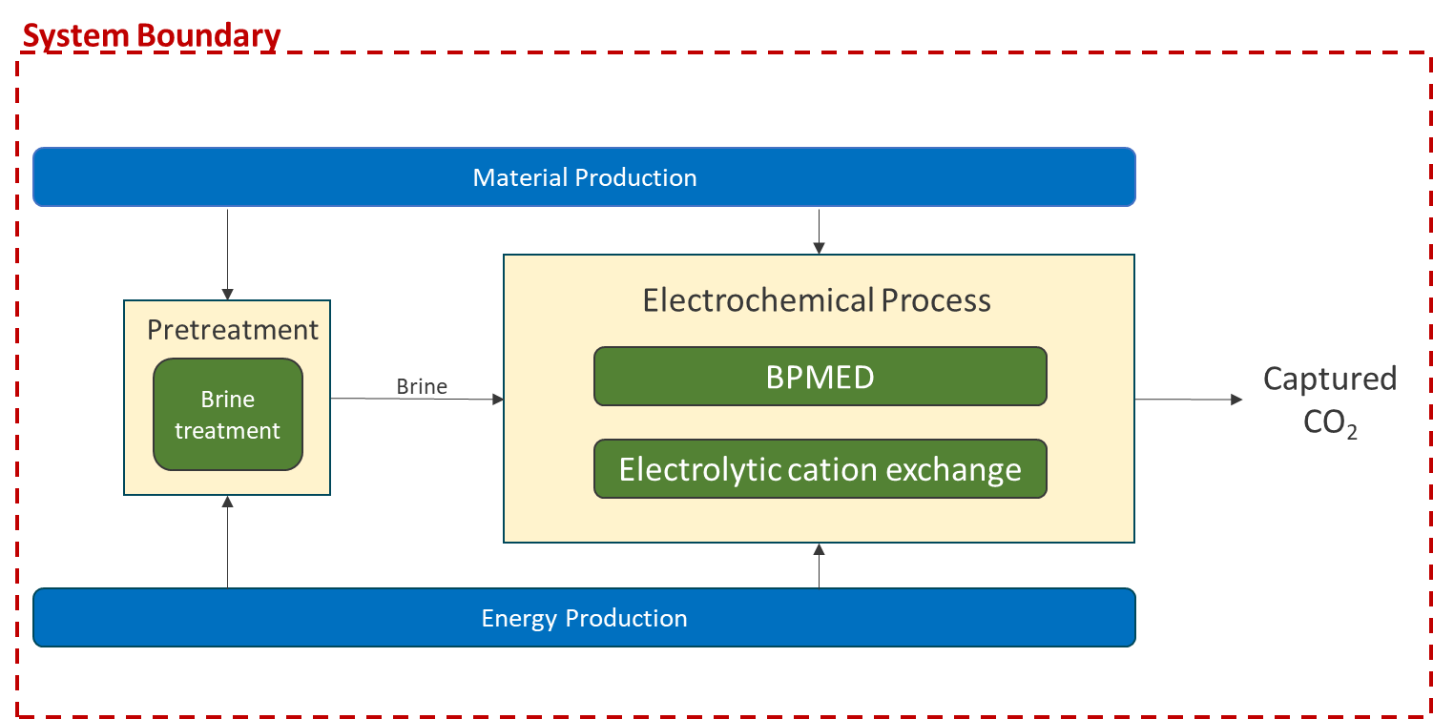
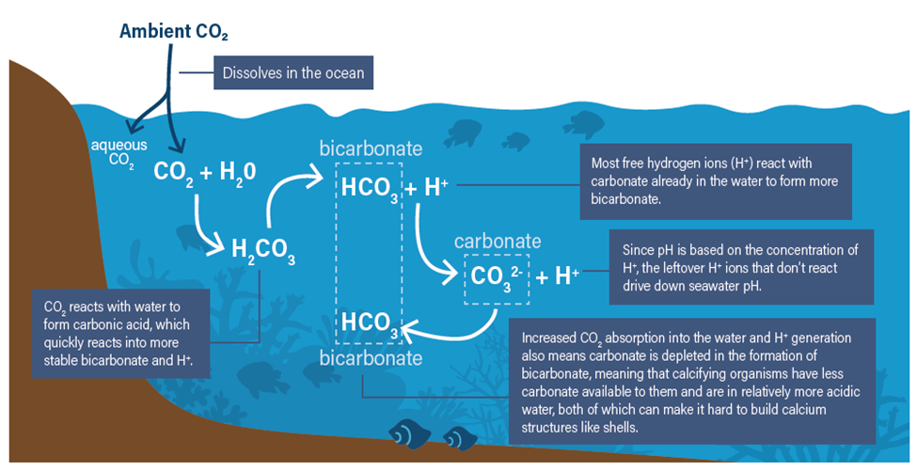
Life Cycle Analysis and Techno Economic Analysis of Marine Carbon Dioxide Removal
Roksana Mahmud^{1,2}, Tommy Schmitt^{1,2}, Derrick Carlson^{1,2}, Sally Homsy¹, Matt Jamieson¹
¹US Department of Energy, National Energy Technology Laboratory (NETL), Pittsburgh PA /Morgantown WV; ²NETL site support contractor
Introduction
Marine Carbon Dioxide Removal (mCDR) is defined as the indirect removal of CO₂ from the atmosphere “via an enhancement of the downward air-sea flux of CO₂ from the atmosphere to the surface ocean.”
The surface of the ocean is in a constant exchange of CO₂ with the atmosphere and represents the largest exchange of CO₂ with the atmosphere compared to any other reservoir. The ocean carbon cycle can be seen below.
LCA Methods
Boundary: Cradle-to-Gate
Functional unit: 1 kg of CO2 captured
Modeling platform: openLCA v2.1.1
Impact assessment: Traci 2.1 (AR6 100-year time horizon)
Life cycle inventory: TEA material and energy flows
Ocean Carbon Cycle
Results
N. Wei, The Wei Forward Report II: A radical rethink of the policy framework for investing with impact, 1st ed. Future Planet Capital, 2023. Accessed: Jul. 02, 2023. [Online]. Available: https://static1.squarespace.com/static/582e25f02e69cf5247166bad/t/63f4ac0e0d02fd4a9e021c2c/1676979222143/Wei+Forward+Report+II.pdf
TEA Methods
Cost and performance estimates for three electrochemical mCDR technologies are presented. The reported costs are in May 2023 dollars.
^{A}M for mCDR, E for electrochemical engineering approach, B for bipolar membrane electrodialysis [BPMED] and C for electrolytic cation exchange membrane [CEM]), and pH shift (1 for acidic, 2 for basic), respectively.
The scale is based on an expected CO₂ capture rate of an mCDR facility co-located with an average sized desalination plant in the U.S.
The estimating models are based on a U.S. Florida Atlantic Coast location, and the labor cost was scaled from a Midwest Gulf Coast location.
Levelized cost of capture (LCOC) comparison.
Sensitivity of mCDR technologies to plant size.
Case | Technology | mCDR Approach | Membrane Process | pH Shift | Capture Rate | CO₂ Product
MEB1^{A} | mCDR | Electrochemical Engineering | Bipolar Membrane Electrodialysis (BPMED) | Acidic | 63% | CO₂ (g)
MEB2 |  |  |  | Basic | 63%
MEC1 |  |  | Electrolytic Cation Exchange Membrane (CEM) | Acidic | 62%
GWP impacts of standalone and co-located marine CDR facilities.
Sensitivity analysis for different electricity sources scenarios.
Conclusion
The preliminary TEA indicates that an LCOC > $1,000/tonne CO₂ can be expected for electrochemical mCDR technologies.
The analysis of environmental impacts highlighted that under certain conditions (renewable electricity source) electrochemical mCDR technologies can be net negative.
These results are preliminary, based on limited availability of transparent data.
Performance Summary | MEB1 | MEB2 | MEC1
Inlet DIC (CO₂e), umol/kg (ppmw) | 2,074 (126) | 2,074 (126) | 2,074 (126)
CO₂ capture rate, % | 63 | 63 | 62
CO₂ product flow rate (pipeline quality), tonne/yr | 13,000 | 13,000 | 13,000
H₂ product flow rate, tonne/yr | - | - | 1,481
Total auxiliary load, kWe | 11,994 | 16,455 | 71,754
Preliminary Results, Do Not Cite
Disclaimer: This project was funded by the Department of Energy, National Energy Technology Laboratory an agency of the United States Government, through a support contract. Neither the United States Government nor any agency thereof, nor any of its employees, nor the support contractor, nor any of their employees, makes any warranty, expressor implied, or assumes any legal liability or responsibility for the accuracy, completeness, or usefulness of any information, apparatus, product, or process disclosed, or represents that its use would not infringe privately owned rights. Reference herein to any specific commercial product, process, or service by trade name, trademark, manufacturer, or otherwise does not necessarily constitute or imply its endorsement, recommendation, or favoring by the United States Government or any agency thereof. The views and opinions of authors expressed herein do not necessarily state or reflect those of the United States Government or any agency thereof.

