Slide 1
Gamma-ray imaging using GeGI Compton imaging for uranium holdup
Dr. Jeff Preston
Jeff.Preston@pxy12.doe.gov
Engineering Advisor
Notes:
Covers tasks A, B, and F

Slide 2
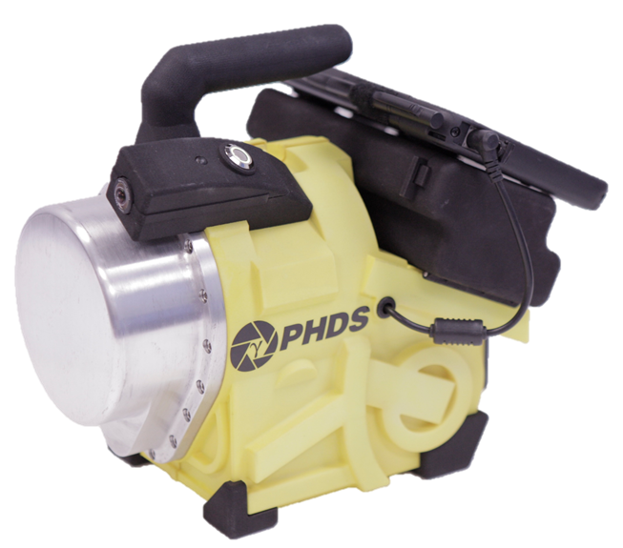
Compton Imaging
GeGI-5 (double sided cross strip HPGe)
90mm diameter x ~11mm thick
3-D Position sensitive detector
16 channels per side, 32 total
Depth of interaction
Physics
Multiple hits independently recorded
List mode data output
Energy weighting function determines forward/backward not time of flight
Simple back projection creates cones
Cones overlap on unit sphere
Vendor algorithm determines hotspots
Multiple gammas may contribute to single image
Vendor algorithm has capability for rough mass estimation
PHDS GeGI-5

Slide 3
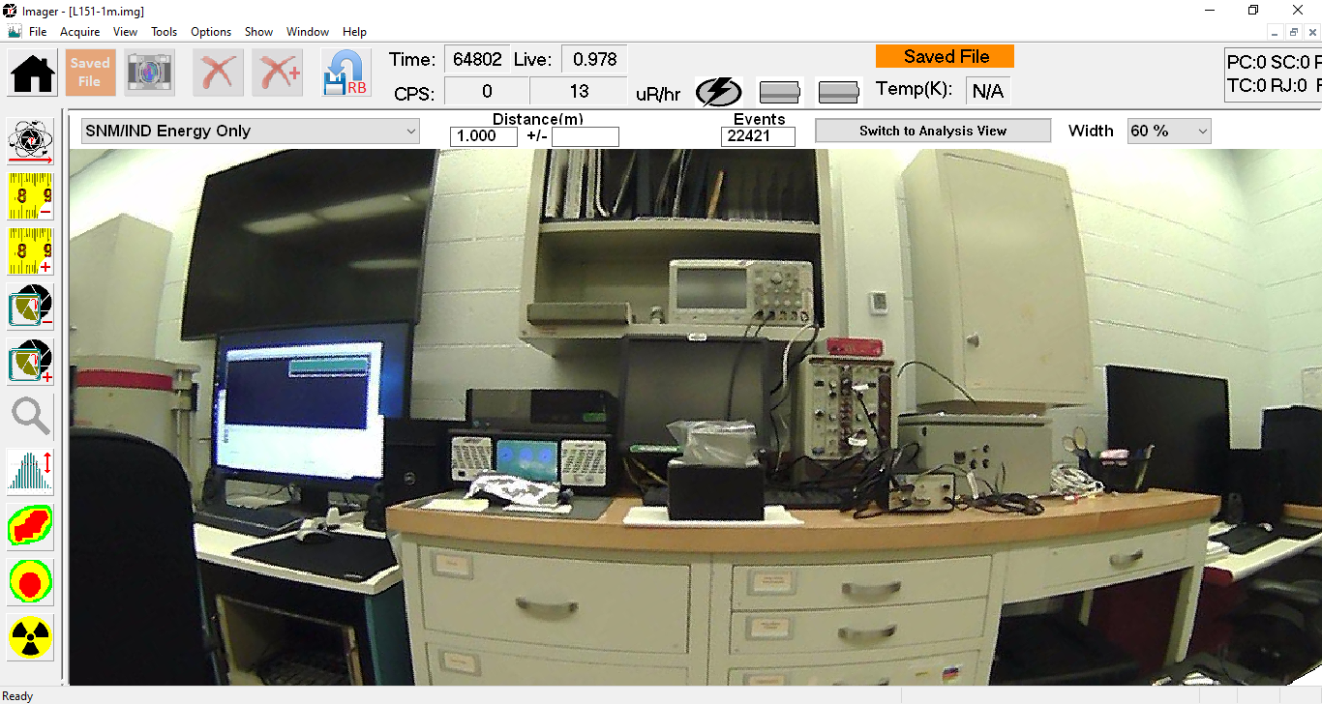
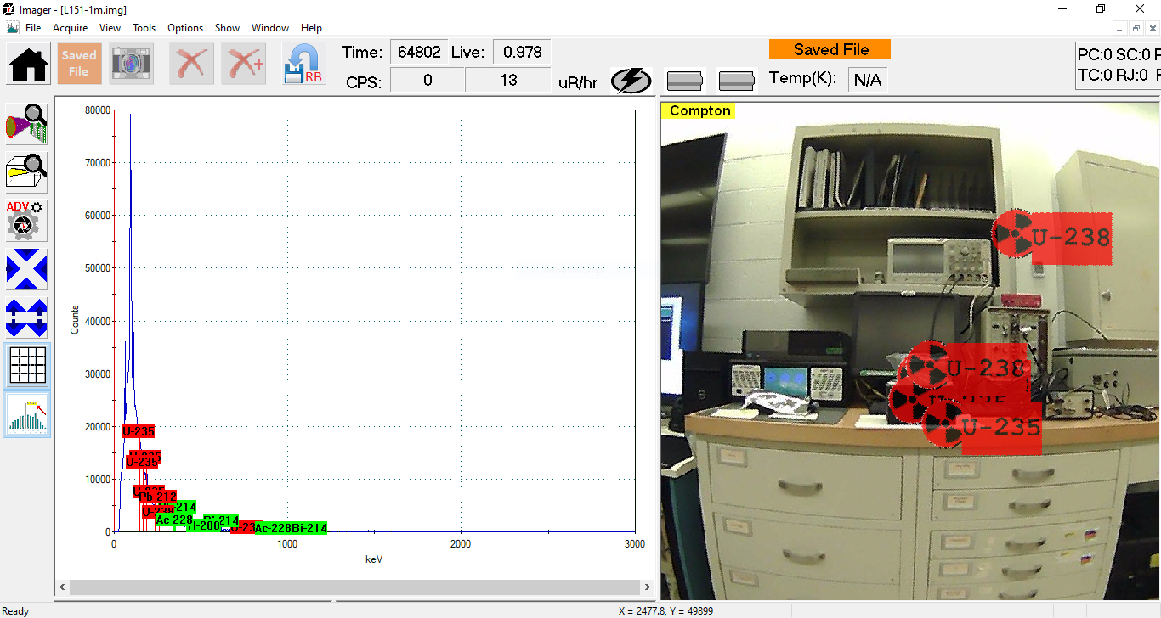
Compton Imaging
Advantages
Fast measurement time
Localization suitable for wide areas
Full efficiency of detector
Wide energy range
Lightweight equipment
Disadvantages
Limited spatial resolution (application dependent)
Single gamma energy analysis (multiple energies do not improve results)
Additional counts do not significantly improve image (may be vendor algorithm specific)
Low count rates have significant artifacts (requires adjusting response threshold)
Source

Slide 4
Compton Imaging
Point Source
Cone projection overlaps in few locations
Artifacts ideally at minimum
Single point may show up
Spurious artifacts often appear/disappear
Area Spread
Amorphous shapes
Not necessarily an intensity weighted map
Analysis overlaid on same 2-D field for one or more gammas (not distinguishing color scheme)
Raw Reconstruction
Result
Raw Reconstruction
Result
Notes:
Artifacts sometimes can be removed through selectively filtering image

Slide 5
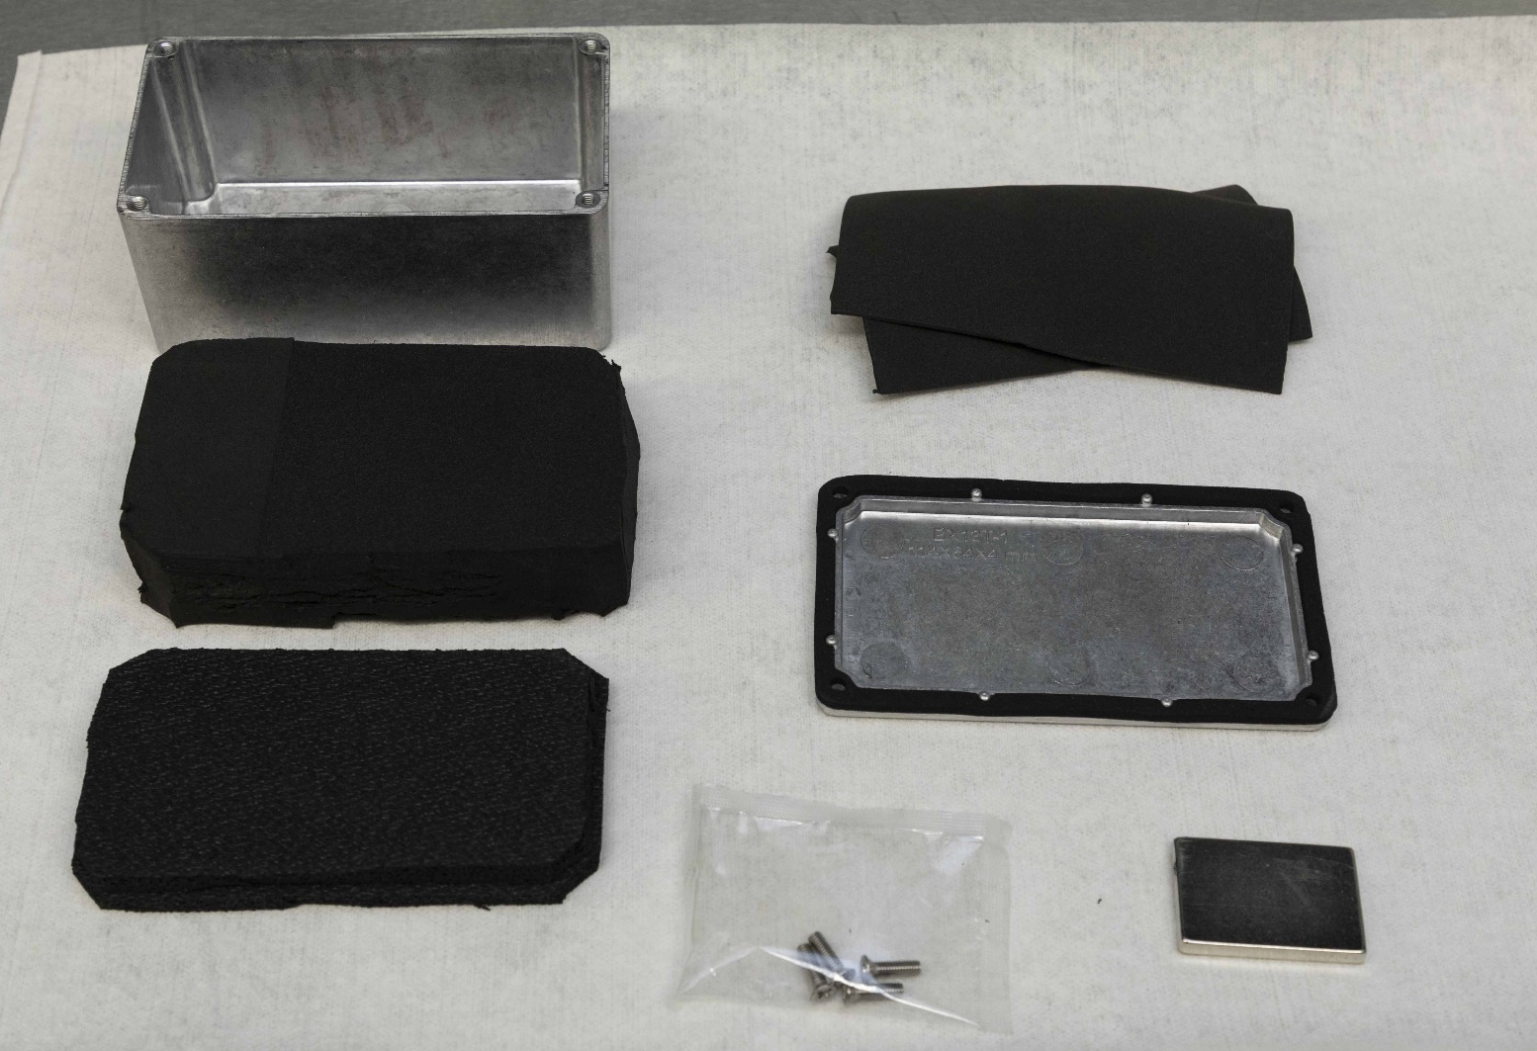
Source Construction
Finite Source
Standards of loose pack DU₃O₈
Holdup often other material forms
Chosen for chemical stability
Increasing mass/thickness up to infinite thickness
Material packed inside to limit powder motion
Gasket to seal box for use outside HCA
Strong magnets included for mounting sources
Two sizes
4.4” x 2.4” x 2”
2.25” x 2” x 2.1”
DU not ideal for coded aperture
Small 186keV contribution
Sufficient 766/1001keV lines for Compton imaging
YPH-20-904013

Slide 6
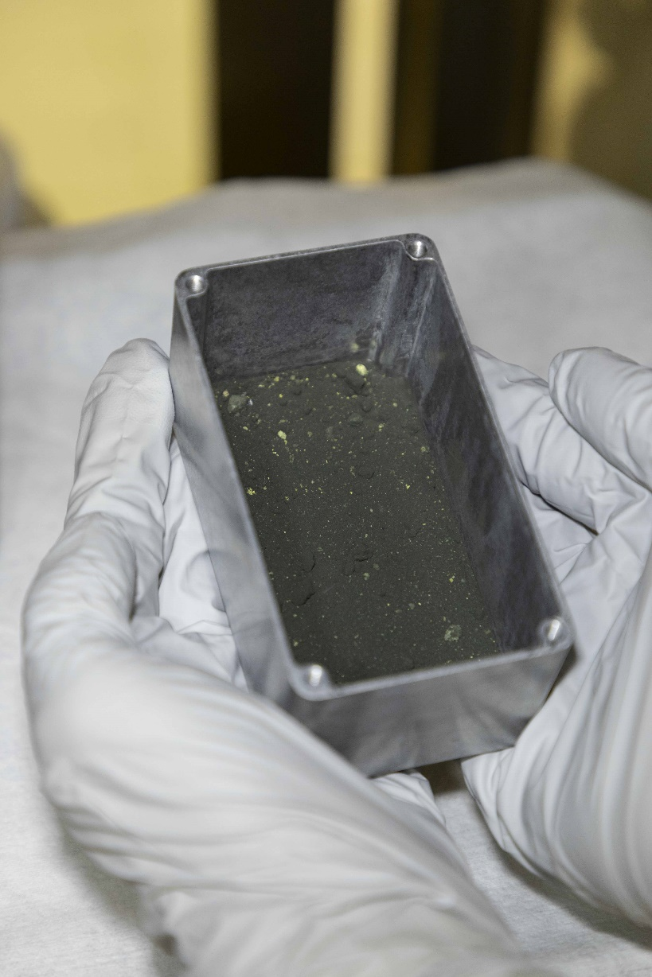
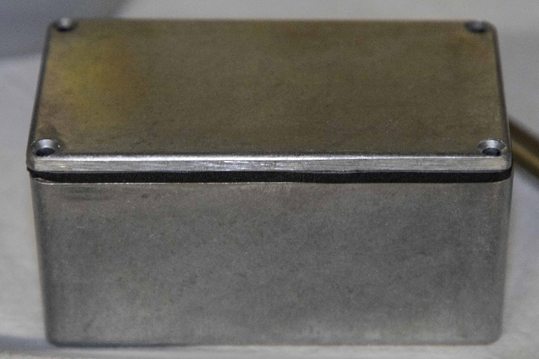
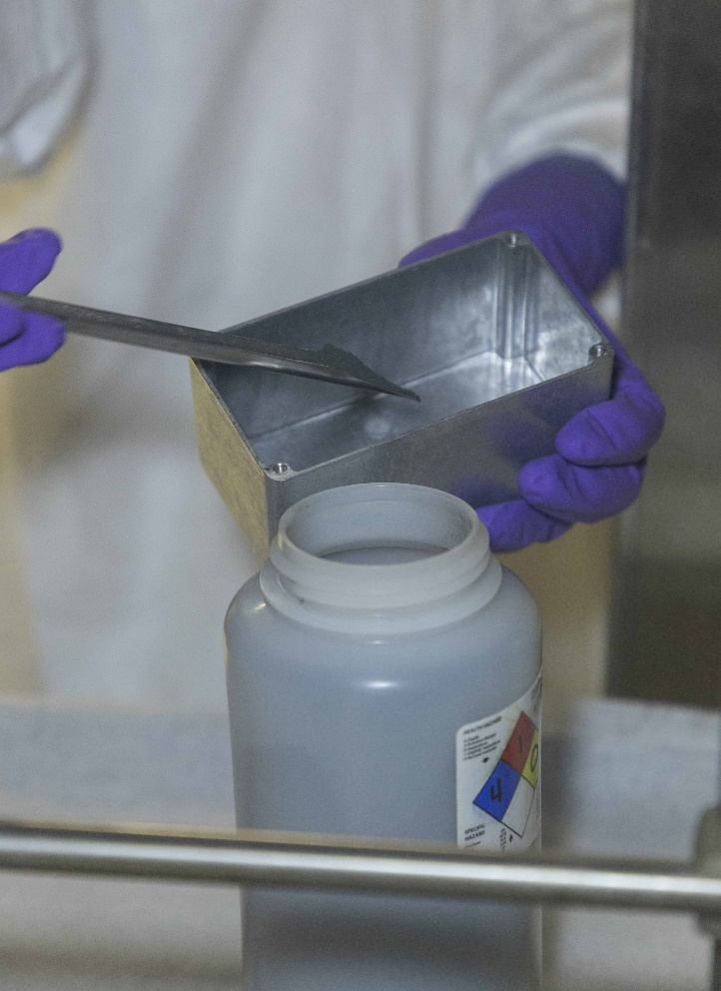
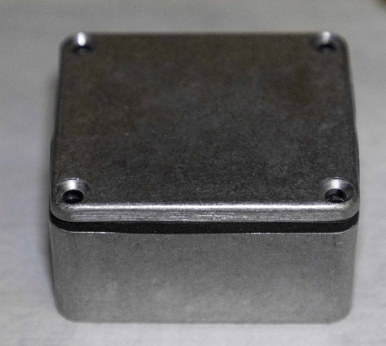
Source Construction
YPH-20-904018
YPH-20-904016
YPH-20-904017
YPH-20-904019

Slide 7
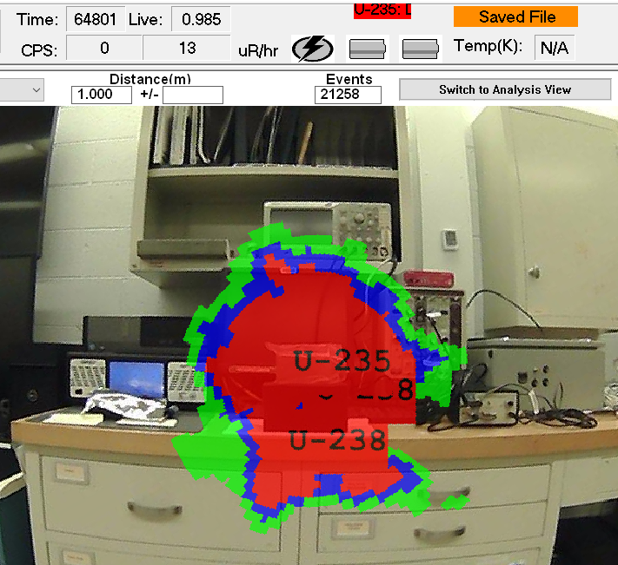
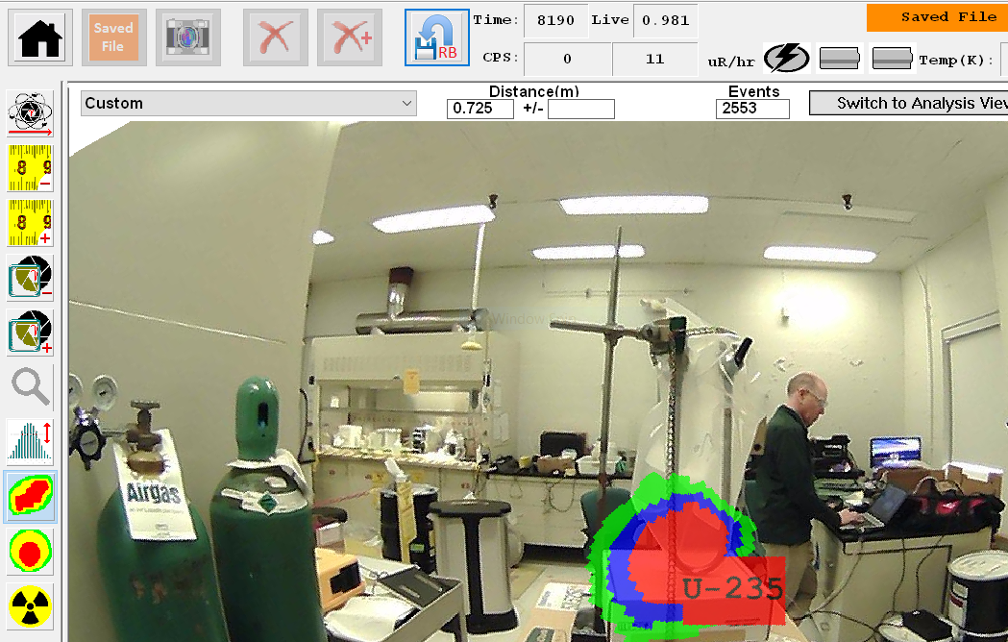
Compton Imaging
Non-point sources
1m distance from detector front to source surface
3D projection onto 2D image
Area spread ~4” beyond source dimensions in all directions
<10% of indicated area is real source
Spurious artifacts outside of source area
U-tube Measurement
1m distance from detector front to source surface
Enriched uranium source
Material settled at bottom of tube
Similar spread around source
Caveat: results may be vendor algorithm specific to an extent

Slide 8
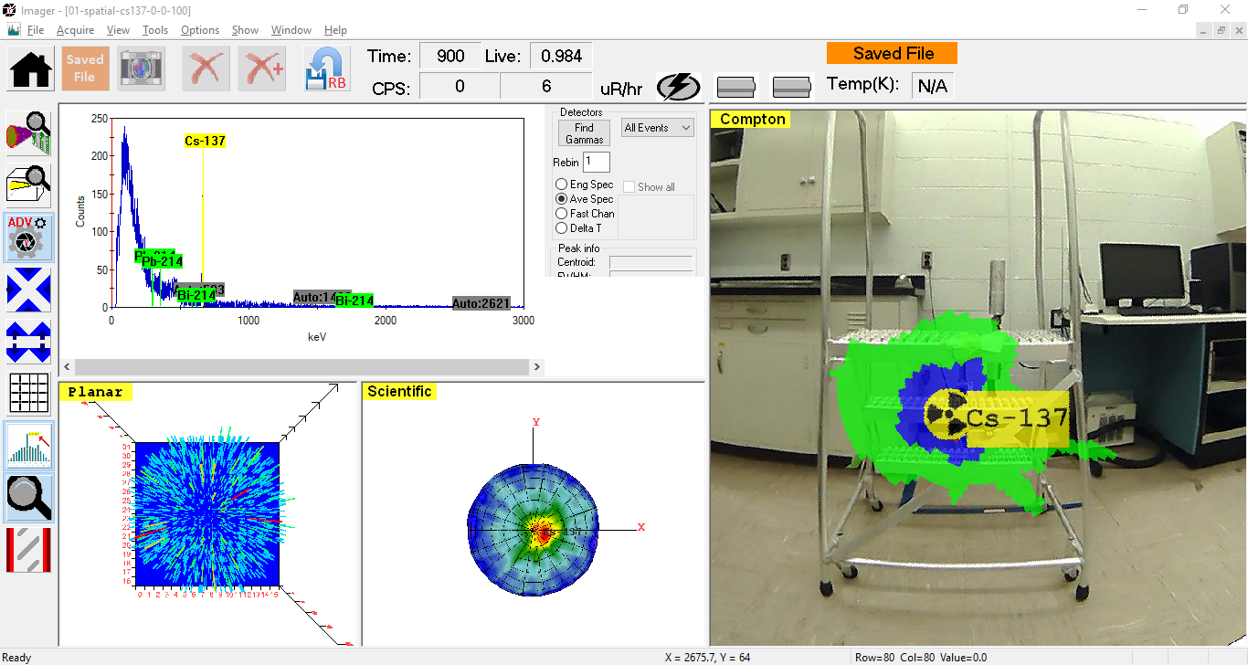
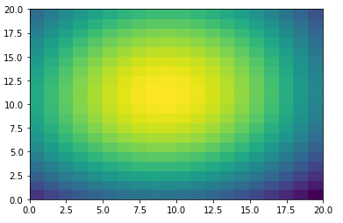
Imaging Improvement
Maximum Likelihood Expectation Maximization (MLEM)
“GIBLET” created by Keith Bledsoe and Justin Knowles
Initial effort to use idealized point source data
Separate runs for Cs-137 and Ho-166m sources
1m distance
Python implementation for loops
Initial trials require overnight runs
Modification to vectorized math sped up results
Parallelized code
Still required several hours on i9 processor
Images collapsed to point sources
Method not continued for speed and performance using fieldable systems
New method will be discussed in later talk
400 pixels, -20cm to 20cm, 12hr runtime

Slide 9

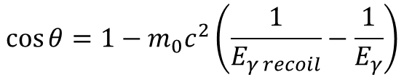
Imaging Improvement
Bayesian Inference
Multiple energies from uranium can contribute to solution
Similar is approach to effective-Z determination
Multiple energies attenuating independently
Compton scattering angle linked to energy of incident particle
Source emitting multiple energies will overlap similarly at true material locations
Constrain spatial possibilities based from isotope branch emissions
186keV angles informed by 1001keV angles
Wide angle scatter and forward scatter bias by energy
Coded aperture data can also inform Compton results
Constrain possible locations
Retrieves a greater depth information than for single 186keV line
Requires re-creating reconstruction algorithm for speed
Maintain tracking of error bands from cones as weights
New method will be discussed in greater detail in later talk
Compton images to be improved slightly
Fuse with Coded Aperture to massively improve methods.
$$\cos{θ}=1−m_{0}c^{2}\left(\frac{1}{E_{γ recoil}}−\frac{1}{E_{γ}}\right)$$
$$P\left(A | B\right)=\frac{P\left(A | B\right)P\left(A\right)}{P\left(B\right)}$$

Slide 10
Upcoming Measurements
Y-12 Facility measurements
Coordinating with NDA and maintenance personnel
Measure collection of tubes and ducts
Items currently monitored under UHSP using GGH method
Long operating history with cleanout masses
Cleanout is not 100% efficient
Enriched uranium preference for increased 186keV intensity
Intending to follow items (Task F: Unattended Monitoring)
Immediately following cleanout
During full process cycle
End with cleanout
Obtain physical mass collection measurements afterwards
Acquire list mode data using
GeGI5 with coded aperture add-on
Mass estimation comparison with GGH and mass measurements
PHDS mass estimation routine using Compton
New routine fusing coded aperture and Compton (to be discussed later)
Notes:
Uranium Holdup Survey Program

Slide 11
DISCLAIMER
This work of authorship and those incorporated herein were prepared by Consolidated Nuclear Security,
LLC (CNS) as accounts of work sponsored by an agency of the United States Government under
Contract DE‑NA‑0001942. Neither the United States Government nor any agency thereof, nor CNS, nor any of their employees, makes any warranty, express or implied, or assumes any legal liability or responsibility to any non-governmental recipient hereof for the accuracy, completeness, use made, or usefulness of any information, apparatus, product, or process disclosed, or represents that its use would not infringe privately owned rights. Reference herein to any specific commercial product, process, or service by trade name, trademark, manufacturer, or otherwise, does not necessarily constitute or imply its endorsement, recommendation, or favoring by the United States Government or any agency or contractor thereof, or by CNS. The views and opinions of authors expressed herein do not necessarily state or reflect those of the United States Government or any agency or contractor (other than the authors) thereof.

Slide 12
