Slide 1

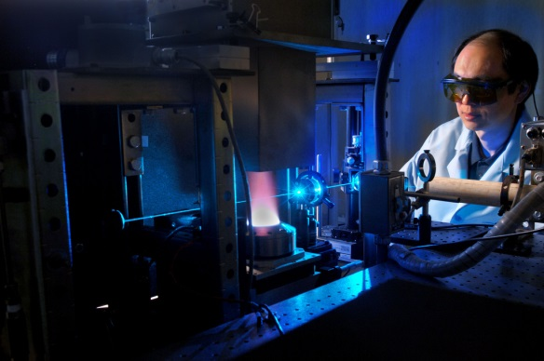

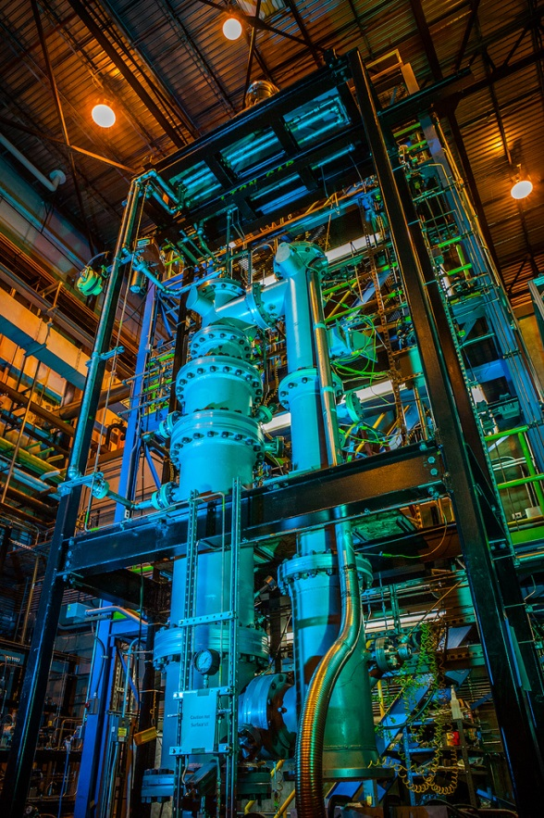
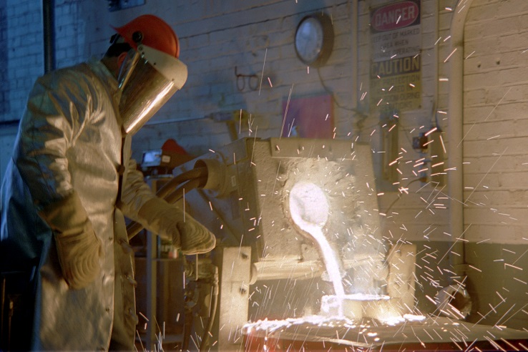

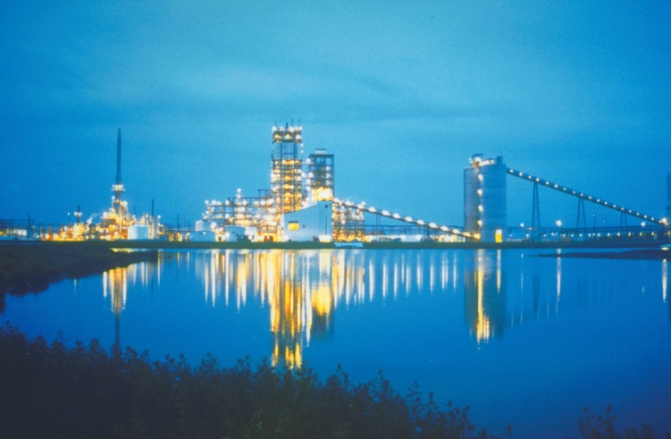
Coal and Biomass to Liquids:
Early-Mover Opportunity for CCS Deployment
US DOE NETL – Research & Innovation Center
Thomas J. Tarka, P.E.
Morgan Summers
February 3-5, 2016
Notes:
Good afternoon,
My name is Robert James. I’m a General Engineer at the US DOE National Energy Technology Laboratory, and part of the Strategic Energy Analysis & Planning Division
My talk today is about coal hybrid power systems for the future

Slide 2
Disclaimer
Disclaimer
This report was prepared as an account of work sponsored by an agency of the United States Government. Neither the United States Government nor any agency thereof, nor any of their employees, makes any warranty, express or implied, or assumes any legal liability or responsibility for the accuracy, completeness, or usefulness of any information, apparatus, product, or process disclosed, or represents that its use would not infringe privately owned rights. Reference therein to any specific commercial product, process, or service by trade name, trademark, manufacturer, or otherwise does not necessarily constitute or imply its endorsement, recommendation, or favoring by the United States Government or any agency thereof. The views and opinions of authors expressed therein do not necessarily state or reflect those of the United States Government or any agency thereof.

Slide 3
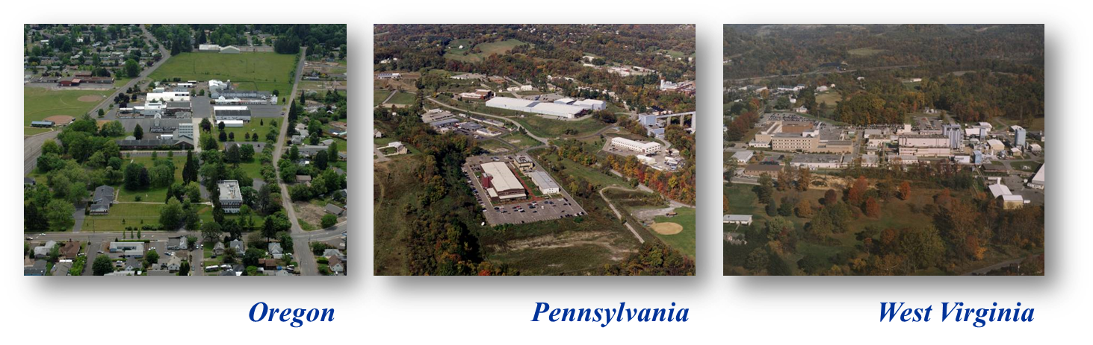
National Energy Technology Laboratory
National Energy Technology Laboratory
Where Energy Challenges Converge and Energy Solutions Emerge
Full service DOE national laboratory
Dedicated to energy RD&D, domestic energy resources
Fundamental science through technology demonstration
Unique industry – academia – government collaborations
Notes:
The U.S. Department of Energy’s National Energy Technology Laboratory develops advanced technologies and accelerates their commercialization to provide clean, reliable, affordable solutions to America’s energy challenges. NETL conducts energy and environmental research, development, and demonstration projects in the U.S. and around the world.
For more than 100 years, the U.S. Department of Energy’s National Energy Technology Laboratory has helped provide clean, safe, affordable, and reliable energy to the American people. Today, NETL research sites in Pittsburgh, Pennsylvania, Morgantown, West Virginia, and Albany, Oregon, develop advanced energy technologies and accelerate their commercialization in the United States and around the world. NETL also collaborates with industry, academia, and other government organizations to supplement the laboratory’s research and energy analysis portfolios.
The innovations that NETL and its partners discover address a range of fossil energy challenges, including carbon dioxide capture, utilization, and storage; advanced coal processing; enhanced natural gas exploration and production; next-generation emissions controls; production of materials for extreme environments; and high-efficiency boilers, turbines, fuel cells, and other power systems. NETL also manages DOE projects that tackle emerging issues in renewable energy, SmartGrid implementation, and improving the reliability and efficiency of existing and future power plants and other electricity delivery systems.
Our nation realizes return on research investment when NETL transfers its energy solutions into the commercial and educational arenas. Licensing agreements with large and small companies bring viable solutions to market, while internships and other educational programs bring renowned researchers together with students and faculty. Further, NETL-sponsored papers, presentations, publications, websites, and conferences ensure that laboratory breakthroughs are shared openly with decision makers, stakeholders, and researchers around the globe. Most importantly, all of NETL’s activities support the DOE mission to promote the national, economic, and energy security of the United States.

Slide 4
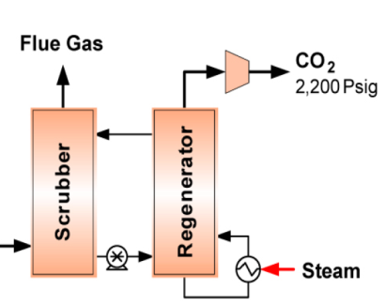
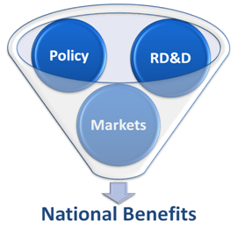

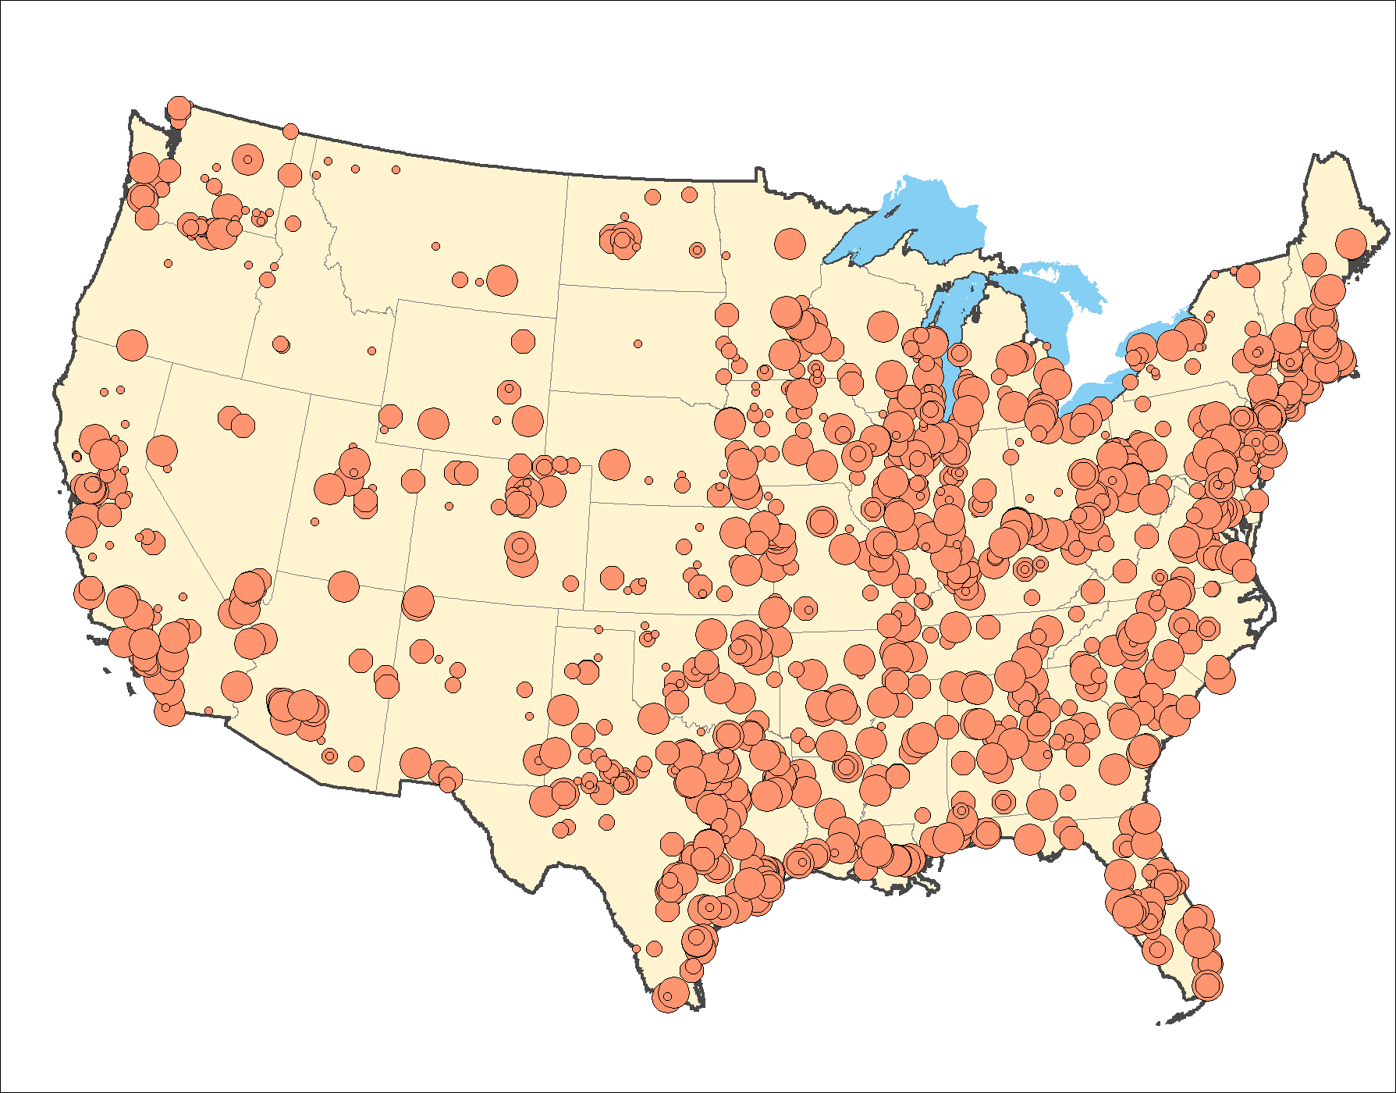
Systems Engineering & Analysis
Informing Energy Policy Development & Technology Deployment
Coal
21%
Coal
21%
Gas
25%
Gas
25%
Analyses
Oil
37%
Oil
37%
Nuclear
9%
Renewables
8%
Technologies
Benefits
Situations & Trends
Integrated Electric Power Systems
Technology evaluation
Process & cost engineering
R&D targets
Policy scenarios
Market deployments
National benefits of R&D
Current conditions
Future scenarios
Cost of electricity
System design & integration
Drivers

Slide 5
Why Carbon Capture & Storage (CCS)?
[t]he IPCC Fifth Assessment Synthesis report showed that [7 of 11] global models could not meet the 2°C target without CCS and that mitigation costs would increase by 138% if CCS and Bio-CCS were excluded...
IEA GHG Information Paper
http://energy.gov/sites/prod/files/2015/12/f27/2015-IP30%3B%20Special%20Issue%2010%20year%20anniversary%20IPCC.pdf
Notes:
Let’s first discuss the importance of coal
Remember that:
It’s still cheap and inexpensive
It has an ease of both transport and storage
It is a good backstop fuel for other solid fuels
And its showing burgeoning use in developing nations
That being the case, what is the path forward for coal?
We still need to identify pathways for coal to compete on both a cost and emissions basis
And we must enable expanded use of renewable energy

Slide 6
Why Carbon Capture & Storage (CCS)?
Current CO₂ capture costs range from $56 to $79 per ton CO₂
Bituminuous Baseline Reports, volumes 1 and 2.
Notes:
Let’s first discuss the importance of coal
Remember that:
It’s still cheap and inexpensive
It has an ease of both transport and storage
It is a good backstop fuel for other solid fuels
And its showing burgeoning use in developing nations
That being the case, what is the path forward for coal?
We still need to identify pathways for coal to compete on both a cost and emissions basis
And we must enable expanded use of renewable energy

Slide 7
Coal and Biomass Liquefaction Pathways
Indirect Liquefaction Pathways for Coal and/or Biomass
Coal and/or
Biomass
Methanol
Methanol-to-Gasoline
MTG Products
Fungible Gasoline
Electricity (Plant use and/or Export)
Hydrogen*
Liquefied Petroleum Gas (LPG)*
Gasification
Fischer-Tropsch Synthesis
Low-Temp FT Products
Ultra-Low Sulfur Diesel
FT Naphtha (Gasoline via upgrading)
Jet Fuel*
Electricity (Plant use and/or Export)
Liquefied Petroleum Gas (LPG)*
* Secondary or Optional Product based on system configuration
Notes:
Let’s first discuss the importance of coal
Remember that:
It’s still cheap and inexpensive
It has an ease of both transport and storage
It is a good backstop fuel for other solid fuels
And its showing burgeoning use in developing nations
That being the case, what is the path forward for coal?
We still need to identify pathways for coal to compete on both a cost and emissions basis
And we must enable expanded use of renewable energy

Slide 8
CTL: Assessing the Cost of CCS Methodology
CO₂ Sequestration and CO₂ Vent Cases Evaluated
Process broken down into several subsections:
Synthesis Gas Production and Cleanup
Fischer-Tropsch Synthesis
Vapor Phase Recovery
Product Upgrading
Minimal Excess Power Production
CO₂ vent case does not include CO₂ compression, water gas shift of the fuel gas, or CO₂ capture from the fuel gas
Economics were evaluated using two different financing structures
Standard Financing: Standard Transportation Fuel Financing, Higher risk
Government Incentives: Government Incentives, such as a loan guarantee, is assumed, which reduces risk
Notes:
Let’s first discuss the importance of coal
Remember that:
It’s still cheap and inexpensive
It has an ease of both transport and storage
It is a good backstop fuel for other solid fuels
And its showing burgeoning use in developing nations
That being the case, what is the path forward for coal?
We still need to identify pathways for coal to compete on both a cost and emissions basis
And we must enable expanded use of renewable energy

Slide 9
CTL: Assessing the Cost of CCS CTL Process with & without CCS
Notes:
Let’s first discuss the importance of coal
Remember that:
It’s still cheap and inexpensive
It has an ease of both transport and storage
It is a good backstop fuel for other solid fuels
And its showing burgeoning use in developing nations
That being the case, what is the path forward for coal?
We still need to identify pathways for coal to compete on both a cost and emissions basis
And we must enable expanded use of renewable energy

Slide 10
CTL: Assessing the Cost of CCS Results: CO₂ Sequestration Case Costs
CO₂ Sequestration Case, 2011$ | Standard Financing | Gov’t Incentives
TOC, $1000 | 6,532,052 | 6,532,052
TOC, $/bpd or $/kWh | 130,662 | 130,662
TOC, $/bpdECO or $/kWh | 124,557 | 124,557
TOC, $/bpdEPD or $/kWh | 155,696 | 155,696
TASC, $1000 | 7,715,660 | 7,494,877
TASC, $/bpd or $/kWh | 154,338 | 149,922
TASC, $/bpdECO or $/kWh | 147,127 | 142,917
TASC, $/bpdEPD or $/kWh | 183,908 | 178,646
Total annual emissions value charge (90% CF), $1000 | 0 | 0
Total annual fixed and variable O&M (90% CF), $1000 | 330,929 | 330,929
Total annual fuel cost (90% CF), $1000 | 473,377 | 473,377
Total annual power credit (90% CF), $1000 | -2,149 | -2,149
COP F-T Diesel $/bbl | 154 | 133
COP F-T Naphtha $/bbl | 107 | 93
Equivalent Crude Oil Price, $/bbl | 134 | 116
Equivalent Petroleum Diesel Price, $/bbl | 167 | 145
Notes:
Let’s first discuss the importance of coal
Remember that:
It’s still cheap and inexpensive
It has an ease of both transport and storage
It is a good backstop fuel for other solid fuels
And its showing burgeoning use in developing nations
That being the case, what is the path forward for coal?
We still need to identify pathways for coal to compete on both a cost and emissions basis
And we must enable expanded use of renewable energy

Slide 11
CTL: Assessing the Cost of CCS Results: CO₂ Vent Case Costs
CO₂ Vent Case, 2011$ | Standard Financing | Gov’t Incentives
TOC, $1000 | 6,398,760 | 6,398,760
TOC, $/bpd or $/kWh | 127,996 | 127,996
TOC, $/bpdECO or $/kWh | 122,014 | 122,014
TOC, $/bpdEPD or $/kWh | 152,518 | 152,518
TASC, $1000 | 7,558,216 | 7,341,938
TASC, $/bpd or $/kWh | 151,189 | 146,862
TASC, $/bpdECO or $/kWh | 144,123 | 139,999
TASC, $/bpdEPD or $/kWh | 180,154 | 174,999
Total annual emissions value charge (90% CF), $1000 | 0 | 0
Total annual fixed and variable O&M (90% CF), $1000 | 324,775 | 324,775
Total annual fuel cost (90% CF), $1000 | 473,377 | 473,377
Total annual power credit (90% CF), $1000 | -44,844 | -44,844
COP F-T Diesel $/bbl | 144 | 123
COP F-T Naphtha $/bbl | 100 | 86
Equivalent Crude Oil Price, $/bbl | 125 | 107
Equivalent Petroleum Diesel Price, $/bbl | 156 | 134
Notes:
Let’s first discuss the importance of coal
Remember that:
It’s still cheap and inexpensive
It has an ease of both transport and storage
It is a good backstop fuel for other solid fuels
And its showing burgeoning use in developing nations
That being the case, what is the path forward for coal?
We still need to identify pathways for coal to compete on both a cost and emissions basis
And we must enable expanded use of renewable energy

Slide 12
CTL: Assessing the Cost of CCS Total Overnight Cost (TOC) Comparison
Notes:
Let’s first discuss the importance of coal
Remember that:
It’s still cheap and inexpensive
It has an ease of both transport and storage
It is a good backstop fuel for other solid fuels
And its showing burgeoning use in developing nations
That being the case, what is the path forward for coal?
We still need to identify pathways for coal to compete on both a cost and emissions basis
And we must enable expanded use of renewable energy

Slide 13
CTL: Assessing the Cost of CCS Cost Sensitivity to Financing Scenario
Gov’t Incentives
Standard Financing
Notes:
Let’s first discuss the importance of coal
Remember that:
It’s still cheap and inexpensive
It has an ease of both transport and storage
It is a good backstop fuel for other solid fuels
And its showing burgeoning use in developing nations
That being the case, what is the path forward for coal?
We still need to identify pathways for coal to compete on both a cost and emissions basis
And we must enable expanded use of renewable energy

Slide 14
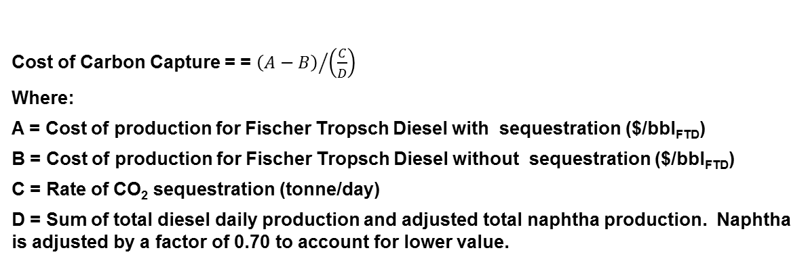
CTL: Assessing the Cost of CCS CO₂ Capture Cost
 | Vent Case | Sequestration Case | Cost of adding CCS (delta)
Total Overnight Cost, $1000 | 6,398,760 | 6,532,052 | 133,292
Total annual fixed O&M, $1000 | 197,405 | 200,854 | 3,448
Total annual variable O&M (90% CF), $1000 | 127,370 | 130,076 | 2,706
Total annual fuel cost (90% CF), $1000 | 473,377 | 473,377 | 0
COP F-T Diesel*, $/bbl_{FTD} | 123 | 133 | 10
COP F-T Naphtha*, $/bbl_{FTN} | 86 | 93 | 7
Equivalent Crude Oil Price*, $/bbl_{ECO} | 107 | 116 | 9
Equivalent Petroleum Diesel Price*, $/bbl_{EPD} | 134 | 145 | 11
Cost of Carbon Capture*, $/Tonne | 19
* Government Incentives finance structure
Cost of Carbon Capture = = ${\left(A−B\right)}/{\left(\frac{C}{D}\right)}$
Where:
A = Cost of production for Fischer Tropsch Diesel with sequestration ($/bbl_{FTD})
B = Cost of production for Fischer Tropsch Diesel without sequestration ($/bbl_{FTD})
C = Rate of CO₂ sequestration (tonne/day)
D = Sum of total diesel daily production and adjusted total naphtha production. Naphtha is adjusted by a factor of 0.70 to account for lower value.
Notes:
Let’s first discuss the importance of coal
Remember that:
It’s still cheap and inexpensive
It has an ease of both transport and storage
It is a good backstop fuel for other solid fuels
And its showing burgeoning use in developing nations
That being the case, what is the path forward for coal?
We still need to identify pathways for coal to compete on both a cost and emissions basis
And we must enable expanded use of renewable energy

Slide 15
CTL: Assessing the Cost of CCS Cost Results
CTL liquid fuels are more expensive than fuels produced conventionally from crude oil at today’s oil prices.
Standard fuels financing structure:
Sequestration Case – ECO price of $134/bbl
Vent Case – ECO price of $125/bbl
Government Incentives financing structure:
Sequestration Case – ECO price of $116/bbl
Vent Case – ECO price of $107/bbl
The incremental cost of adding sequestration is about $9/bbl (ECO price) or $0.21/gal independent of the financing structure used.
The equivalent cost of CO₂ Capture is $20 per ton of CO₂, significantly below the cost of capture for electricity-only cases
Notes:
Let’s first discuss the importance of coal
Remember that:
It’s still cheap and inexpensive
It has an ease of both transport and storage
It is a good backstop fuel for other solid fuels
And its showing burgeoning use in developing nations
That being the case, what is the path forward for coal?
We still need to identify pathways for coal to compete on both a cost and emissions basis
And we must enable expanded use of renewable energy

Slide 16
Flexible Solutions for a Changing World
Climate change mitigation requires gigatonne-scale CO₂ removal technologies […]
The flexibility of thermochemical conversion of biomass and fossil energy, coupled with carbon capture and storage, offers a route to commercializing carbon-negative energy.
- Daniel Sanchez, Carnegie Institution for Science
- Daniel Kammen, University of California, Berkeley
Nature Energy, January 2016
http://energy.gov/sites/prod/files/2015/12/f27/2015-IP30%3B%20Special%20Issue%2010%20year%20anniversary%20IPCC.pdf
Notes:
Let’s first discuss the importance of coal
Remember that:
It’s still cheap and inexpensive
It has an ease of both transport and storage
It is a good backstop fuel for other solid fuels
And its showing burgeoning use in developing nations
That being the case, what is the path forward for coal?
We still need to identify pathways for coal to compete on both a cost and emissions basis
And we must enable expanded use of renewable energy

Slide 17
Coal & Biomass Liquefaction Pathways Why use biomass?
Domestic, renewable energy source
Reduce the greenhouse gas (GHG) impact of energy
Advantages:
Reduced environmental impacts
Increased public acceptance
Potential revenues from renewable energy credits
Potential for carbon negative plants
Challenges:
Availability
Reliability of supply
Cost
Storage and logistics
Densification
Gasification feed systems
Notes:
With coal power hybrids, we’re talking about the integration of the remaining renewable technologies into the coal plant
Operation could either boost the baseload output, or offset BOP loads to help with plant efficiency and output
Here is where you’ll see the wide range of renewables, including geothermal, which could be used for either power or feedwater heating.

Slide 18
Coal & Biomass Liquefaction Pathways Co-Gasification Technology Status
Plant | Biomass Type | Biomass Ratio | Biomass Weight (tons) | Test Duration (hours) | Results
Tampa Electric IGCC Mulberry, FL | Coarsely ground eucalyptus (55% petcoke, 44% coal) | 1.2% | 8.8 | 8.5 | • Gasification of biomass is technically feasible and will not adversely impact emissions
Nuon IGCC Willem-Alexander Power Plant Buggenum, The Netherlands | Wood | 10% | 100,000/y | 3 yrs | • 34 types of biomass tested • Up to 30% by wt. biomass demonstrated
Elcogas IGCC Plant Puertollano, Spain | Meat and bone meal (MBM) mixed with limestone (50% blend petcoke and coal) | 1-4.5 % | 93.3 | 20.0 | • Technical viability of co-gasification demonstrated • Similar clean gas characteristics
 | Orujillo (olive oil waste) Mixed with 2% limestone / % required orujillo (50% blend petcoke and coal) | 1-10% | 7-675 | 7-289 | • The technical viability of co-gasification up to 10% has been demonstrated
 |  | Total | 3,661.4 | 1126.7
Notes:
With coal power hybrids, we’re talking about the integration of the remaining renewable technologies into the coal plant
Operation could either boost the baseload output, or offset BOP loads to help with plant efficiency and output
Here is where you’ll see the wide range of renewables, including geothermal, which could be used for either power or feedwater heating.

Slide 19
Coal & Biomass Liquefaction Pathways Challenges: Availability at Possible Sites
Dedicated energy crops*
Crop residues
Woody residues
MSW
*assumed to be grown on CRP land
Only top quartile could supply
at least 4,000 dry tpd
Reproduced from: Liquid Transportation Fuels from Coal and Biomass, National Academy of Sciences and Engineering, 2009.
Notes:
With coal power hybrids, we’re talking about the integration of the remaining renewable technologies into the coal plant
Operation could either boost the baseload output, or offset BOP loads to help with plant efficiency and output
Here is where you’ll see the wide range of renewables, including geothermal, which could be used for either power or feedwater heating.

Slide 20
Coal & Biomass Liquefaction Pathways Biomass Challenges: Cost
Feedstock Properties | Illinois No. 6 Coal | Rosebud PRB Coal | Switchgrass
Energy Density, HHV (Btu/lb) | 11,666 (AR, 11% moisture) | 8,564 (AR, 26% moisture) | 6,619 (AR, 15% moisture)
Cost: “As Received (AR)” ($/ton) | $69 | $20 | $103-106
Cost: “Dry” ($/ton) | $78 | $26 | $121-125
Cost: $/mmBtu | $2.94 | $1.15 | $7.52 - $7.74
*Biomass costs are based on a production rate of 5,000 dry tons per day.
Notes:
With coal power hybrids, we’re talking about the integration of the remaining renewable technologies into the coal plant
Operation could either boost the baseload output, or offset BOP loads to help with plant efficiency and output
Here is where you’ll see the wide range of renewables, including geothermal, which could be used for either power or feedwater heating.

Slide 21
Coal & Biomass Liquefaction Pathways Technology Assessment
Co-Gasification of up to 15% (by weight) biomass can be achieved at numerous sites without requiring reduced plant sizes
50,000 barrels per day (bpd) is considered to be the plant size above which minimal improved scale-economies can be achieved
Smaller plant sizes might be viable in the future
Numerous technology developers and government agencies pursuing smaller, modular systems
Biomass co-gasification will result in cost increases
15wt% biomass imposes a $11/bbl penalty on the price of diesel due to:
High cost of biomass on a Btu basis ($7.52-7.74/MMBtu)
Pretreatment and biomass preparation costs
Higher percentages will have higher impacts, especially if scale-economies are impacted
Depending on the biomass source, CCS-enabled CBTL can reduce the greenhouse gas impacts of the produced transportation fuel
Notes:
With coal power hybrids, we’re talking about the integration of the remaining renewable technologies into the coal plant
Operation could either boost the baseload output, or offset BOP loads to help with plant efficiency and output
Here is where you’ll see the wide range of renewables, including geothermal, which could be used for either power or feedwater heating.

Slide 22
Coal & Biomass Liquefaction Pathways Potential Benefits of CBTL
Co-Gasification of biomass is a near-term pathway to producing low-carbon transportation fuels
Enables large-scale production of fuels from biomass
Reduced risk compared to other biomass-derived fuel pathways
Market for low-carbon fuels is substantial
Early mover plants can reduce risk of other gasification projects
Reduced cost of CCS
Product diversification can improve economic viability
Enables greater usage of biomass as technology evolves
Notes:
With coal power hybrids, we’re talking about the integration of the remaining renewable technologies into the coal plant
Operation could either boost the baseload output, or offset BOP loads to help with plant efficiency and output
Here is where you’ll see the wide range of renewables, including geothermal, which could be used for either power or feedwater heating.

Slide 23











It’s All About a Clean, Affordable Energy Future
For More Information, Contact NETL
the ENERGY lab
Delivering Yesterday and Preparing for Tomorrow
National Energy Technology Laboratory
23

Slide 24
Backup slides

Slide 25
Coal and Biomass Liquefaction Pathways Methodology: Financing
Notes:
Let’s first discuss the importance of coal
Remember that:
It’s still cheap and inexpensive
It has an ease of both transport and storage
It is a good backstop fuel for other solid fuels
And its showing burgeoning use in developing nations
That being the case, what is the path forward for coal?
We still need to identify pathways for coal to compete on both a cost and emissions basis
And we must enable expanded use of renewable energy

Slide 26
Synthesis Gas Production
Synthesis gas (syngas) Production:
Air separation unit – produces oxygen for gasifier and Claus plant
Coal dryer
Gasifier – dry-feed Shell-type gasifier (4 trains, 2 gasifiers per train, one spare)
Quench and cooling – Transfers heat to steam cycle
Syngas is cleaned and prepared in:
Water-wash scrubber – particulate removal
Activated carbon bed – mercury removal
Water-gas-shift reactor – utilized to obtain desired H₂:CO ratio (between 1:1 and 1.1:1)
Acid gas removal (AGR) – removes sulfur and CO₂ (dual-stage Rectisol)
CO₂ compressors
Sour water stripper – separates out ammonia and H₂S
Claus plant – produces elemental sulfur and incinerates ammonia

Slide 27
Synthesis Gas Production
Notes:
Coal enters the drying unit to produce a dry coal (5 wt% water) and a water vapor vent stream. The dry coal is mixed with oxygen (95 mol% O₂), produced in an air separation unit, along with a small amount of steam to produce syngas with slag as a waste product. The syngas is cooled, scrubbed of particulates, part of the scrubbed syngas is shifted, mercury is removed, CO₂ and Sulfur is separated out and the cleaned syngas is sent to the FT reactor. The water from the scrubber and cooling is treated in the sour water stripper for ammonia and H₂S control. The vapor is sent the claus along with oxygen to produce elemental sulfur and incinerate the ammonia. The tail gas is recycled to the AGR and the CO₂ is compressed and piped to a sequestration site.

Slide 28
Fischer-Tropsch Synthesis
Zinc Oxide – sulfur polishing bed
FT Reactor
Two parallel first-stage slurry beds – converts ~61% of carbon monoxide
Intercoolers
Condensers – water and hot hydrocarbon condensate is separated out
Reheaters
One second-stage slurry bed – converts an additional ~61% of carbon monoxide
Steam generating heat exchangers – maintains FT temperature (480 ºF)
CO₂ Removal
Dehydration and Compression

Slide 29
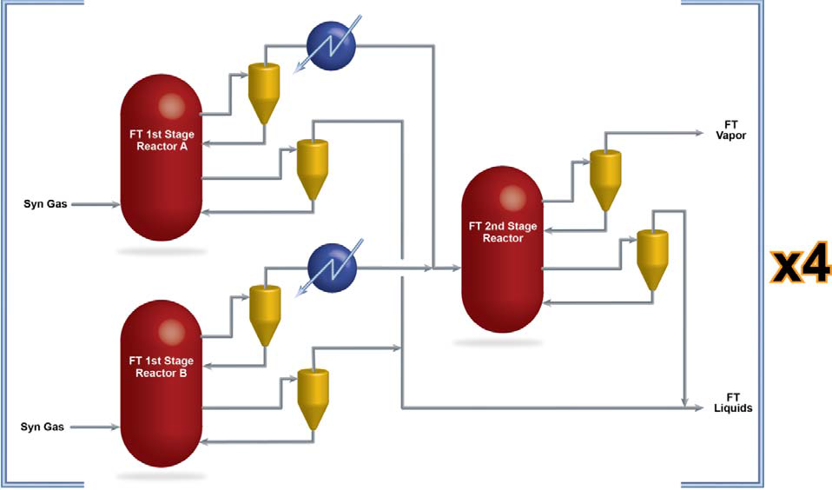
Fischer-Tropsch Synthesis
Notes:
The Syngas, with an H₂:CO ratio of 0.73 is preheated and mixed with steam and recycled tail gas (now has an H₂:CO of 1.02) prior to being fed to one of the two first stages of the FT reactor. The iron based catalyst promotes WGS activity, which allows a portion of the WGS reaction to occur in the reactor.
Synthesis gas is introduced into the reactors through a cylindrical gas distributor and bubbles up through the slurry phase. Fischer-Tropsch wax and catalyst make up the slurry phase, into which the synthesis gas dissolves, contacts the catalyst, and is oligomerized, producing more Fischer-Tropsch liquids. Streams of liquid wax are withdrawn from the reactors with a slurry valve, which accomplishes the majority of the catalyst-wax separation.
The outlet of the FT reactors are cooled and the water and hot hydrocarbon condensate is removed with the hydrocarbons being sent to the product recovery process. The remaining gas from the first stages of the FT reactor is reheated before entering the second stage of the FT reactor. Each stage converts ~61% with a per-pass conversion of ~85% of carbon monoxide.
Syngas is converted to straight chain olefinic and aliphatic hydrocarbons with an H:C ratio of approximately 2.1

Slide 30
Fischer-Tropsch Synthesis
Notes:
The remaining vapor stream is processed in an amine for CO₂ removal to prevent buildup in the recycle loop and reduce equipment size. The vapor stream is then dehydrated and compressed prior to being sent to the product recovery process.

Slide 31
Vapor Phase Recovery
The vapor phase recovery processes are:
Hydrocarbon recovery
Hydrogen Recovery

Slide 32
Product Recovery
Notes:
The wax and condensate are combined in the hydrocarbon recovery unit where they are separated out into a light hydrocarbon vapor stream and three liquid streams: naphtha, middle distillate, and wax. The compressed vapor is used for pressure control and serves as stripping media.
A portion of the vapor product is recycled to the FT reactor with the remainder being processed for hydrogen recovery. The recovered hydrogen is used in the hydrotreaters and hydrocracker. A pressure swing adsorption unit is used to produce the hydrogen with the rejected stream being blended with FT tail gas for use as fuel gas.
Fuel gas recovered from the plant is mixed with oxygen and stream and processed in a WGS reactor to increase the H₂ and CO₂ fraction. After, the fuel gas is treated in an AGR for CO₂ removal. A portion of the fuel gas is used in various FT process furnaces. The remaining fuel gas is sent to the power generation area for use in the combustion turbine, and synthesis gas production area for use in coal drying.

Slide 33
Product Upgrading
Product upgrading consists of:
Naphtha Hydrotreaters – Light liquid hydrocarbons are hydrotreated to produce stabilized FT naphtha by reducing heteroatom, olefinic, and aromatic content.
Middle Distillate Hydrotreaters – Fixed-bed catalytic hydrotreater that removes oxygenates and residual heteroatoms and reduces the olefinic and aromatic content to produce diesel.
Wax Hydrocracking – Wax is primarily catalytically cracked into naphtha and middle distillate with the hydrocracking system selectively tuned to produce a product in the diesel boiling range. Middle distillate is blended with the diesel from the middle distillate hydrotreater. The naphtha is blended with the product of the naphtha hydrotreater.

Slide 34
Power Production
The plant is designed to produce enough electricity to satisfy the needs of the CTL facility.
The use of a combined-cycle power system with a combustion turbine was utilized
Excess fuel gas is combusted in the turbine, which produces power.
The exhaust gas is cooled in a heat recovery steam generator which produces steam that is combined with steam produced with syngas coolers and from the FT reactor.
The steam is put through turbines to produce additional power.
Three General Electric (GE) gas turbines were selected. (MS6001B)

Slide 35
Power Production

Slide 36
Cost Methodology
Equipment typically associated with an IGCC plant were scaled from the cost estimates for the Shell gasifier Case 6 in “Cost and Performance Baseline for Fossil Energy Power Plants, Volume 1: Bituminous Coal and Natural Gas to Electricity.”
Capital costs for the F-T reactor and various treatment and upgrading systems were based on adjusted, vendor-furnished, actual cost data, and best possible projections.
A process contingency of 25 percent was applied to the F-T reactor and associated equipment.
The capital costs at the TPC level include equipment, materials, labor, indirect construction costs, engineering, and contingencies.

Slide 37
Cost Methodology
Project contingency was added to the engineering/ procurement/ construction management (EPCM) capital accounts to cover project uncertainty and the cost of any additional equipment that would result from a detailed design.
TOC values are expressed in June 2011 dollars.
Diesel COP ($/bbl):
Take total COP and divide by the sum of diesel production (bbl/day) and 0.70 * naphtha production (ratio of naphtha to diesel)
The equivalent petroleum diesel price (EPD):
Calculated by adjusting the cost of diesel (COP) by the equivalent heating value of petroleum-based diesel (Petrol LHV/Product LHV)*Diesel COP
Equivalent crude oil price (ECO):
Calculated by multiplying the EPD by 0.80 (ratio of crude oil to diesel spot price)

Slide 38
Cost Methodology
Cost of production of liquid fuels
The COPs were calculated using the Power Systems Financial Model (PSFM) in June 2011$s.
The COP is estimated to be the value calculated when the required return on equity (ROE) equals the internal rate of return (IRR) for 30 years of operation based on the assumed financial structure and escalations.
COP is assumed to escalate at three percent per year for the thirty-year economic life of the plant.
In the sequestration case T&S costs were combined with the plant capital and operating costs to produce an overall COP.
A credit of $58.59/MWh is included for excess power generated.

Slide 39
Cost Methodology
Two financial structures were examined that reflect a hypothetical future in which technical risk has been partially mitigated by the demonstration of two or three commercial-scale CTL plants.
The first is assumed to have no government incentives (commercial fuels)
The second assumed moderate government incentives in the form of a government loan guarantee are available
Both scenarios face a high degree of market risk because of the volatile nature of energy prices, especially the world oil price. The TOC, TASC, and annual O&M costs were estimated based on plant performance and a 90 percent capacity factor (CF).

Slide 40
Cost Methodology
Financial assumptions for PSFM
¹Based on historic LIBOR rates plus 6 percent

Slide 41
Cost Methodology
The economic assumptions used to estimate the COPs are shown below

Slide 42
Performance Methodology
The CTL process configuration chosen for this study is designed to
Maximize the conversion of feedstocks to liquid transportation fuels, achieved through recycling unreacted synthesis gas back to the reactor;
Maximize diesel fuel as the primary liquid fuel product;
Produce enough electrical power for the facility to be self-sufficient, but minimize exported electrical power to a level no greater than 10 percent of the internal power requirements for the CO₂ sequestration case;

Slide 43
Performance Methodology
The facility was designed to produce 50,000 bbl/day of F-T liquids using an iron-based catalyst
The final product split was expected to be approximately 70:30 diesel/naphtha
Additional hydrogen is supplied to hydroprocessing units for product upgrading.
The diesel produced in the facility is ready for delivery to end-use customers.
The naphtha produced has been stabilized and can either be shipped to a refinery for further upgrading to a commercial grade gasoline blendstock or sold as a chemical feedstock.

Slide 44
Performance Methodology
The iron-based FT catalyst can promote WGS in situ
The FT reactor requires an H₂/CO molar ratio of 1:1 to 1.1:1
The H₂O:CO ratio was based on common practice and assures an atmosphere conducive to shifting and provides a suitable moisture content at the WGS exit to prevent coking.
In systems without significant water gas shift activity, the S# is targeted to values near 2 . Since the iron-based catalyst promotes the WGS reaction, the S# is less than 2 in the study cases.

Slide 45
Performance Methodology
From a modeling standpoint, the CTL was split into a gasification and an FT area.
Fuel gas was transferred from the FT area to the gasification area
The two models did not have the same component list – adjustments were required
Hydrocarbons heavier than methane were changed to methane on a weight basis
Overestimates heating value
Increases power production – methane has a higher heating value than heavier hydrocarbons
However, this change is slight since there is only a relatively small amount of these hydrocarbons in the total fuel gas going to the gas turbine.

Slide 46
Performance Methodology

Slide 47
Challenge: Biomass Availability & Reliability
Biomass Type | USDA Billion-Ton Study (2005) | DOE/FEMP Biomass Energy Analytical Model (2010, Draft)
 | Million Metric Tonnes per Year
Agricultural Residue | 102.5 | 227.1
Wood Residues | 124.3 | 328.7
Manures | 31.8 | 32.0
Total: | 258.6 | 587.8
½ Billion Metric Tonnes Seems Like a lot of Biomass, Equal to about 25% of U.S. Electricity Consumption.
However, it is dispersed around the United States and can only be collected based on seasonal harvests or logging schedules (exception is forest thinning to reduce fire hazards and manures).
A Significant Availability and Reliability Challenge.
USDA Source: Perlack, R.D., et al. "Biomass as Feedstock for a Bioenergy and Bioproducts Industry: The Technical Feasibility of a Billion-Ton Annual Supply," Oak Ridge National Laboratory: Oak Ridge, TN, 2005; DOE/GO-102005-2135, ORNL/TM-2005/66.
DOE/FEMP Source: Hustwit, C., et. al. “Biomass Energy Analytical Model,” Federal Energy Management Program, National Energy Technology Laboratory, Pittsburgh, PA; November 2010 Draft Report.
Notes:
40 quads of energy input to electricity production in 2009.
Average heating value of biomass, 8,000 btu/lb dry (HHV).
25% = about 10 quads.

